Slide 1
GfG Instrumentation
G888 / G999 product introduction
Bob Henderson
President
GfG Instrumentation, Inc.
1194 Oak Valley Drive, Suite 20
Ann Arbor, Michigan 48108
Toll free (USA and Canada): (800) 959-0329
Direct: +1-734-769-0573
Internet: www.goodforgas.com

Slide 2
GfG Instrumentation
G888 / G999 product introduction

Slide 3
GfG Instrumentation
World-wide manufacturer of gas detection solutions

Slide 4
GfG Instrumentation mbH
Worldwide headquarters in Dortmund, Germany
Founded in 1961
An industry leader in development and production of gas measurement technology for over 58 years
Over 300 employees worldwide

Slide 5
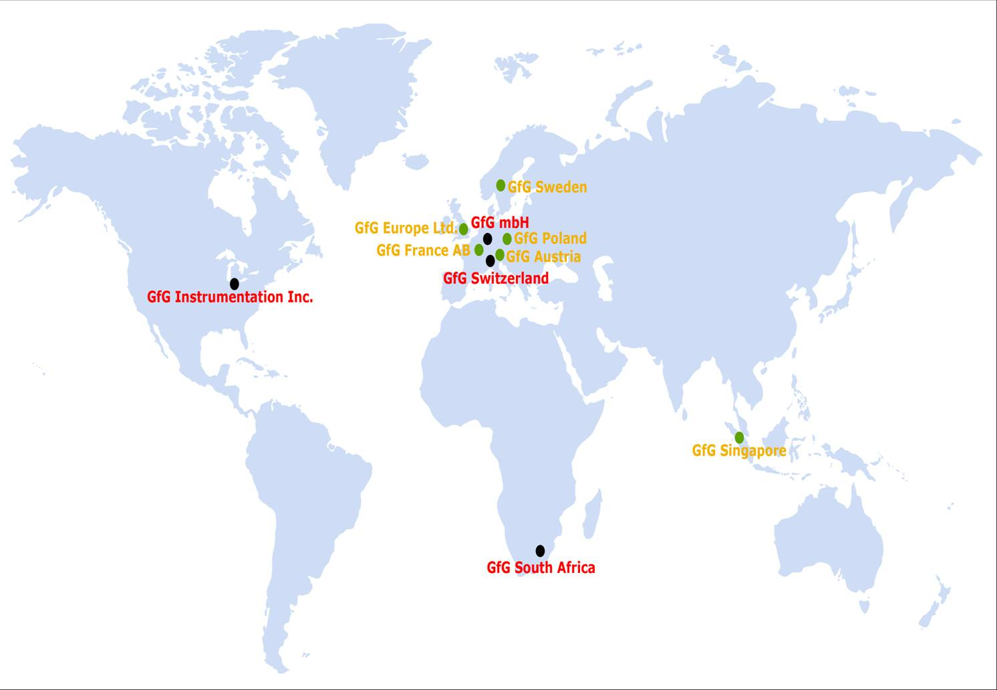
One of the World’s Leading Manufacturers of Gas Detection Products

Slide 6
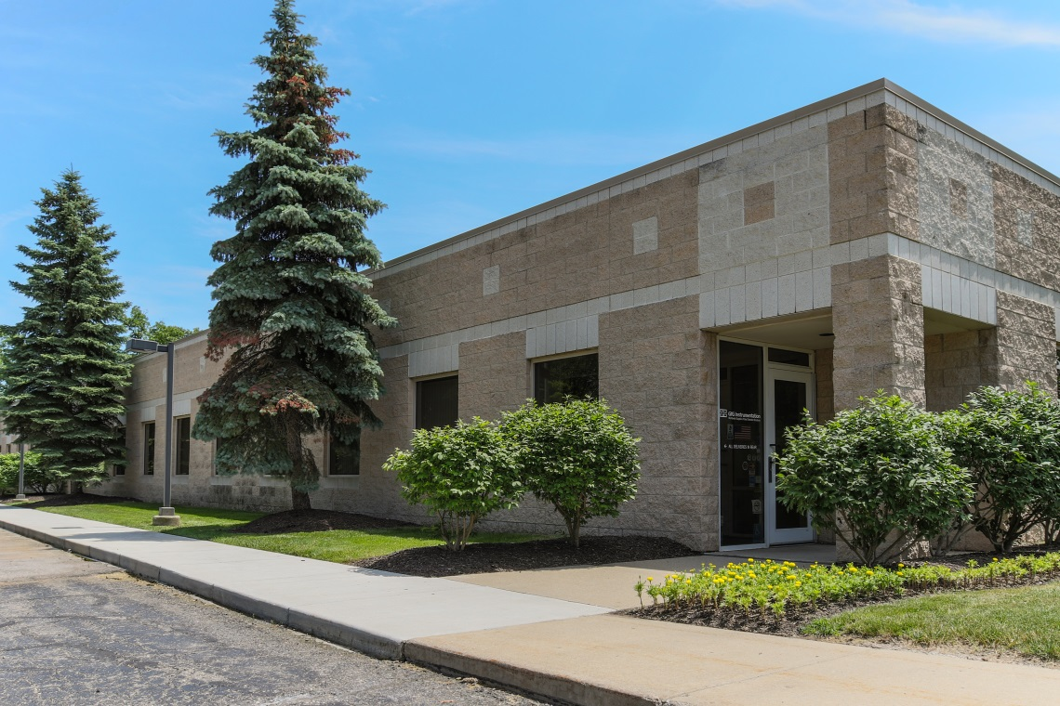
GfG Instrumentation, Inc.
Headquarters in Ann Arbor, Michigan, USA
Responsible for sales for North America and South America

Slide 7
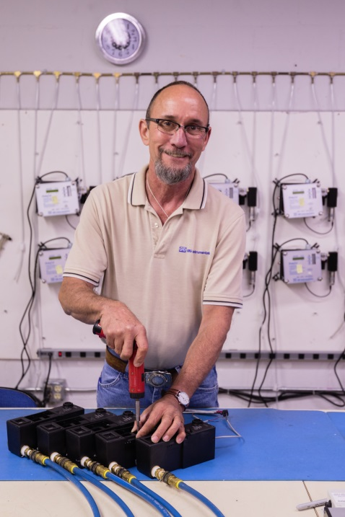
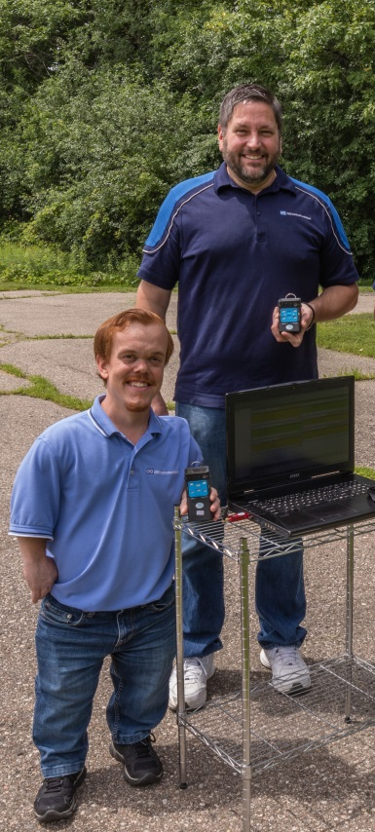
GfG Sales Team Structure
Sales Team – 20 local salesmen across USA
Central Zone – Mark Ahrens
Western Zone – Michael Calvo
Southeast – Bill Rankin
Fixed Systems – Jeff Allsworth
Sales Rep Groups:
Northeastern USA (Sullivan Sales)
Rocky Mountains / Midwest (Shur Sales)
Latin America (Inteccon, Inc.)

Slide 8
Need help? Toll free (USA and Canada): 800-959-0329 Direct: 1-734-769-0573 Customer service e-mail: service@goodforgas.com Sales Territory Map and Contact List: https://goodforgas.com/wp-content/uploads/2019/11/Sales-Territory-Map-V44.pdf

Slide 9
Channel strategy
Excellent support / excellent pricing / excellent discounts
Great products!
Rapid shipment
No stocking order for best pricing
GfG sells exclusively through stocking distributors
We don’t sell direct to end-users!
Exclusively sold through GfG network of value-added resellers
We support our distributors
Demo discounts
Loaners
Field sales support
Training

Slide 10
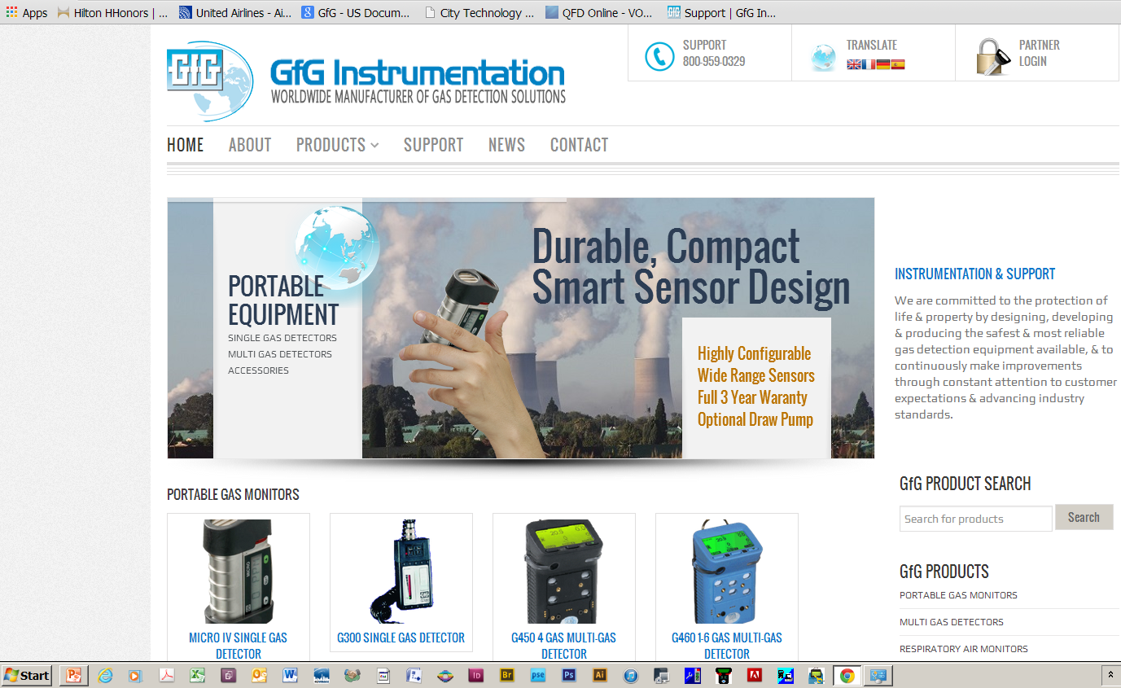
www.Goodforgas.com website

Slide 11
Sales Support: www.Goodforgas.com
Data sheets
Price lists
Manuals
Software
Application Notes
Product comparisons
Presentations
Training videos
...and more!

Slide 12
Technical support and downloads
www.goodforgas.com
Application Notes, Technical Notes and Presentations
Articles
Comprehensive library of gas detection resources

Slide 13
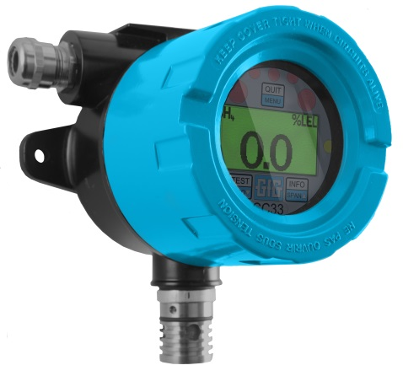
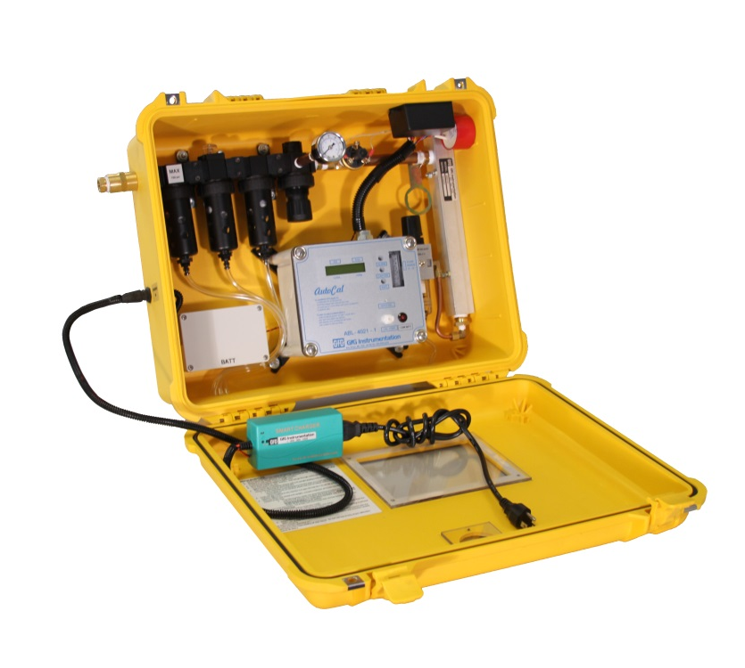
Sales by product category as percent total GfG, Inc. sales
RAM / Airline
Fixed
Portables

Slide 14
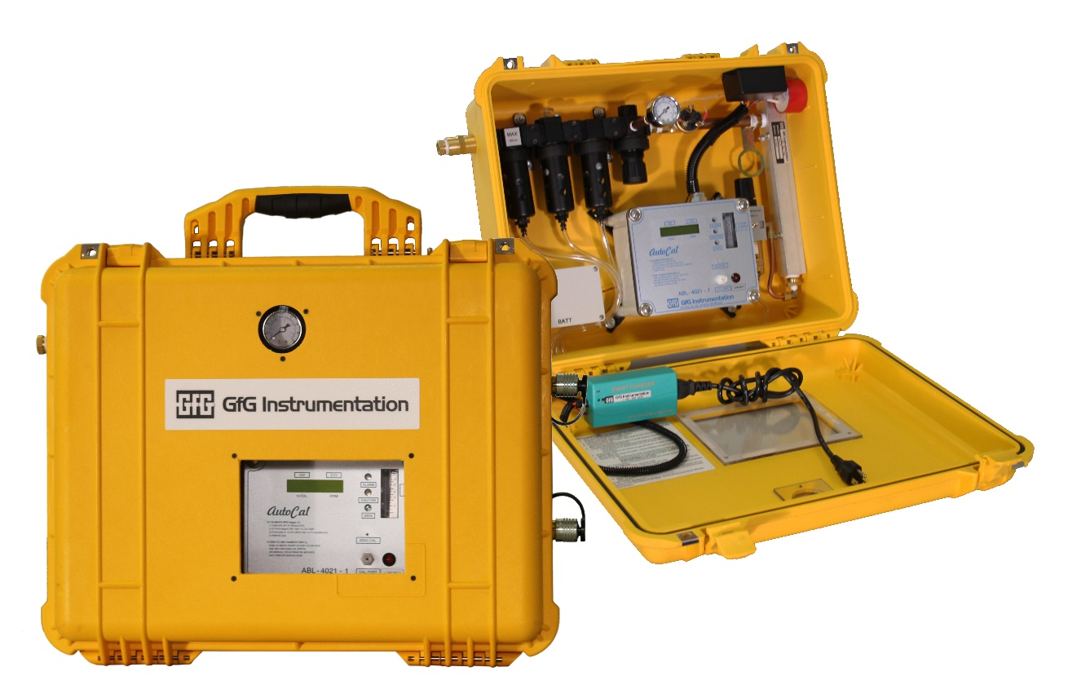
Real-time Air Monitoring (RAM)
Fully portable and wall mounted panels for CO monitoring and purification of compressed breathing air

Slide 15
GfG Instrumentation
Fixed Gas Detection Systems:
Technology based solutions for unique applications

Slide 16
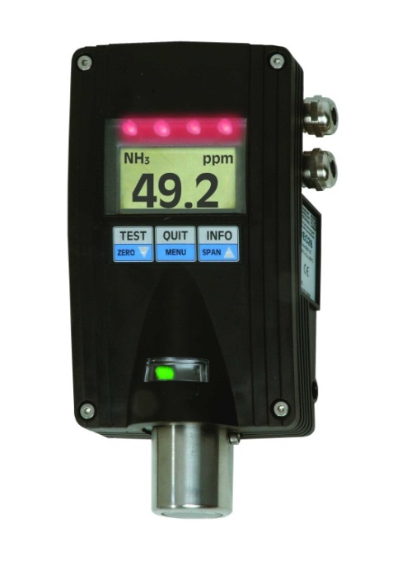
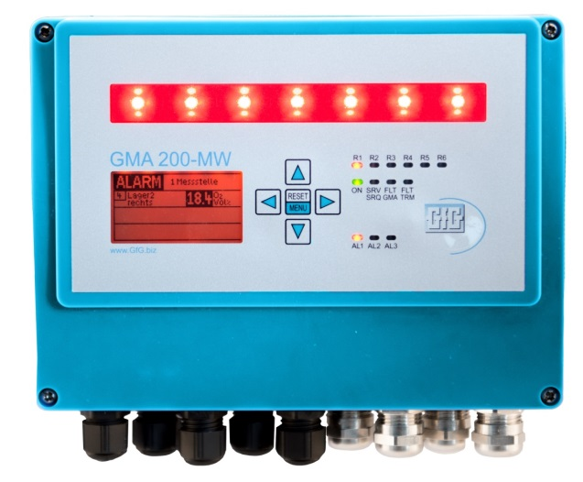
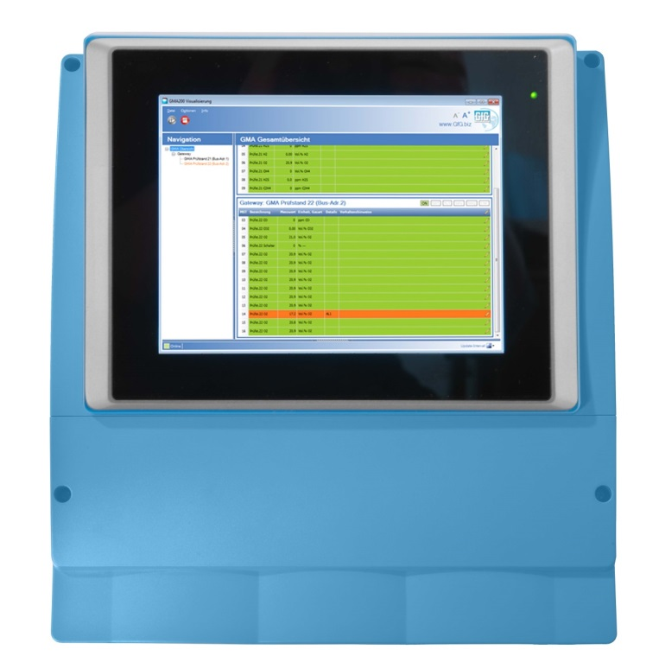
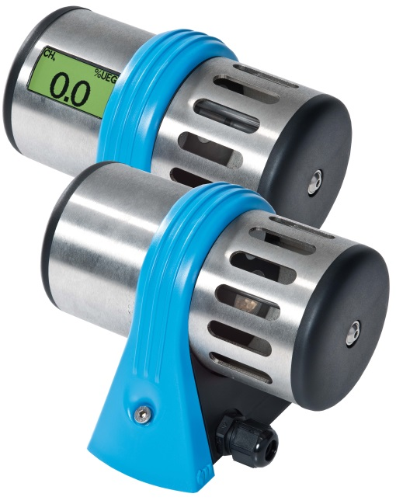
Fixed gas detection systems
Comprehensive line of fixed transmitters and controllers able to detect over 500 gases

Slide 17
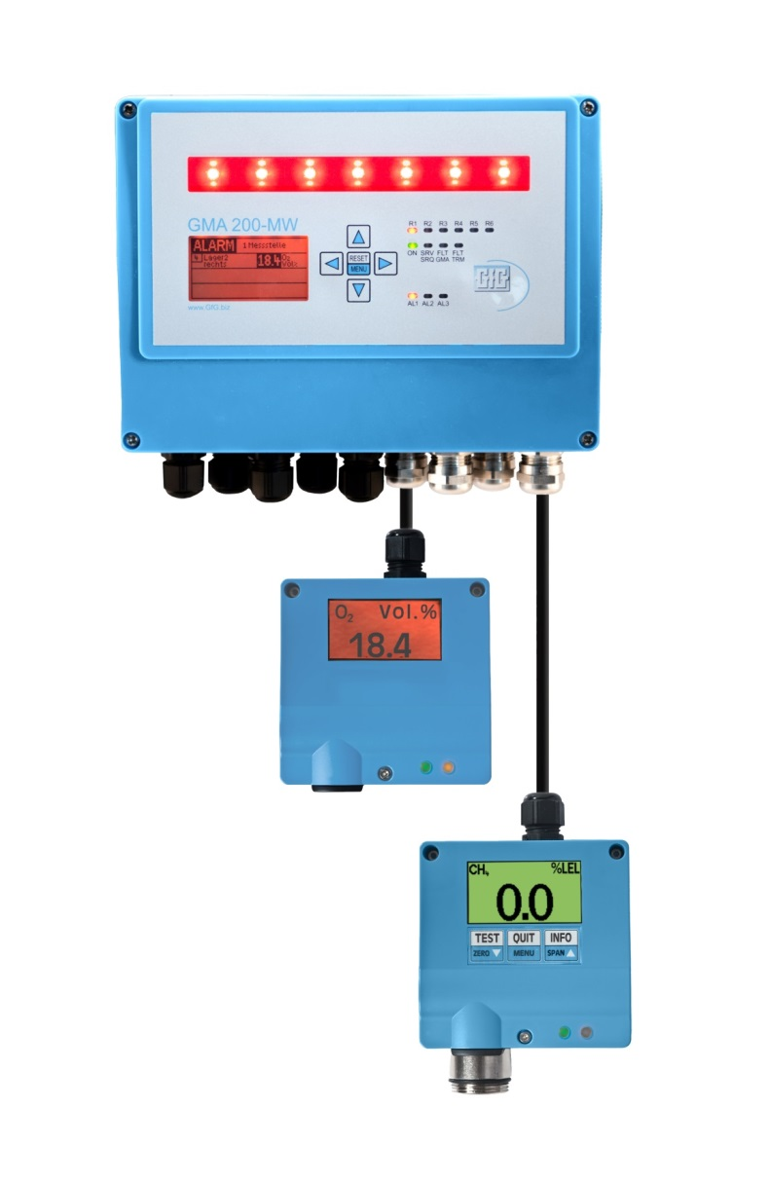
Wirelessly integrated fixed and portable systems
Fixed gas transmitters equipped with WILAN or ISM RF gateways
Realtime readings from fixed and portable instruments displayed on same monitor or PLC

Slide 18
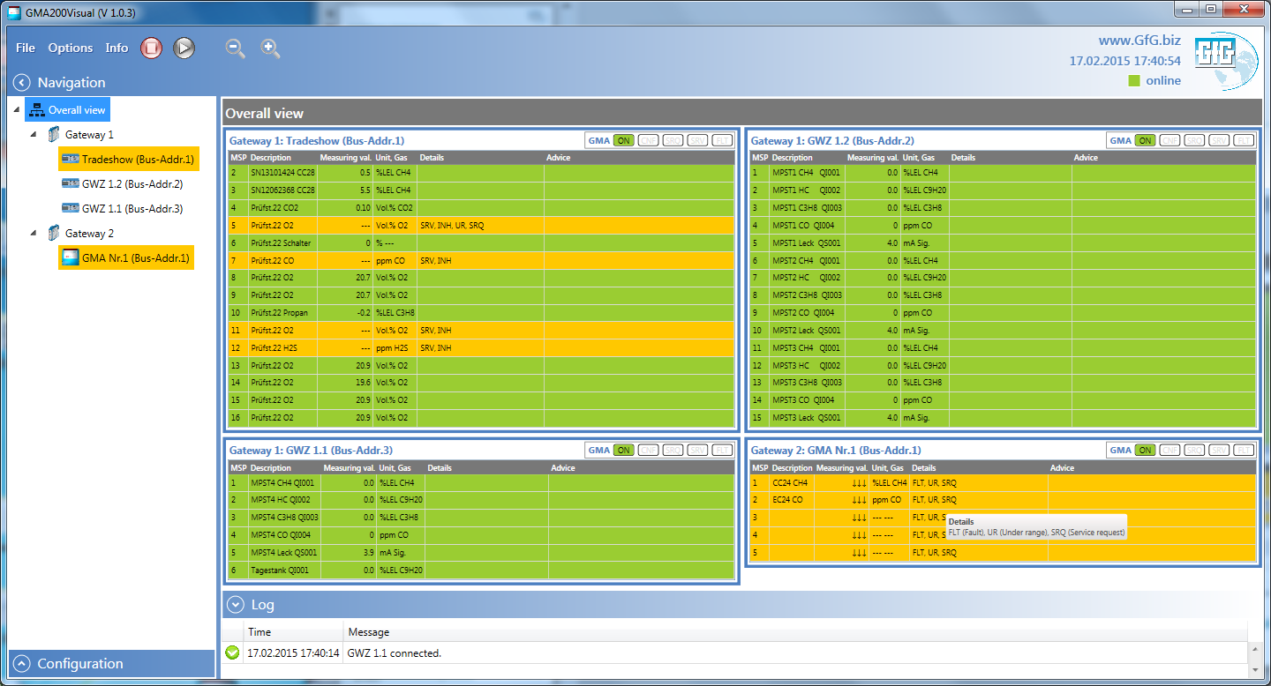
GMA200 Visualization Software Comprehensive system information via digital gateway – Overall system view

Slide 19
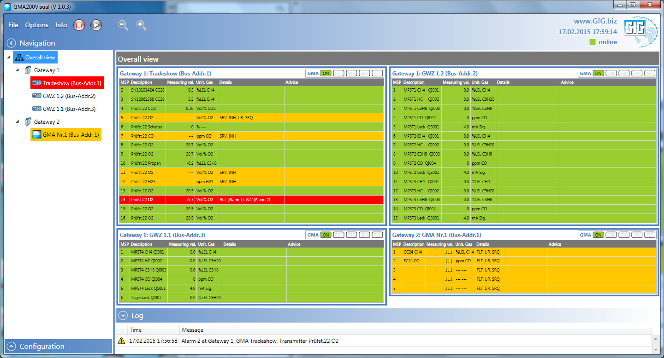
GMA200 Visualization Software Overall system view with high alarm (alarm 2) condition

Slide 20
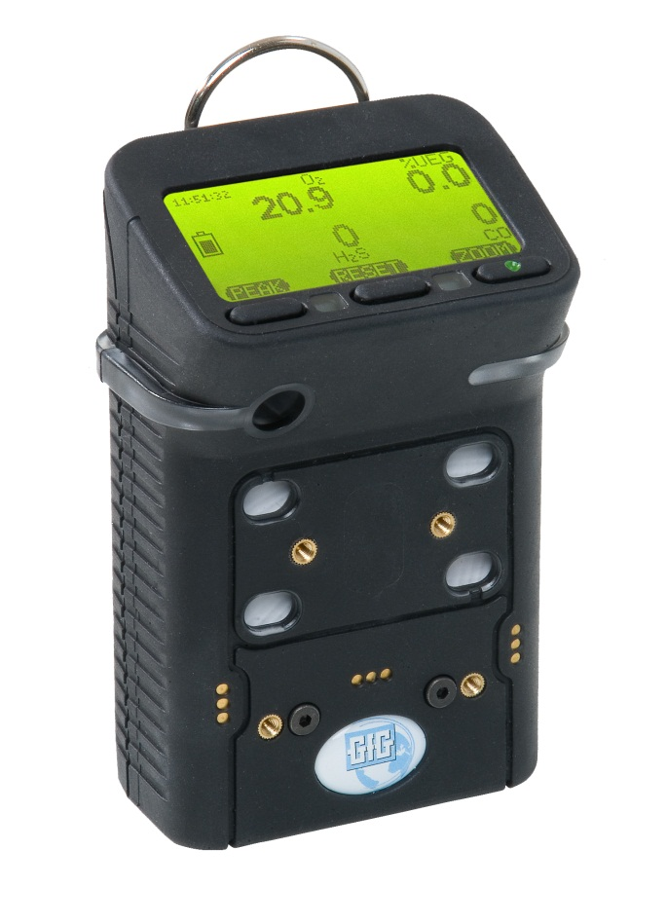
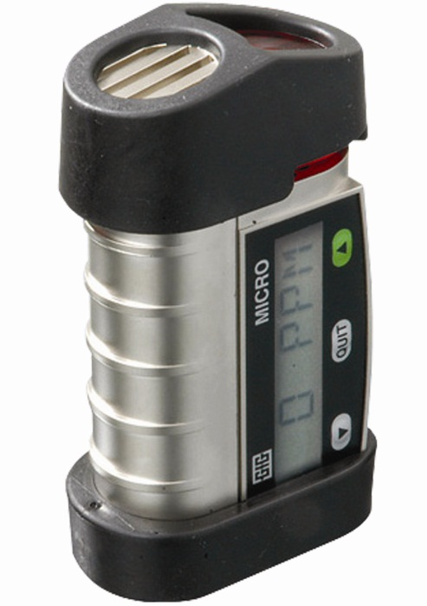
Leading GfG portable gas detectors
Micro IV
single-gas detector
G450
4-gas detector
G460
1 - 7 gas detector

Slide 21
G450 / G460 Multi-Gas Detector
Interchangeable rechargeable (NiMH) or alkaline battery packs last over 20 hours per charge
Top-mounted, three color, full graphics LCD
Durable IP-67 water resistant design
Rated for continuous use in –30°C temperatures

Slide 22
G460 Multi-gas Monitor
Up to SEVEN channels detection
Comprehensive range of interchangeable smart sensors:
O₂ standard warranty: 5-year
LEL, CO, H₂S: 3-year warranty
IR LEL gas: 3-year warranty
IR CO₂: 3-year warranty
Available with PID and wide selection of substance-specific toxic gas sensors

Slide 23
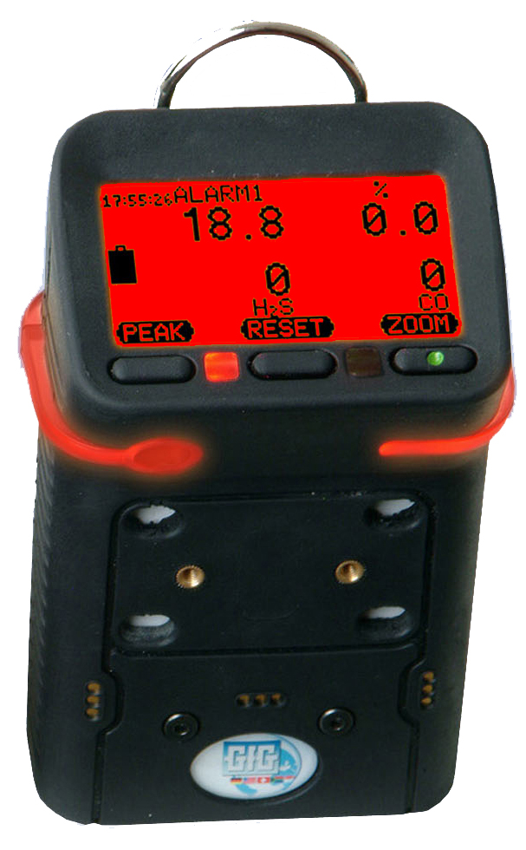
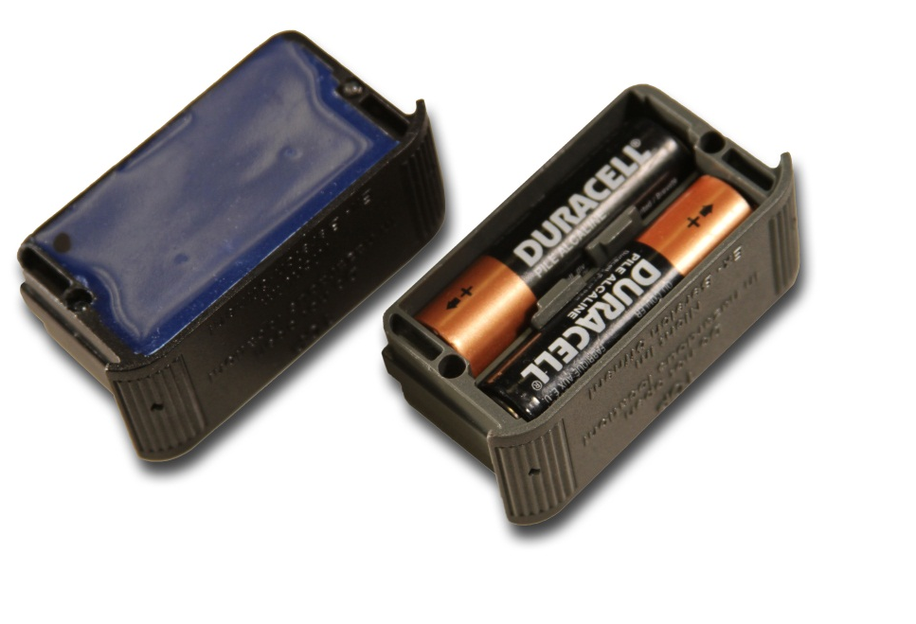
G450 Confined Space Gas Detector
One to four sensors
Full 3-year warranty on all sensors
Interchangeable rechargeable (NiMH) or alkaline battery packs provide over 20 hours of continuous operation
Super durable IP-67 water resistant design
Extremely cost effective pricing!

Slide 24
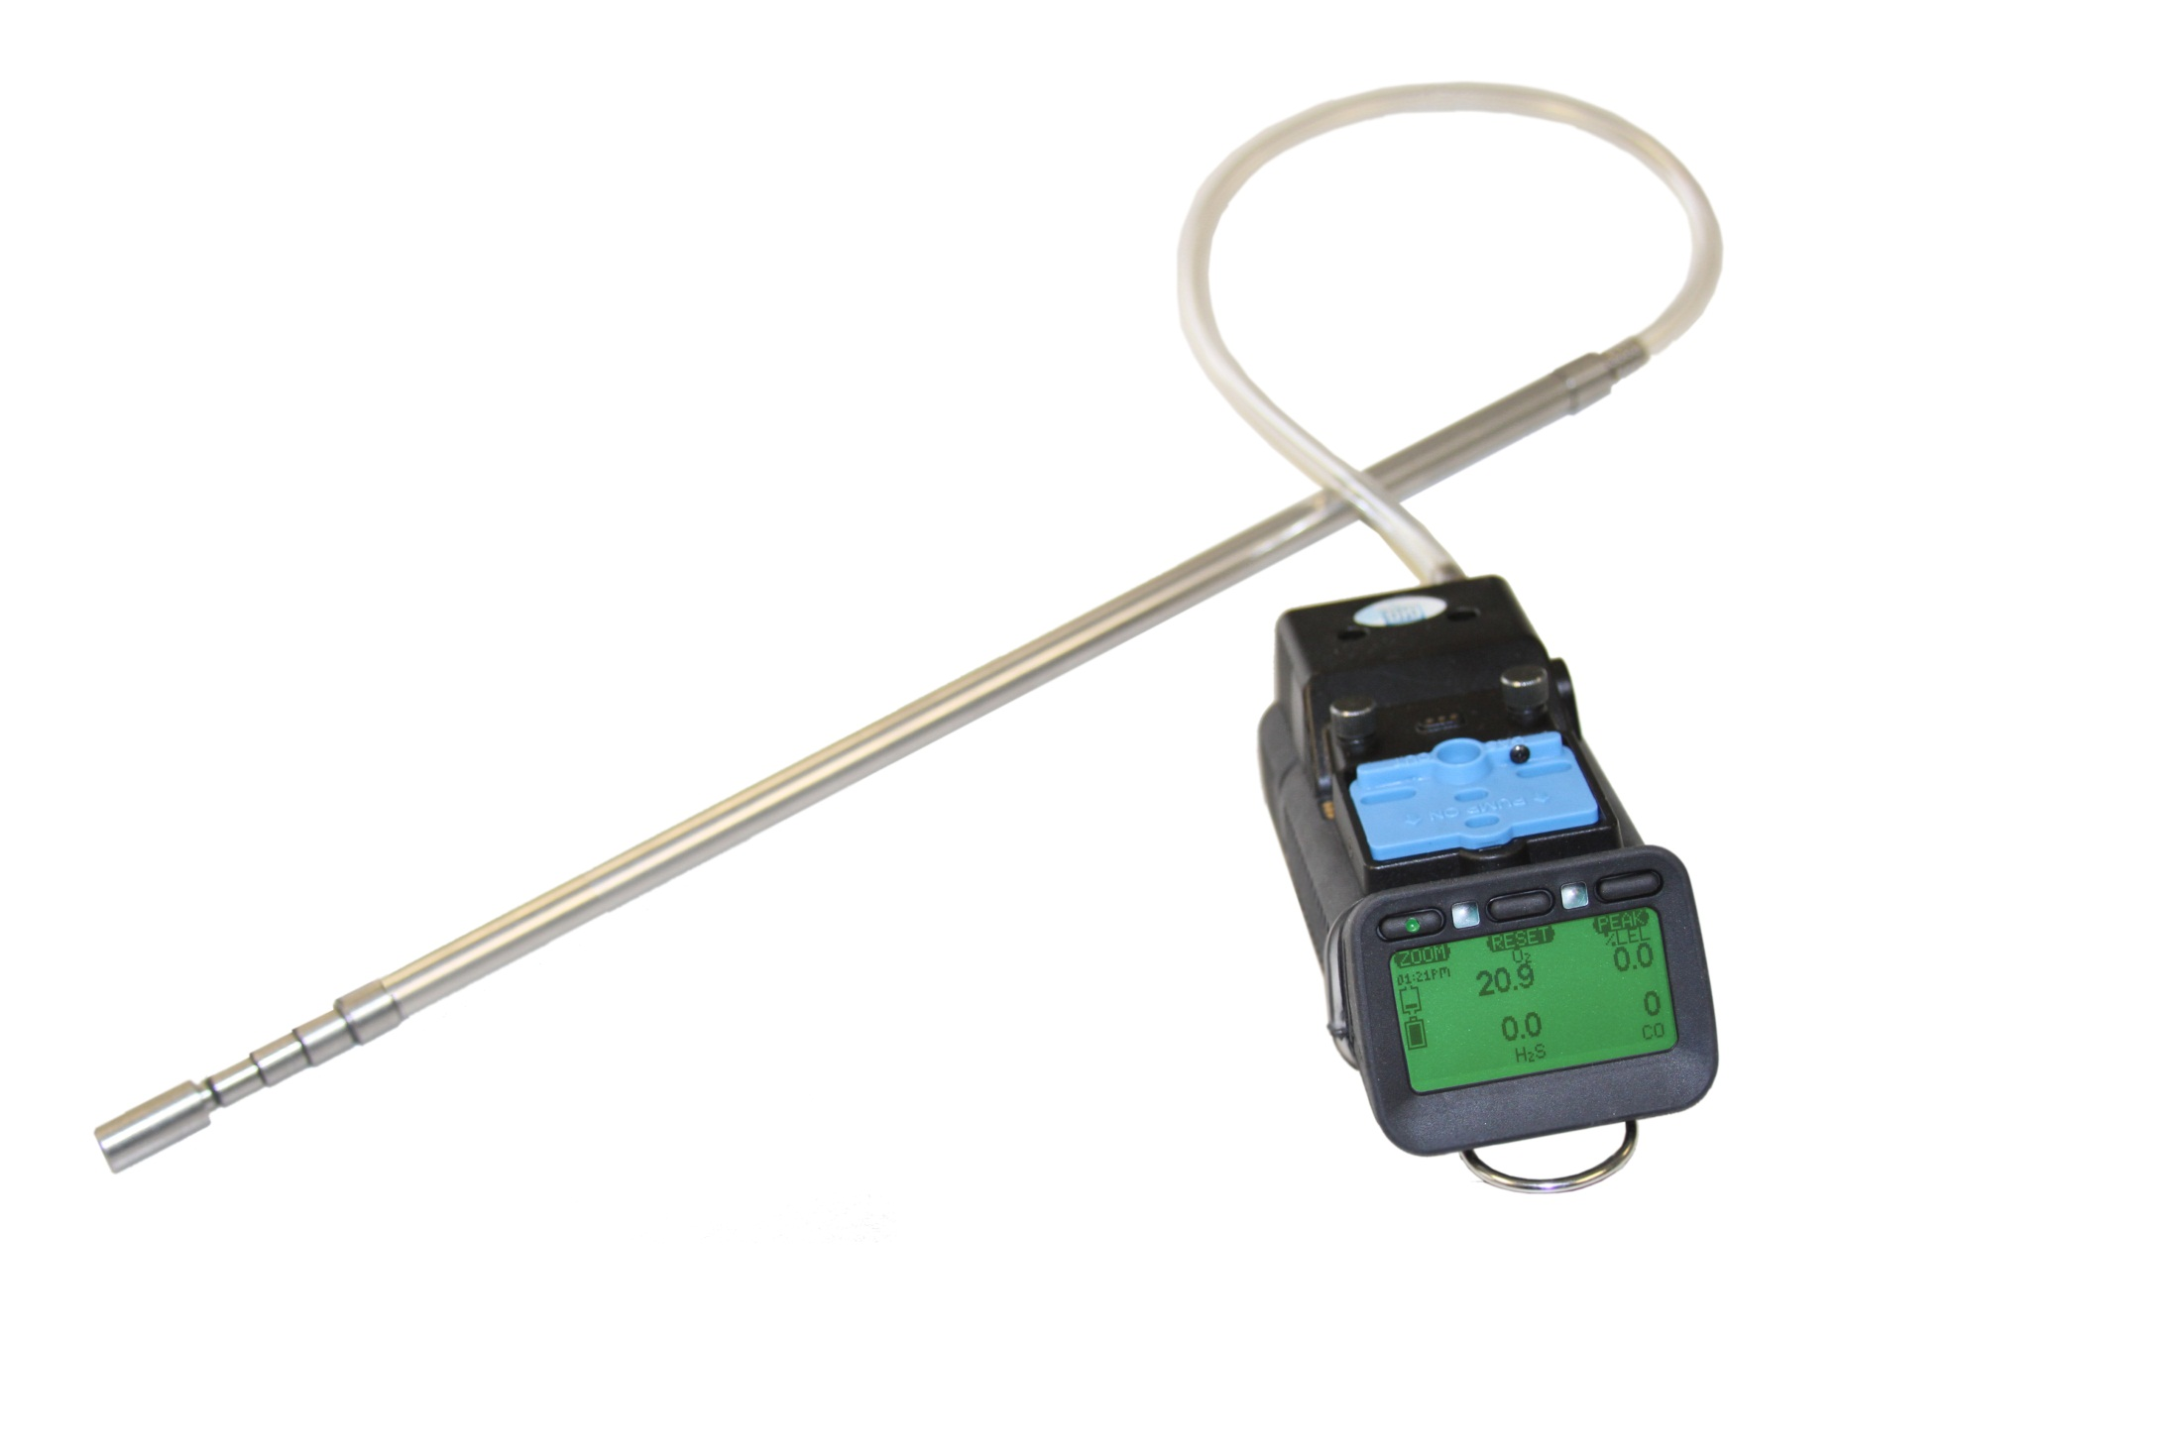
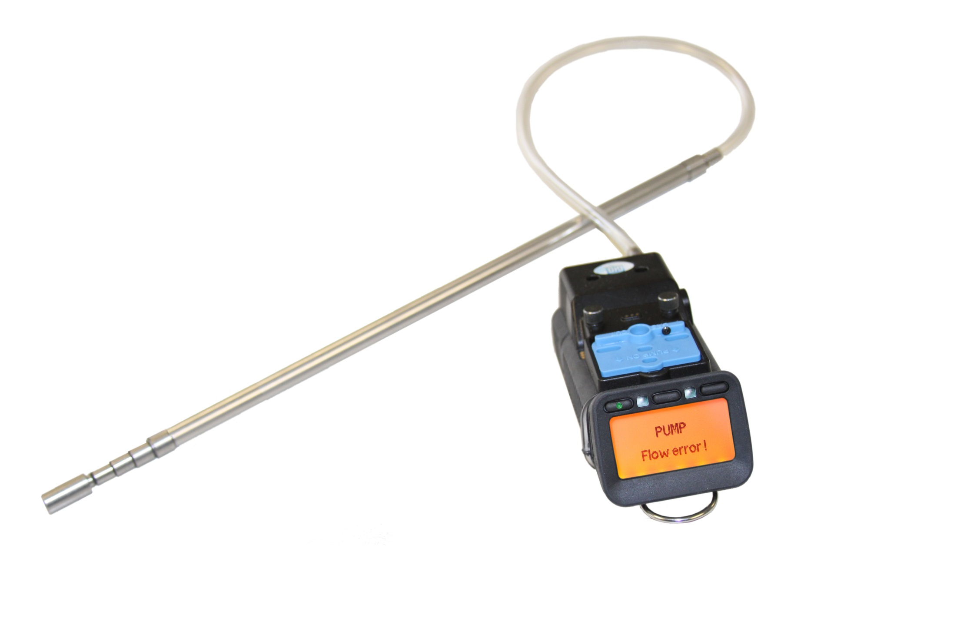
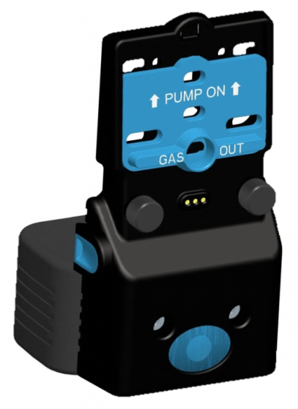
G450 / G460 Motorized Pump
Powerful motorized "smart pump" with its own battery pack
Motorized pump attached or removed from instrument as needed
Shutter switch turns on the pump and covers the diffusion ports
Pump directly monitored by instrument
Low flow and pump malfunction alarms

Slide 25
Confined Space Entry Requirements
In 1993 OSHA enacted 29 CFR 1910.146 “Permit-Required Confined Spaces”
Provisions apply to general industry
1910.146 does not apply to industries with their own vertical standards:
Agriculture
Construction
Shipyard employment

Slide 26
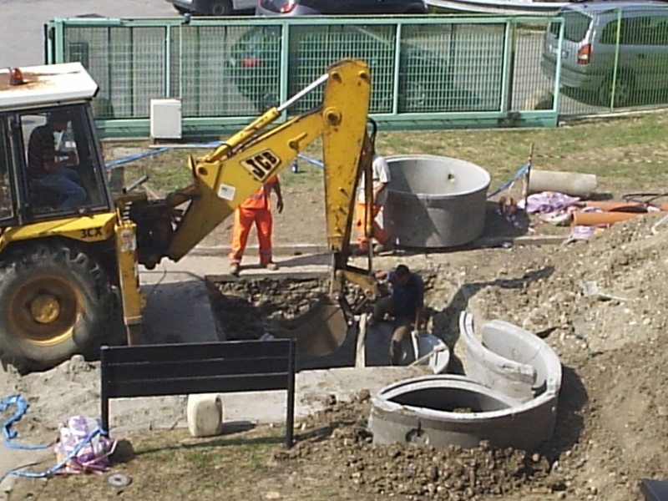
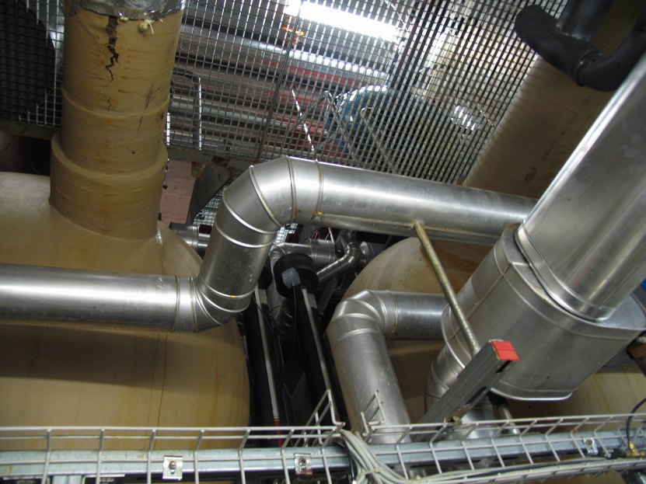
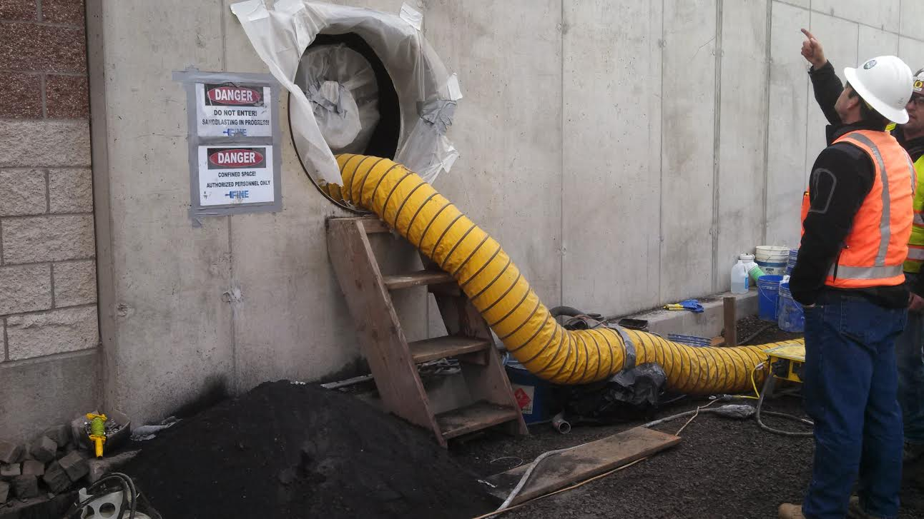
1926 Subpart AA
June 2015: New OSHA CS rule adds many additional construction activities and types of spaces
29 CFR 1926 includes a lengthy list of confined spaces that are covered by the new rule
Significant expansion of CS market in the USA – huge opportunity for GfG, Inc.
Construction contractors prefer low cost, minimum feature instrument – alkaline G450 outstanding compliance choice!

Slide 27
Confined space market dimensions and opportunities
Confined space (4 gas / 5 gas):
USA / Canada: $350 M USD / year
Latin America: $50 M USD / year
Special CS considerations in North America:
Regulations very strict
Recent OSHA changes have expanded market
Every team member needs instrument
Mandatory pre-entry checks require pump
Standby safety watch uses pump continuously for entire entry
Industrial work shift typically 12 hours
Third party real-time wireless monitoring increasingly important and popular option

Slide 28
NFPA 350: Guide for CS entry for Fire Service
Complements and supports existing OSHA regulations such as:
1910.146 General Industry
1926 Subpart AA Construction Standard
1915, Subpart B Shipyard Employment Standards
Addresses gaps in existing standards
OSHA regulations tell you WHAT to do not HOW to do it
NFPA 350 tells you how to perform atmospheric monitoring

Slide 29
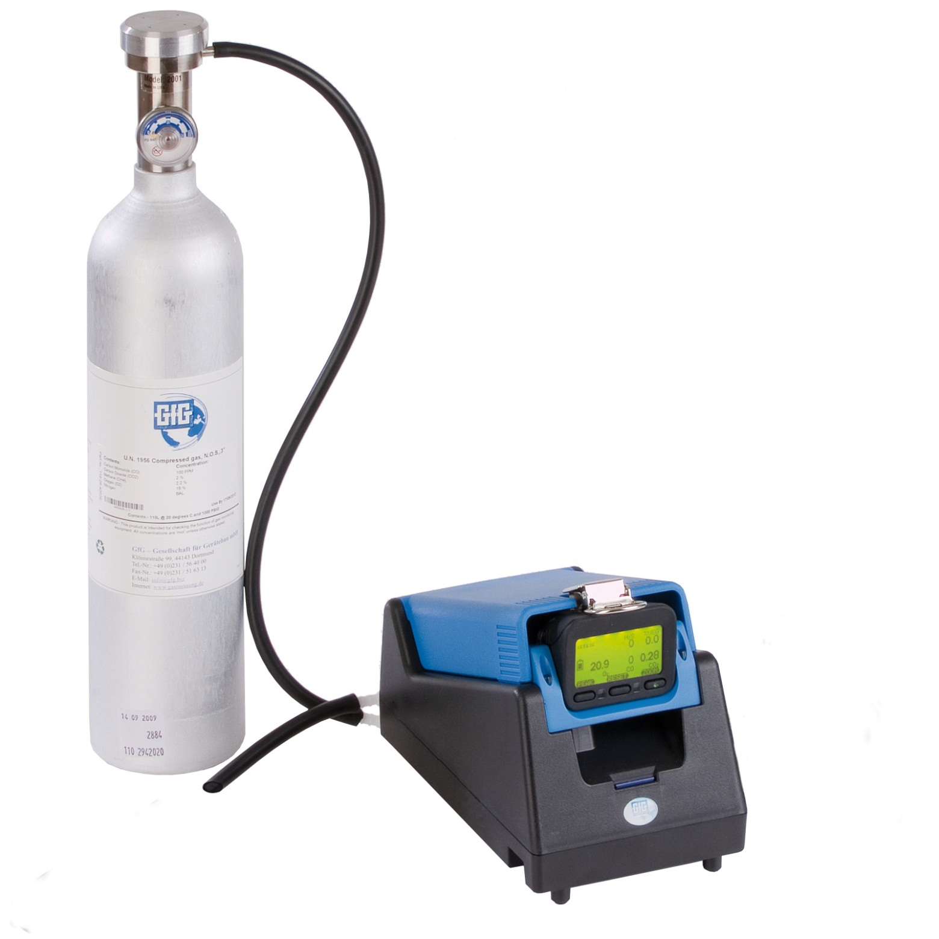
Calibration/Monitor Checks
Zeroing
Span Calibration
Bump Test
Function Test

Slide 30
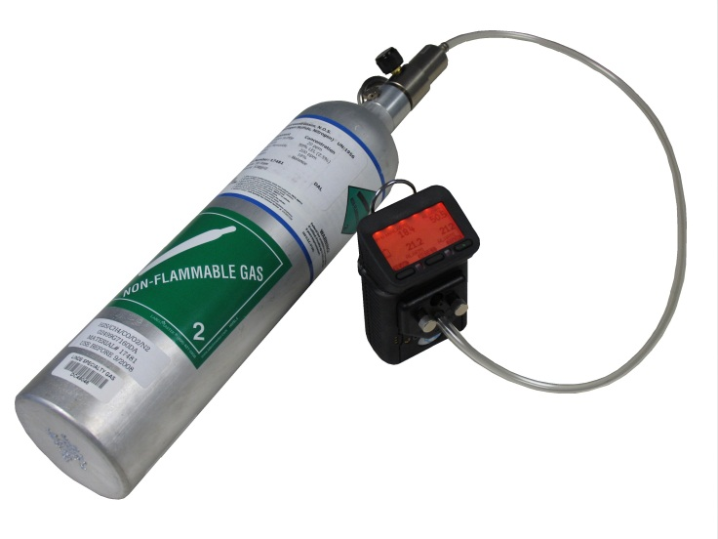
“Bump Test” required before each day’s use!
“Bump test” (function check) is a qualitative test in which the sensors are exposed to gas and the alarms are activated
“Bump test” confirms that gas is capable of reaching the sensors, that the response time (time to alarm) is within normal limits, and that the alarms are activated and function properly
“Bump test” does not verify the accuracy of the readings of the sensors when exposed to gas
Takes 20-45 sec. to perform

Slide 31
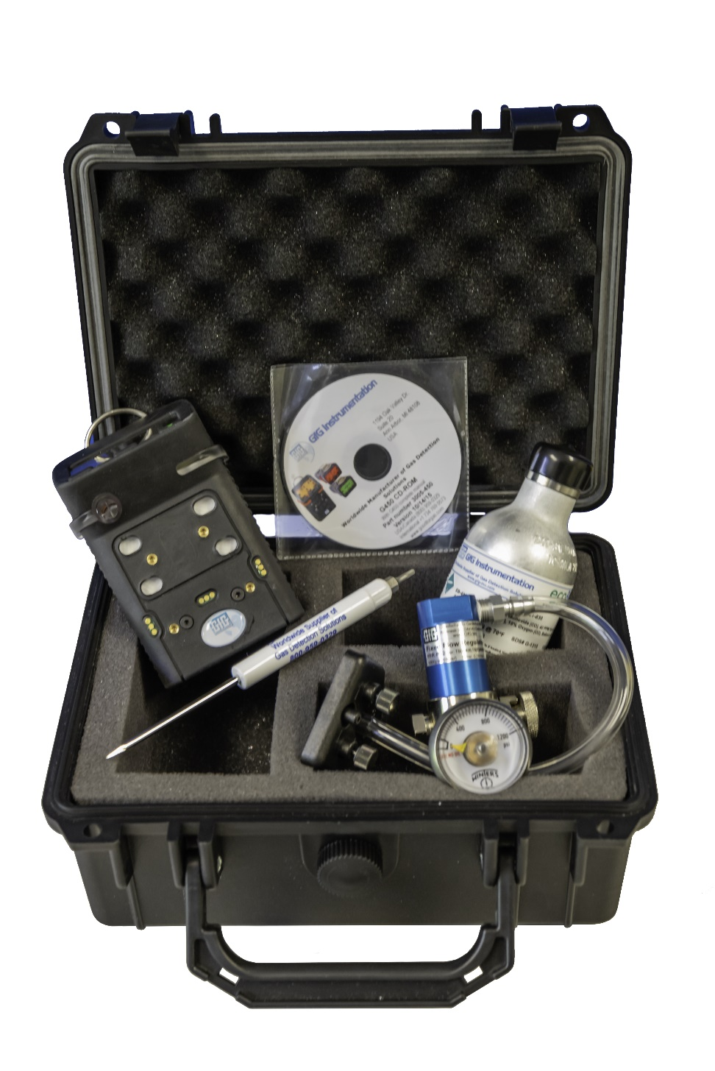
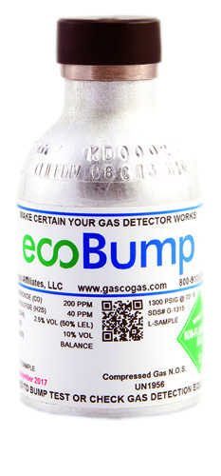
Low cost G450 ecoBump Kits
G450 ecoBump kits have everything customers need for day-to-day use
Convenient and affordable solution
One compact ecoBump cylinder delivers over 250 daily bump tests!

Slide 32
G450 ecoBump Kit

Slide 33
GfG Instrumentation
G888 / G999 product introduction

Slide 34
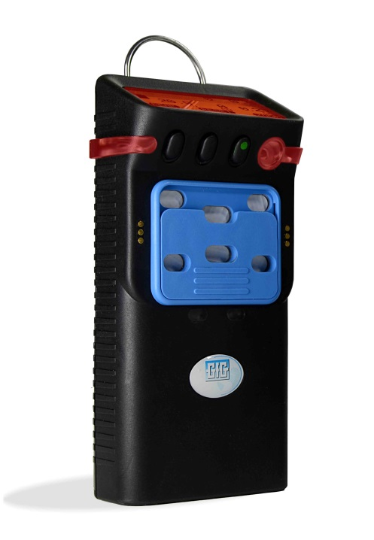
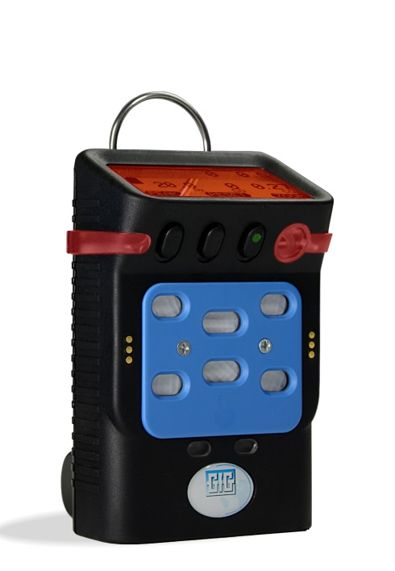
Introducing the latest multigas detectors from GfG Instrumentation
G888: compact, one-to-seven gas atmospheric monitor
G999: compact, one-to-seven gas atmospheric monitor with internal motorized pump

Slide 35
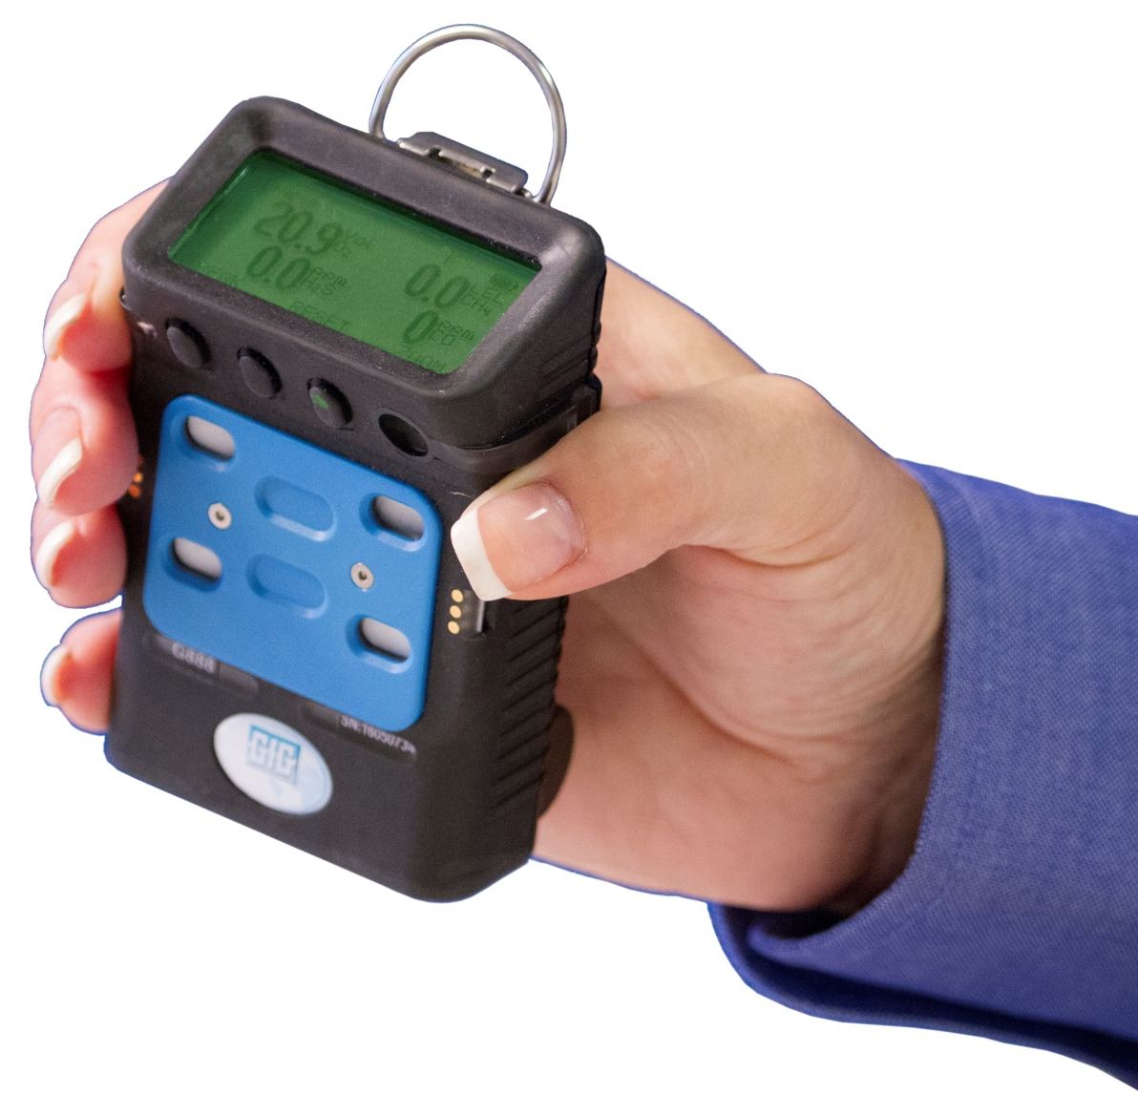
Introducing the G888 personal atmospheric monitor
Compact size!
Up to 7 gases in an instrument smaller than most 4 gas personal instruments
Rechargeable battery pack provides up to 23 hours continuous operation
Safe and dependable nickel metal hydride (NiMH) battery technology
No concerns from dangerous Li-ion batteries

Slide 36
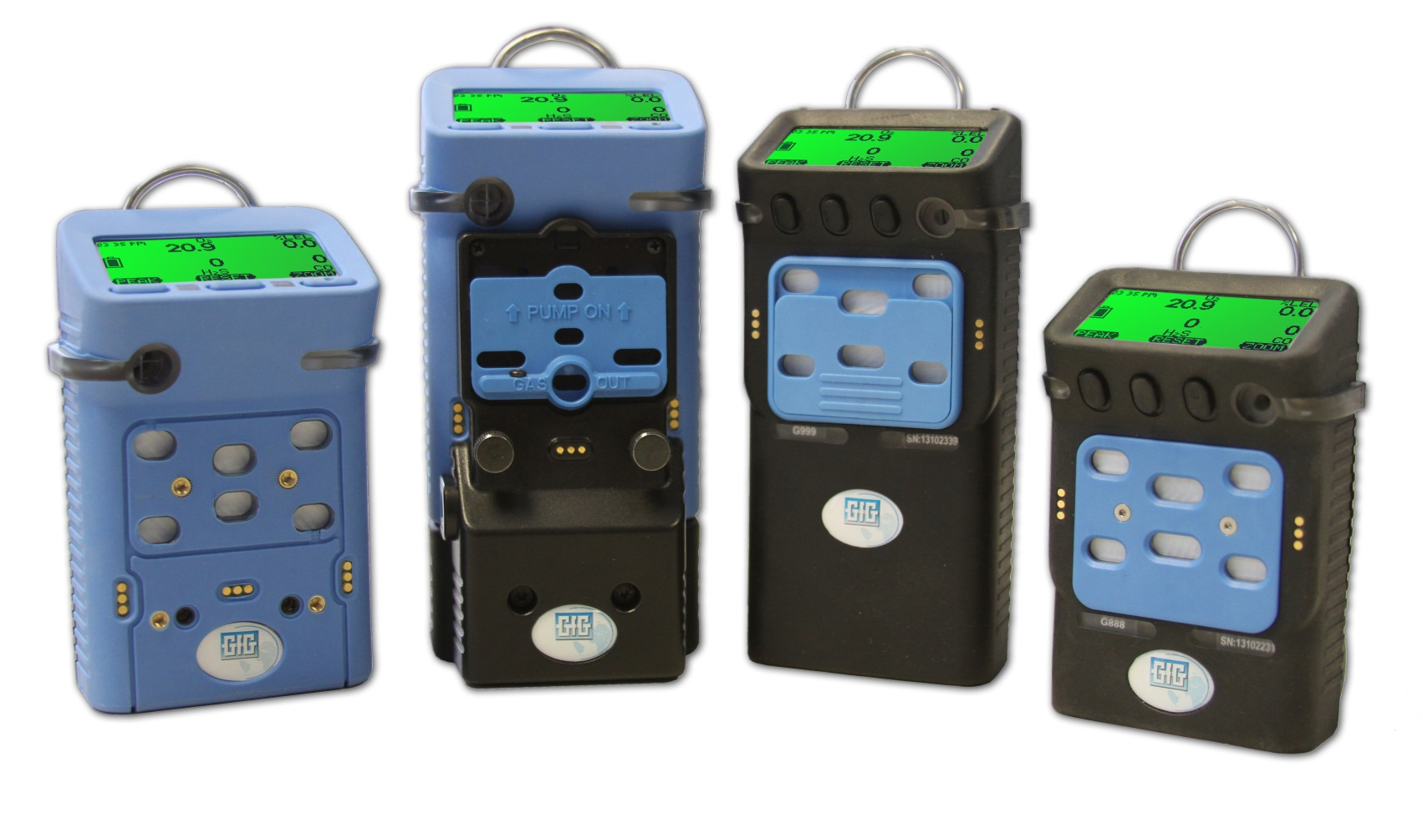
Compact size!
Almost one third smaller than G450 and G460
Smaller than most 4 gas personal instruments!

Slide 37
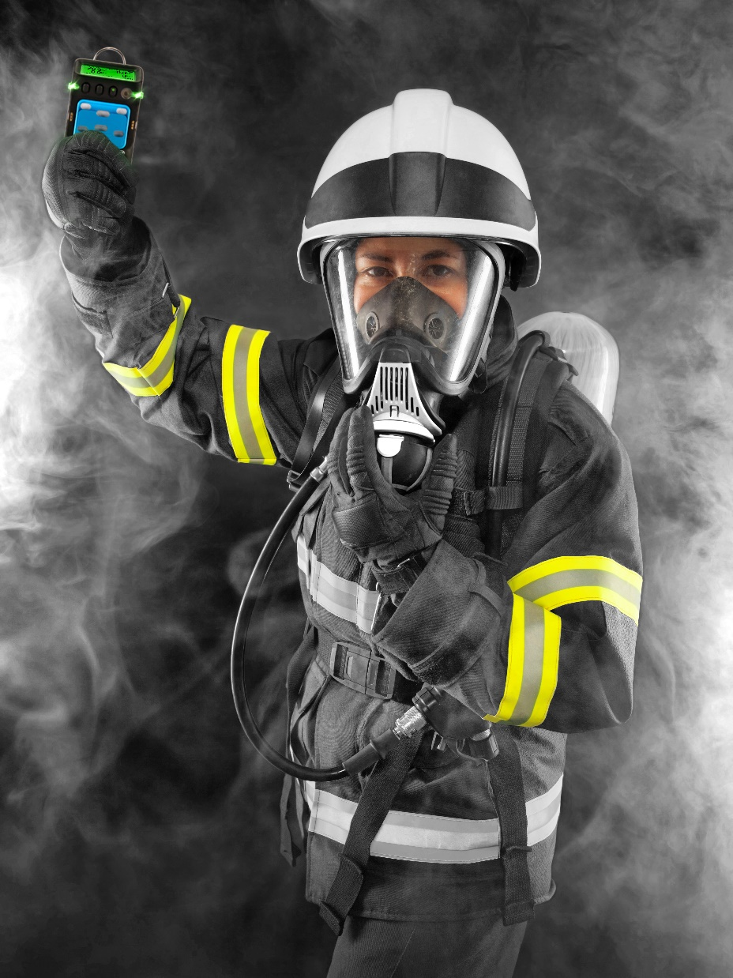
Compact size!
Almost one third smaller than G450 and G460
Smaller than most 4 gas personal instruments!

Slide 38
Introducing the G999 atmospheric monitor
Internal motorized pump for continuous sampling from remote locations
Sample from locations up to 300 feet (100 m) or more away from instrument
Slide on-off pump switch allows instrument to be operated in either diffusion or pumped operation
Compact size means G999 can be used as personal monitor
Twice as much power – internal 4 NiMH cell battery pack

Slide 39
Oil and Chemical Industry Opportunities
Confined space versus 4 gas personal protection in oil industry
In the past, most workers at refinery and oil / gas production sites in USA / Canada equipped with basic 4 gas personal instrument
Increasingly, CS entry at refinery done with PID and LEL equipped instrument
Increasingly, personal protection instruments are including additional sensors (such as CO₂, NO₂, SO₂, H₂, etc.)

Slide 40
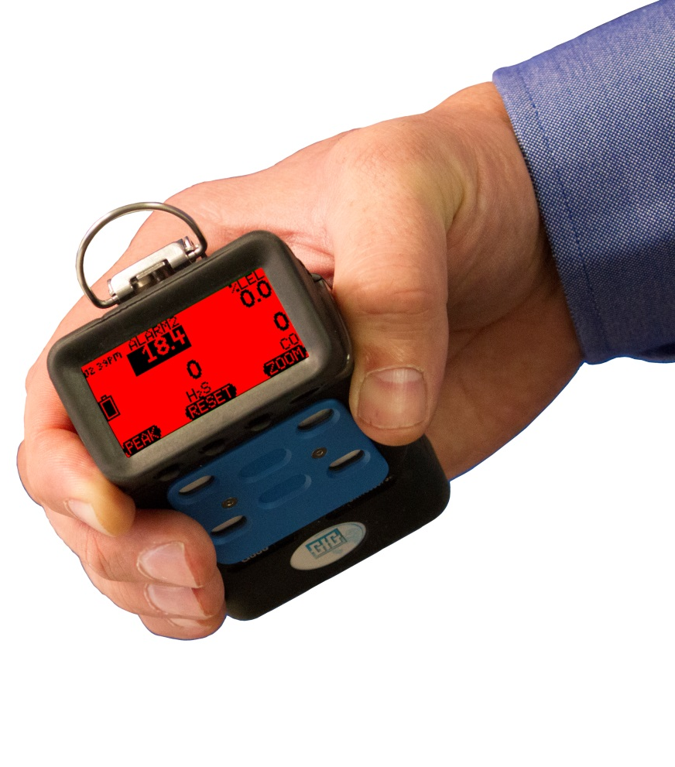
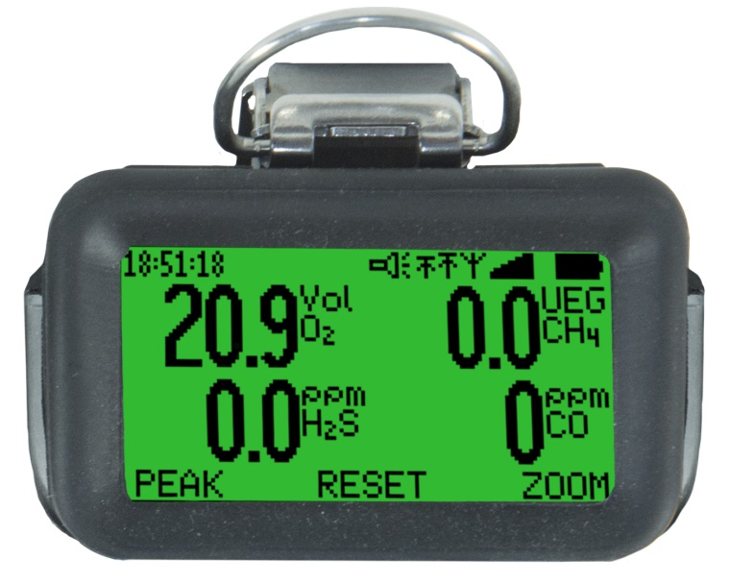
Three color "Traffic Signal" display
Back lit, three-color, full graphics LCD
Top mounted display with wrap around (360º) LED alarm indicator
LCD includes flip and zoom function
Rugged, double shot molded housing includes integral rubberized boot
Durable high-tension steel alligator belt clip

Slide 41
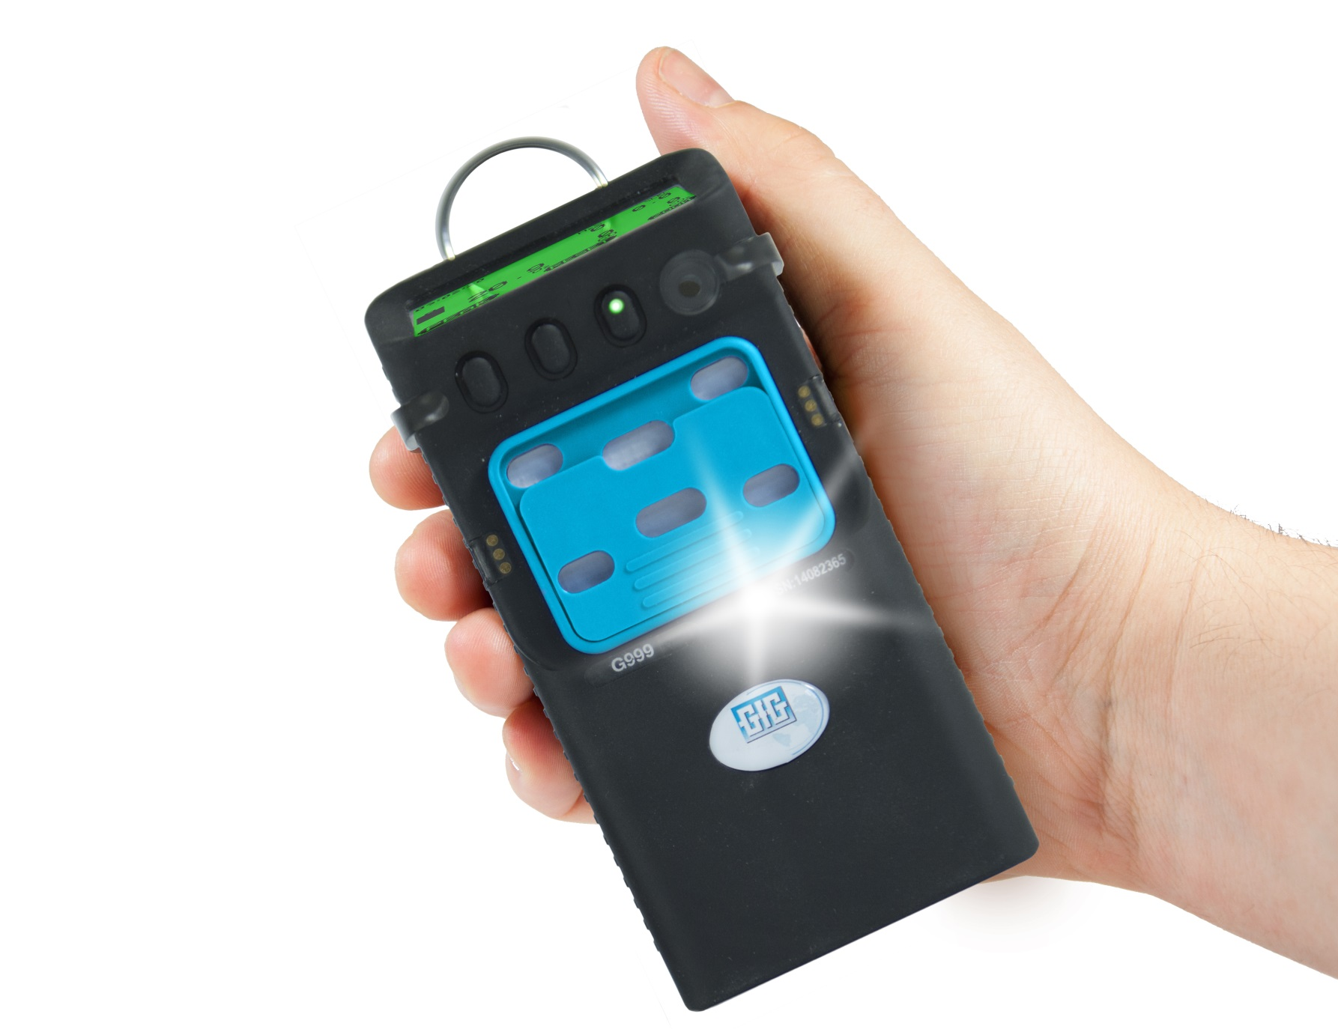
Standard features now include:
Flashlight LED
Man-down alarm
Red / green flash for Bump Test or Calibration due status

Slide 42
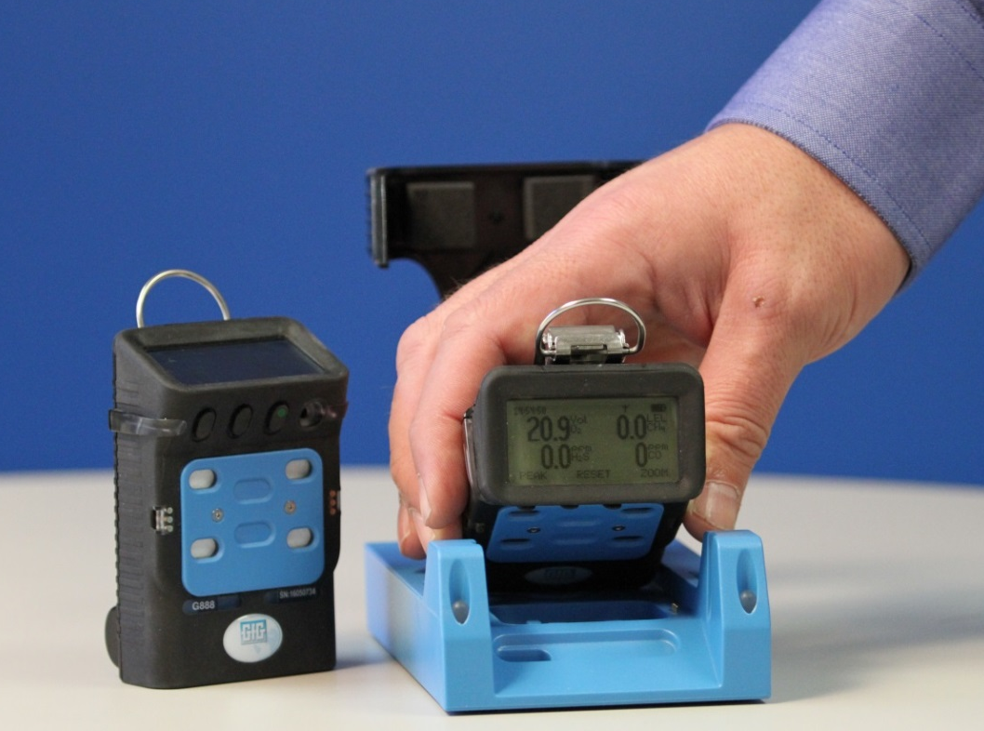
G888 battery packs based on safe and proven nickel metal hydride (NiMH) technology
NiMH batteries provide up to 23 hours of continuous operation for typical 4 gas instrument
NiMH batteries provide excellent cycle life and low temperature performance
Typical run-time after two years for properly maintained NiMH battery packs is usually around 16 hours
No concerns due to dangerous Li-ion batteries
No runaway charging or flammability issues

Slide 43
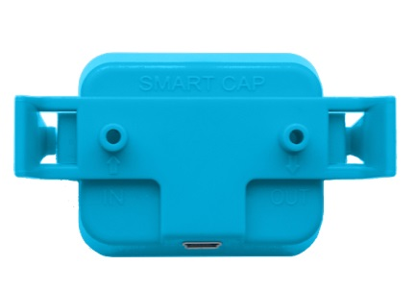
Charge G888 by USB connection via “Smart” calibration adapter or optional cradle
Just like charging a cell phone!
Charge from any USB port
Optional cradle for charging via 110 – 240 VAC

Slide 44
Charging times
Use same cradle for G888 and G999
Charge G888 with either smart cap or cradle
Charge G999 with cradle only
G888
Approx. 6h when the battery is empty
Approx. 4h after one shift (EC+CC sensors)
G999
Approx. 6h when the battery is empty
Approx. 3h after one shift (EC+CC sensors)

Slide 45
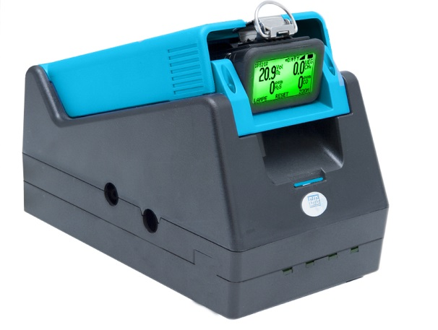
Easy to use!
Operation identical to other GfG instruments
Calibration easy and automatic
DS 400 Docking Station works with new G888 and G999
All you need to do is install a new cradle and update the firmware in your existing docking station
Same cradle works for both G888 and G999

Slide 46
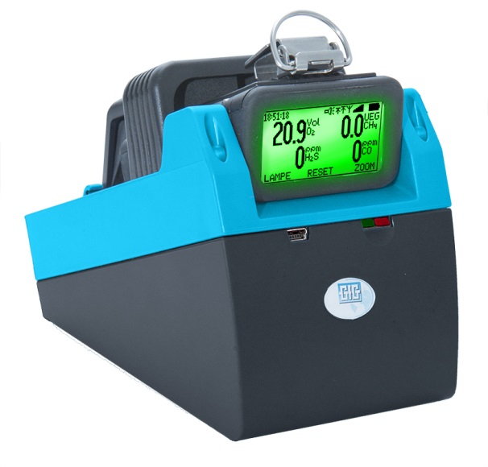
Low cost TS 400 “Test Station” for “Bump test” and Calibration Adjustment
TS-400 requires very little power
Power via USB connection, or cell phone type wall power adapter

Slide 47
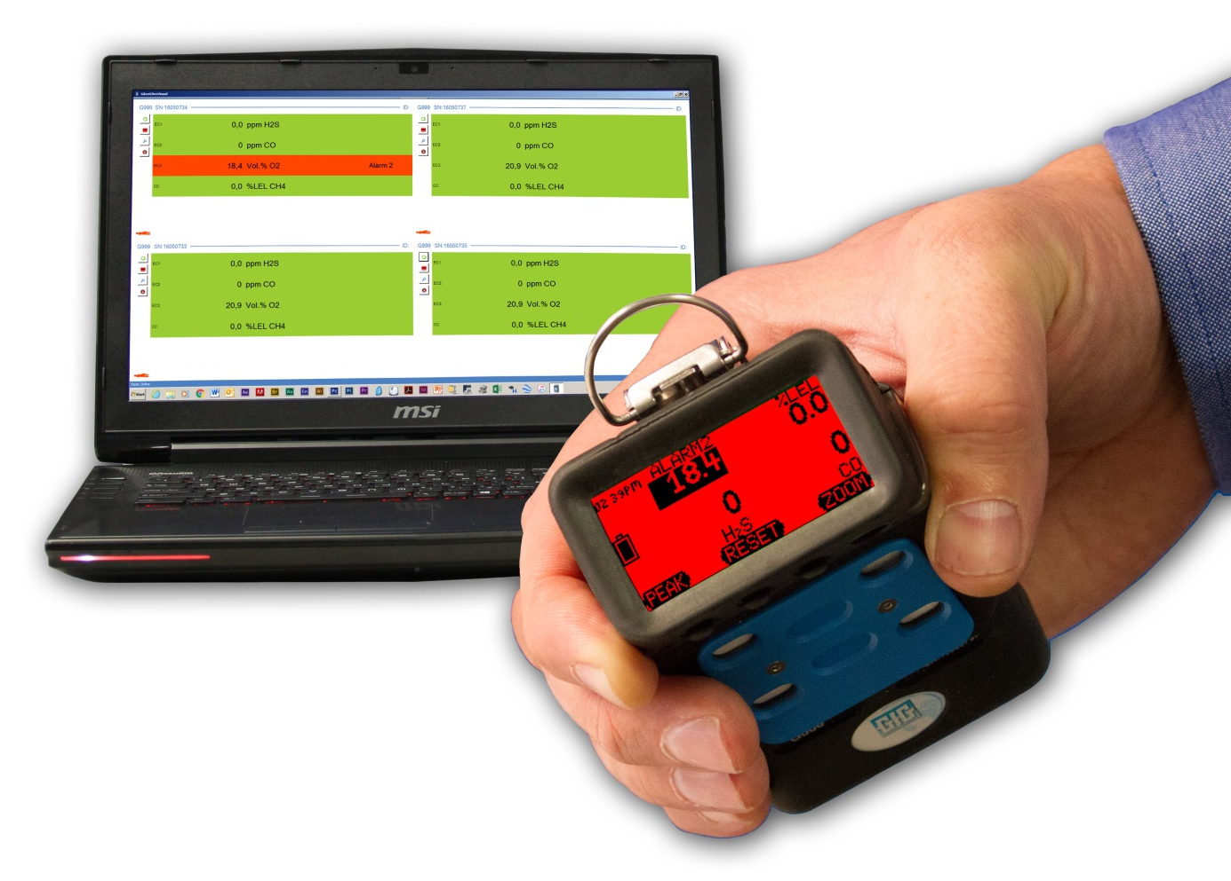
Realtime wireless communication
Optional radio frequency (RF) transmitter
Realtime wireless communication of readings and alarms
Sophisticated wireless “Man down” alarm provides immediate information of movement at base station as well as at instrument
Powerful ISM RF transmitter provides much greater reach than WIFI or Bluetooth connection
915 MHz (US) 1000 feet (300 meters)
868 MHz (EU) 2,300 feet (700 meters)

Slide 48
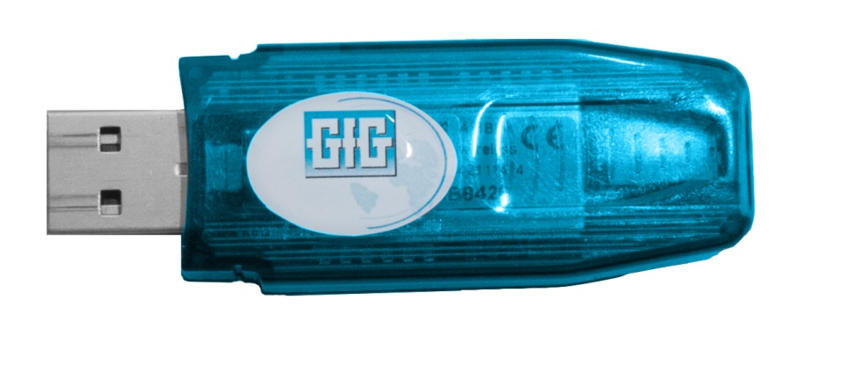
Optional wireless communication
Plug-in RF transceiver turns laptop or computer into base station
Install software, plug-in dongle, and your computer ready for use as a base station for wirelessly integrated G888 / G999 gas detection system

Slide 49
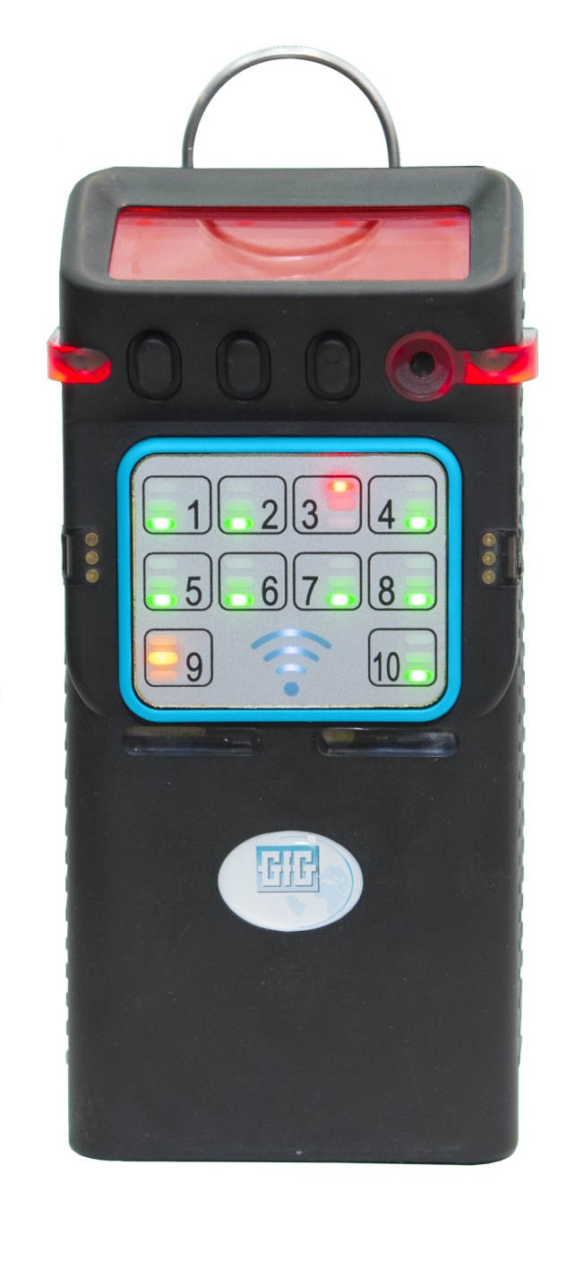
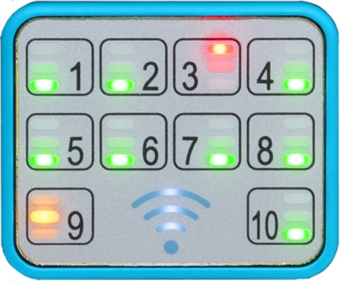
Optional “TeamLink ” Server
Compact self-contained RF base station for local control and 2-way communication with up to 10 instruments
No computer required!
Built in indicators and alarms track RF communication status
Alarm condition immediately communicated to throughout local network and communication hub

Slide 50
GfG TeamLink Server
Compact self-contained server carries same IS certifications as G888 and G999 instruments

Slide 51
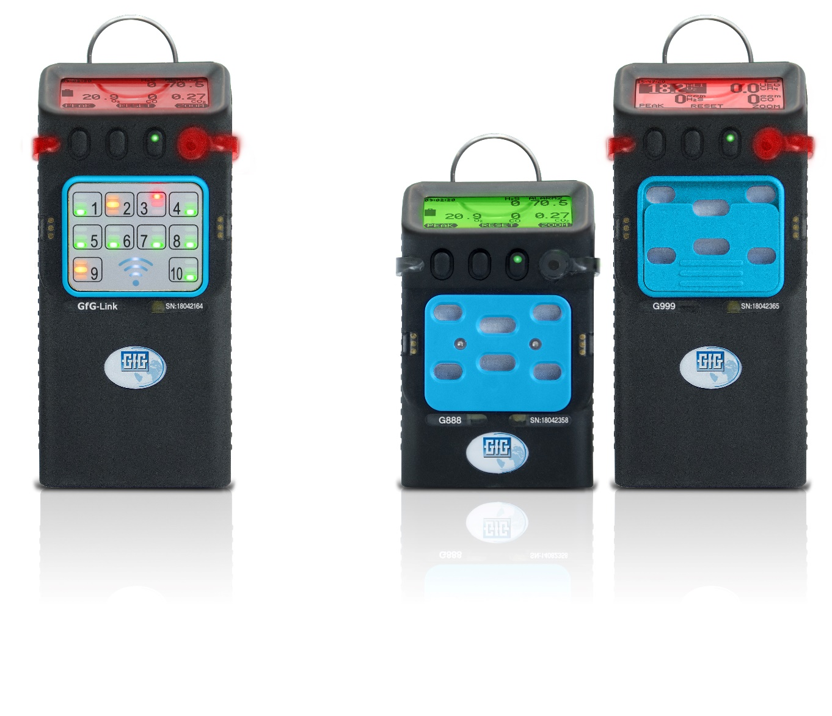
The information you need
Whenever you want
Wherever you want
In real time!

Slide 52
Full size 4 Series and proprietary GfG sensors
5 sensor positions / up to 7 channels
Optional dual channel IR CO2 / IR LEL
Optional dual channel COSH
Wide range of substance specific O2 and EC toxic sensors
User selectable range and resolution for many EC sensors

Slide 53
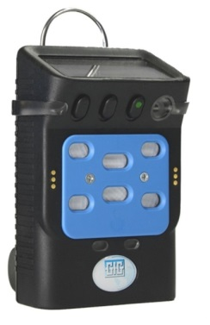
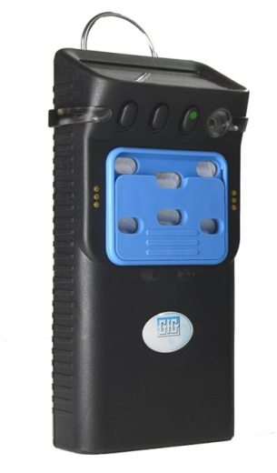
Four different versions of G888 / G999 boards
Version of board determines which sensors can be installed
G888C
Electrochemical sensors EC1, EC2, EC3
Catalytic LEL sensors CC
IR and dual IR sensors IR1, IR2
G999C
Electrochemical sensors EC1, EC2, EC3
Catalytic LEL sensors CC, CC/TC
Dual Infrared sensors IR1, IR2/IR3
G999P
Electrochemical sensors EC1, EC2, EC3
Photoionization sensor PID
IR and dual IR sensors IR1, IR2/IR3
G999E
Electrochemical sensors EC1, EC2, EC3, EC4
IR and dual IR sensors IR1, IR2/IR3

Slide 54
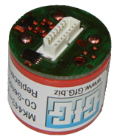
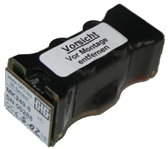
G888 / G999 sensors
IR, EC and O2 are plug and play “smart” sensors
CC and PID sensors installed in dedicated sensor positions
Smart sensors
EC-Sensors
IR-Sensors
Plug-in sensors
CC-Sensor
PID-Sensor

Slide 55
Lead free O₂ sensor detection principle
Oxygen passively diffuses into sensor where it is converted into H₂O
Power from instrument battery used to reverse the reactions and “pump” the O₂ back out
Reactions:
Sensing: O₂ + 4H⁺ + 4e⁻ 2 H₂O
Counter: 2 H₂O O₂ + 4H⁺ + 4e⁻
Amount electricity required to remove reaction product and return sensor to ground state (by generating O₂ at counter electrode) proportional to concentration of oxygen present

Slide 56
Lead free O₂ Sensor Advantages
Advantages:
Non-consuming detection technique (sensor does not lose sensitivity or consume itself over time)
No build-up of internal pressure over life of sensor
Limited electrolyte / nothing to leak!
No internal membranes which are subject to damage or stress due to pressure changes
Warranted for 5 years, expected life 5 to 6 years

Slide 57
Catalytic “Hot Bead” Combustible Sensor
Detects combustible gas by catalytic oxidation
When exposed to gas oxidation reaction causes the active (detector) bead to heat
Requires oxygen to detect gas!
Output
-
+
Signal
+VS
Detector
R1
+
Trimming resistor
D.C. voltage supply
VR1
-
Compensator
R2
-VS

Slide 58
Catalytic Sensor Structure
Catalytic combustion (CC) type LEL sensor is typically housed in robust, stainless steel flame proof enclosure
Gas molecules diffuse into sensor through flame arrestor
Once inside the sensor molecules diffuse to the active bead, where they are oxidized
Oxidation heats active bead to higher temperature. Difference in temperature is proportional to the concentration of gas.

Slide 59
Conditions created by oxidation of large molecules affects diffusion of molecules into the sensor
Oxidation occurs on step-by-step basis and proceeds only when molecules are in physical contact with catalyst coated surfaces within the bead
The very hot reaction by-products create convective currents as they rapidly diffuse away from the catalyst surfaces in the bead
Water vapor produced by oxidation of larger molecules creates a significant net outward flux, impeding diffusion of new molecules into the bead
Oxidation of methane: CH₄ + 2O₂ → CO₂ + 2H₂O
To oxidize one molecule CH₄ three molecules enter bead, and three molecules produced as by-products
Oxidation of pentane: C₅H₁₂ + 8O₂ → 5CO₂ + 6H₂O
To oxidize one molecule of pentane, nine molecules enter bead, and 11 molecules produced as by-products
Oxidation of nonane: C₉H₂₀ + 14O₂ → 9CO₂ + 10H₂O
To oxidize one molecule of nonane, 15 molecules enter bead, but 19 need to leave the sensor

Slide 60
Typical carbon number distribution in No. 2 Diesel Fuel (liquid)
Less than 2% of molecules in diesel vapor are small enough to be measured by means of standard LEL sensor

Slide 61
Non-dispersive infrared (NDIR) sensors
Many gases absorb infrared light at a unique wavelength
In NDIR sensors the amount of IR light absorbed is proportional to the amount of target gas present
Advantages:
Sensor cannot be poisoned
Does not require O₂ to detect gas
Can be used for high-range measurement
Responds well to large hydrocarbon molecules that cannot be measured by means of standard LEL sensor

Slide 62
Combustible gas NDIR sensor advantages and limitations
Limitations:
Molecule must include chemical bonds that absorb at the wavelength(s) used for measurement
Without sophisticated programming to correct readings, readings only accurate for the linearized gas used to calibrate the sensor
Not all combustible gases can be detected!
Hydrogen (H₂) cannot be detected
Acetylene cannot be detected at wavelengths used in portable instruments
NDIR sensors with short optical path-lengths have limited ability to measure gases with lower relative responses
Which gases can be detected depends on the sensor design!

Slide 63
Beer-Lambert Law
I₀ is the intensity of the incident light
I₁ is the intensity after passing through the material
L is the distance that the light travels through the material (the path length)
c is the concentration of absorbing species in the material
α is the absorption coefficient or the molar absorptivity of the absorber
I₁=I₀*e^{-αLc}
L
Optical path-length matters...

Slide 64
Performance of IR LEL sensors differs from performance of catalytic LEL sensors
Read the owner’s manual!
Make sure to verify with manufacturer before attempting to use the sensor to measure unsaturated hydrocarbons, aromatic VOCs or other gases not specifically listed in the owner’s manual!

Slide 65
GfG has better IR LEL sensor with better software
Long path length sensor allows excellent response to VOC and unsaturated HC gases
GfG software uses lookup table with linearized curves for gases in the on-board IR LEL library
Allows users to seamlessly switch from one gas to another

Slide 66
Why use photoionization detector equipped instruments?
For most VOCs, you exceed the toxic exposure limit long before you reach 10% LEL
PID equipped instruments are generally the best choice for measurement of VOCs at exposure limit concentrations
Whatever type of instrument is used to measure these hazards, it is essential that the equipment is used properly, and the results are correctly interpreted
The type of PID sensor you use matters!

Slide 67
Planar "3D" 2-electrode PID design
PID design:
Gap between window and electrodes increases "quenching" effect of water vapor on signal
Potential for drawing particulate contaminants into sensor
More ionic fragments left behind to be adsorbed onto electrodes and window
Results:
Increased sensitivity to water vapor and humidity
Dangerously inaccurate (low) readings
Must clean lamp more frequently

Slide 68
3-electrode PID Design
PID design:
Diffusion design includes "fence electrode" to provide mechanical short circuit between sensing and counter electrodes
Electrodes housed in replaceable "stack"
Diffusion of molecules into and out of glow zone means less ionic fragments or particulates left behind
Results:
Reduced "moisture leakage" response due to humidity
More accurate readings
Clean lamp less frequently

Slide 69
Advantages compared to G450, G460 and MP-2 pump
G888 and G999
More compact
Charging contacts easier to clean
Both sets of contacts used for charging (in G450 / G460 only one set used for charging)
Man-down alarm standard
Flashlight LED standard
G999
4 cell NiMH battery pack with double the power
Optional internal pump
Shutter type on / off switch
Pump does not draw power when off
G999 operates in diffusion when pump off
G888 G450 G999 G460

Slide 70
Advantages compared to G450, G460 and MP-2 pump
Datalogger
Datalogging standard
Up to 12 measured values recorded simultaneously
30,000 logged intervals in on-board memory
Communication
Optional ISM RF wireless
Wired PC communication (through cradle) up to 3 times faster
IrDA interface is now part of the basic equipment
Bluetooth optional (near future)

Slide 71
Optional ISM wireless RF communication
General information
Wireless RF option must be specified at time of purchase – cannot be added later
Use plug-in RF dongle for laptop base station, or
Use TeamLink server for complete 1 – 10 unit local system (no computer required)
915MHz wireless module
For use in the USA and Canada
Without channel selection due to frequency hopping
Range approx. 1000 feet (300m) line of sight (data transfer rate 38,400 baud)
868MHz wireless module
For use in Europe and (some) countries in Latin America
Channel selection: 101…111 and 129…132 (in the 50kHz grid)
Range approx. 2,300 feet (700 meter) line of sight (data transfer rate 2400 baud)

Slide 72
Operation time per charge depends on configuration
G888 examples
approx. 13h EC+CC+IR
approx. 14h EC+CC+915 MHz wireless
approx. 23h EC+CC
approx. 24h EC+IR
approx. 26h EC+915 MHz wireless
approx. 65h EC
G999 examples
approx. 17h EC+IR + Pump
approx. 20h EC+CC+IR+915 MHz wireless
approx. 22h EC+PID+IR+915 MHz wireless
approx. 25h EC+WT
approx. 26h EC+CC+IR
approx. 52h EC+915 MHz wireless
approx. 130h EC

Slide 73
TeamLink Server
Wireless data link for 4 and 10 gas detectors
Clone display of any instrument in network
Display for gas alarm, measured value and man-down
Data forwarding to base station
LED panel for a quick overview
Future version: Communication with base station via GSM
Advantages of the basing TeamLink on G999
Shares same power supply, display and other components (making certification easier)
Same charger cradle
Same leather holster

Slide 74
Wirelessly integrated fixed and portable systems
Fixed gas transmitters equipped with WILAN or ISM RF gateways
Realtime readings from fixed and portable instruments displayed on same monitor or PLC

Slide 75
G888 / G999 Visualization Software
General
Display of online measured gas from up to 20 devices on the PC
Sending short messages to G888 / G999 users (pager function)
Simulation of G888 / G999 measurements for training purposes
Hardware Requirements
Android tablet or smart phone, or Windows laptop or desktop PC
915MHz-USB dongle for laptop base station (868MHz-USB donngle for Europe)
G888/G999 with corresponding wireless modules

Slide 76
G888 / G999 Visualization Software

Slide 77
GfG Instrumentation
Best cost of ownership in the gas detection industry!
Very competitively priced, especially compared to BW, RAE and MSA!
Typical MSRP pricing examples:
G999 four gas Pumped
NiMH: $1395.00
G450 4 gas
Alkaline: $755.00
NiMH: $825.00
G888 four gas NiMH: $995.00
G460 5 gas
(O₂ / LEL / CO / H₂S/ SO₂) Alkaline: $1220.00
NiMH: $1340.00

Slide 78
Support Materials on www.goodforgas.com Comparative features GfG portables

Slide 79
Support Materials on www.goodforgas.com Comparative features GfG portables

Slide 80
Support Materials on www.goodforgas.com Comparative features GfG portables

Slide 81
Support Materials on www.goodforgas.com Product by Product Comparisons

Slide 82
Support Materials on www.goodforgas.com Product by Product Comparisons

Slide 83
Support Materials on www.goodforgas.com Product by Product Comparisons

Slide 84
Support Materials on www.goodforgas.com Product by Product Comparisons

Slide 85
Thanks for the opportunity to discuss what’s going on at GfG, Inc!

