Slide 1
GMA200
Visualization software Version 1.0.3

Slide 2
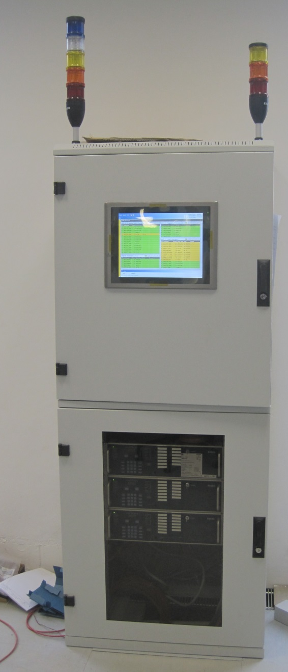
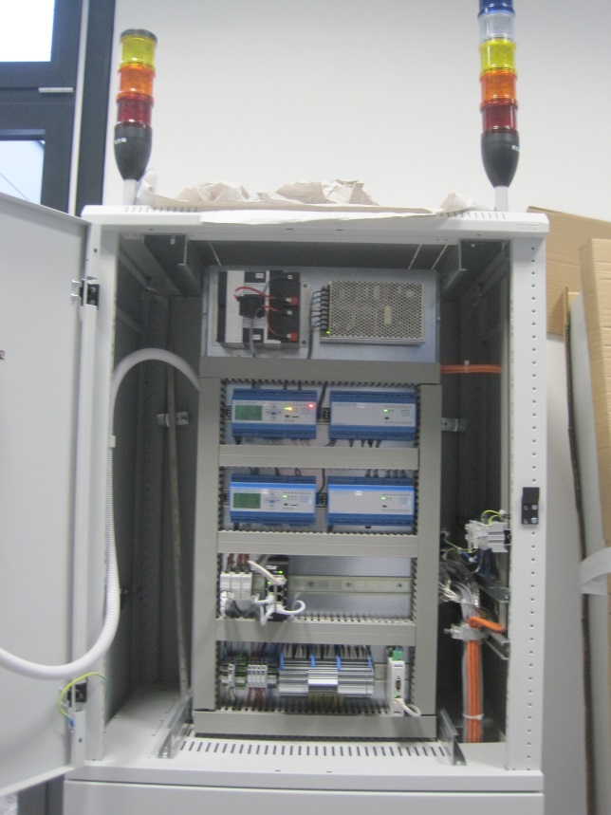
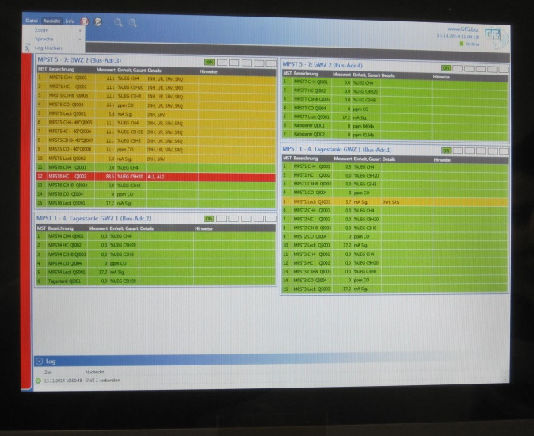
Example: 32 point GMA 200MT system in cabinet with touch screen PC controller
GfG Visualization software allows touch screen PC or laptop to be used as remote terminal or full function GMA system controller

Slide 3
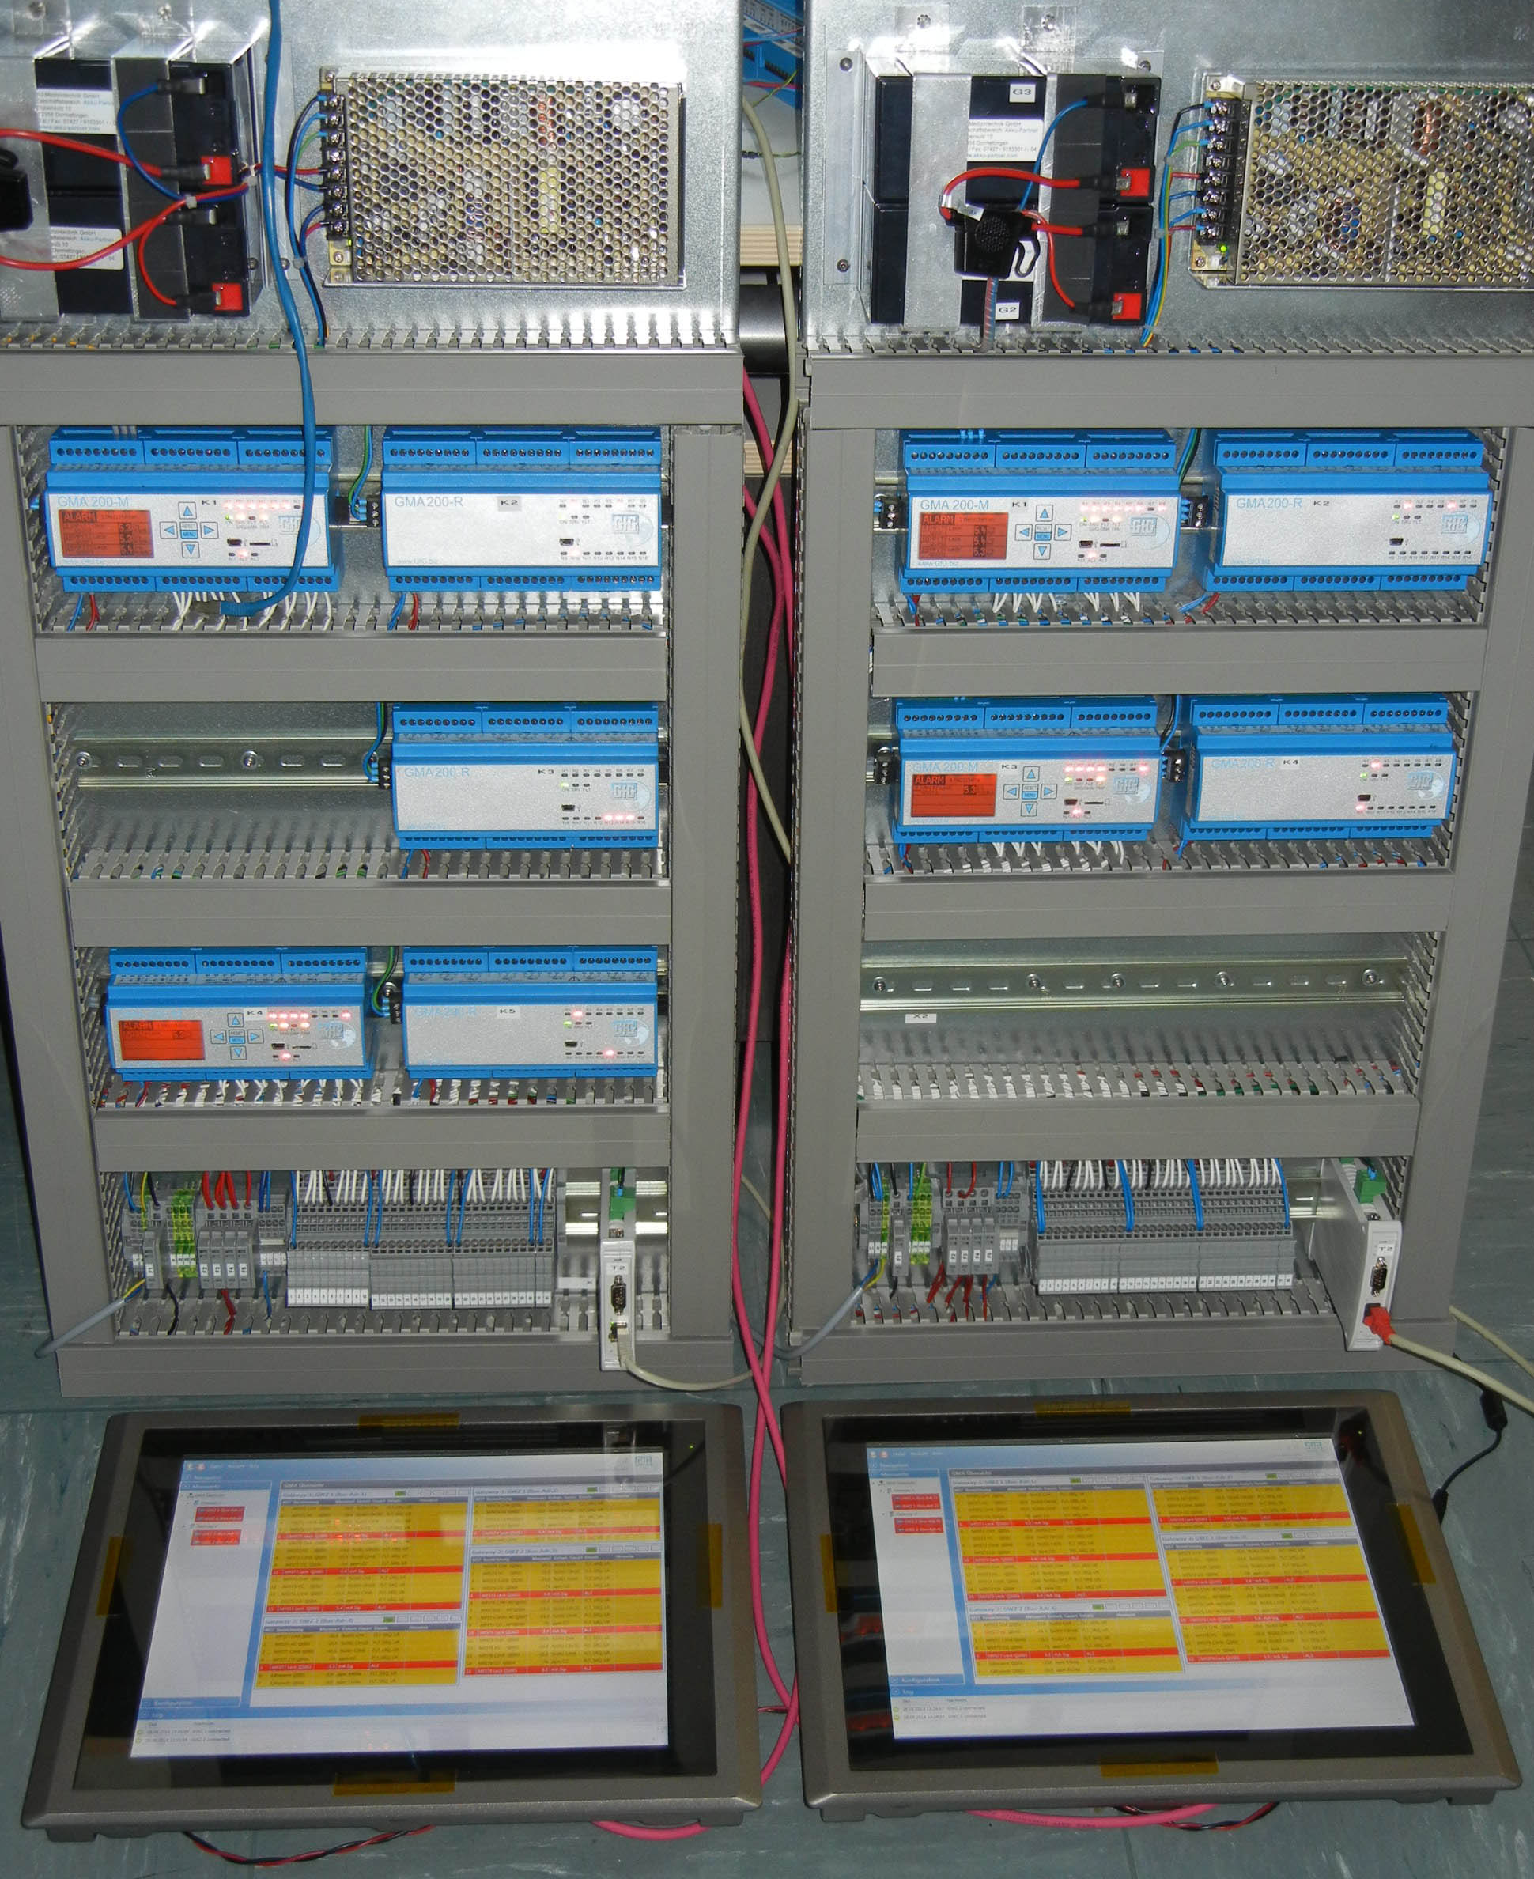
Example: 50 point GMA system with four 200MT controllers, five GMA200RT remote relay modules and two touch screen PC controllers

Slide 4
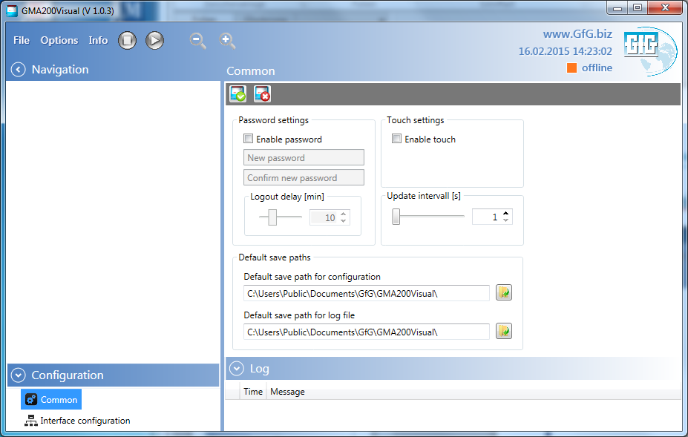
GMA200 Visualization – Common configuration

Slide 5
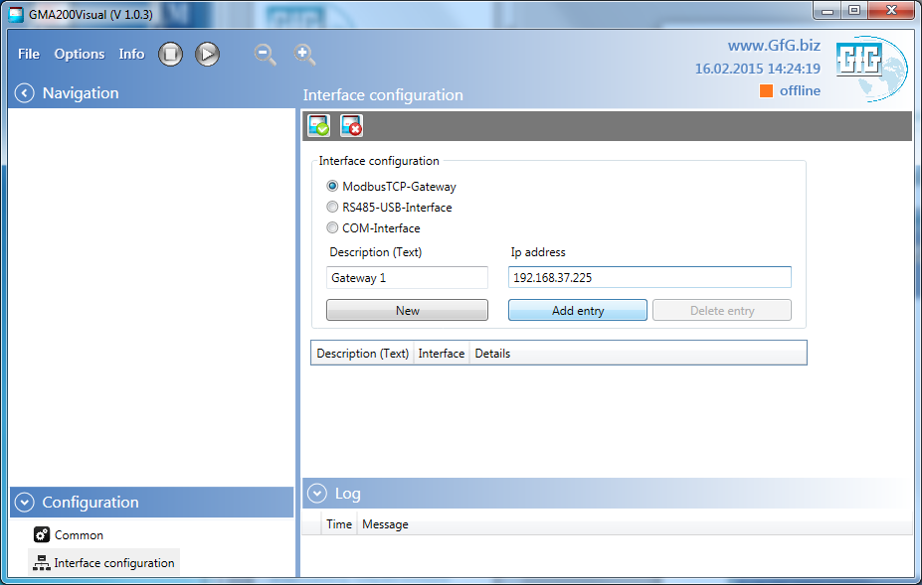
GMA200 Visualization – Interface configuration (gateway)

Slide 6
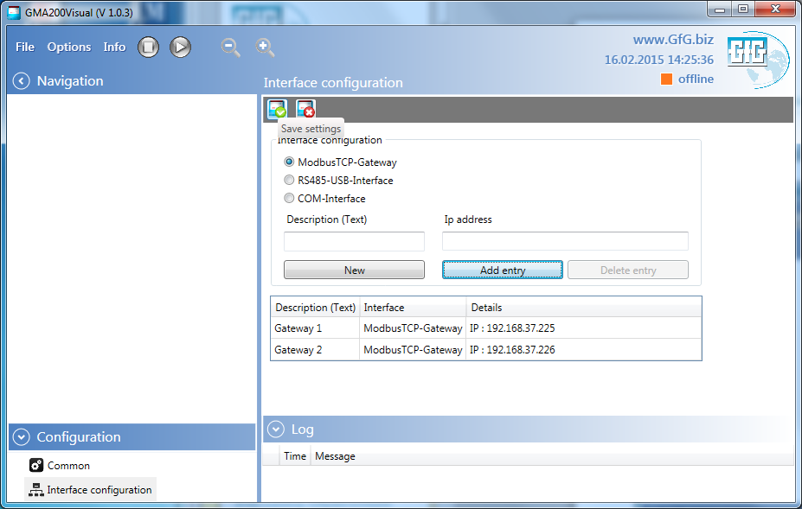
GMA200 Visualization – Interface configuration (gateway)

Slide 7
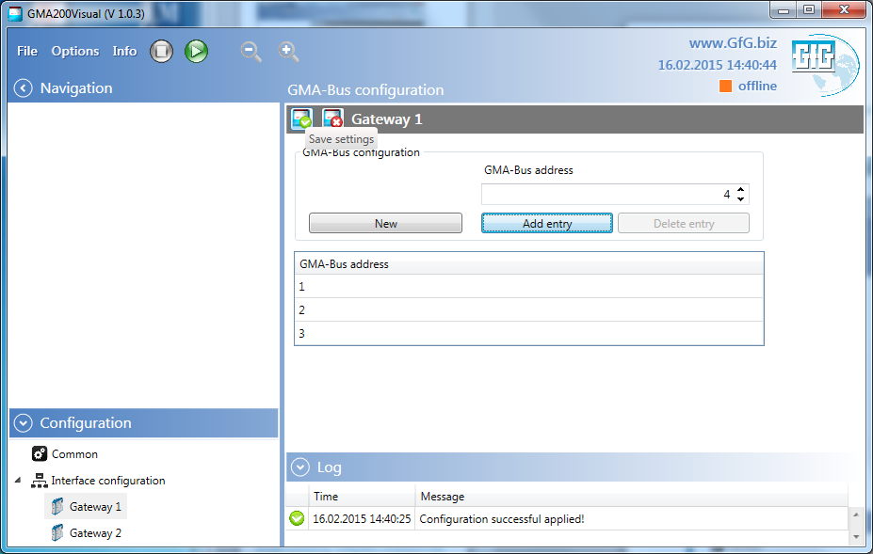
GMA200 Visualization – GMA-Bus configuration (addresses)

Slide 8
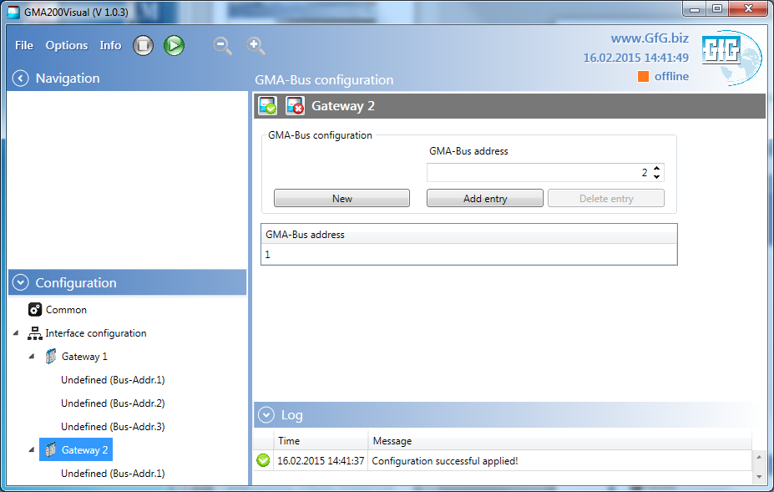
GMA200 Visualization – GMA-Bus configuration (addresses)

Slide 9
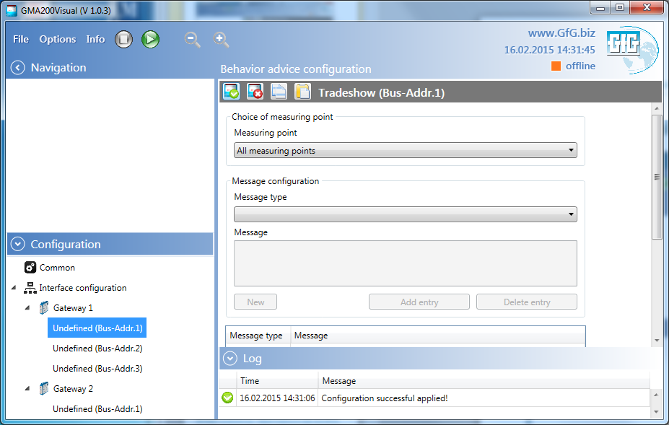
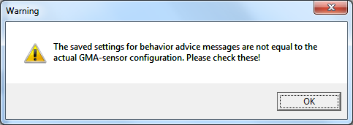
GMA200 Visualization – Configuration of behavior advices

Slide 10
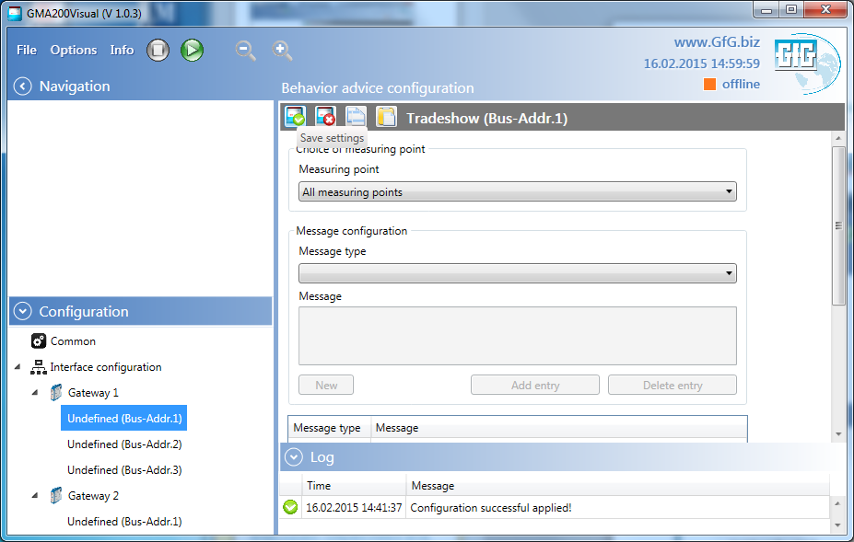
GMA200 Visualization – Configuration of behavior advices

Slide 11
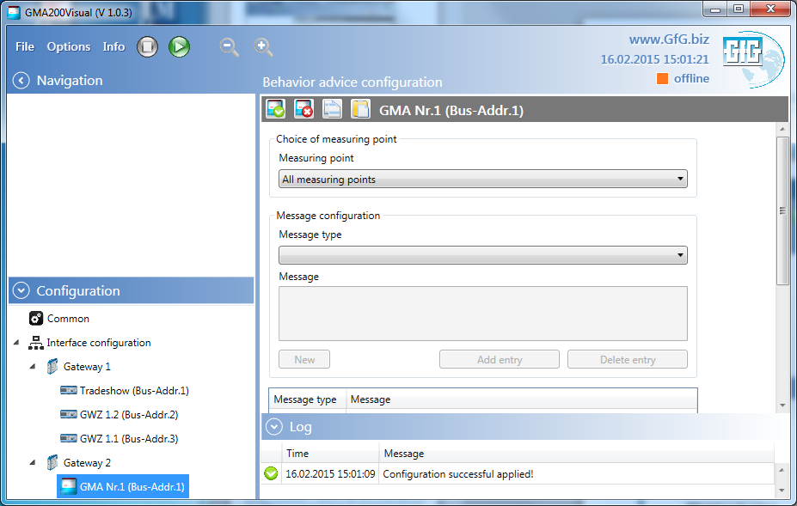
GMA200 Visualization – Configuration of behavior advices

Slide 12
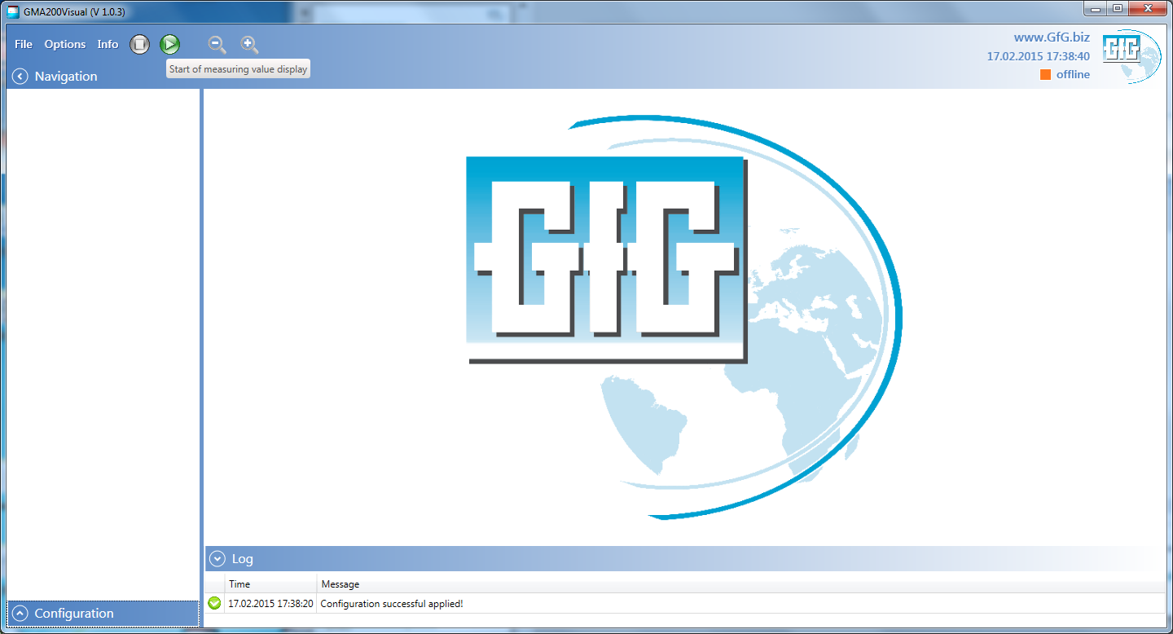
GMA200 Visualization – Start of measuring value display

Slide 13
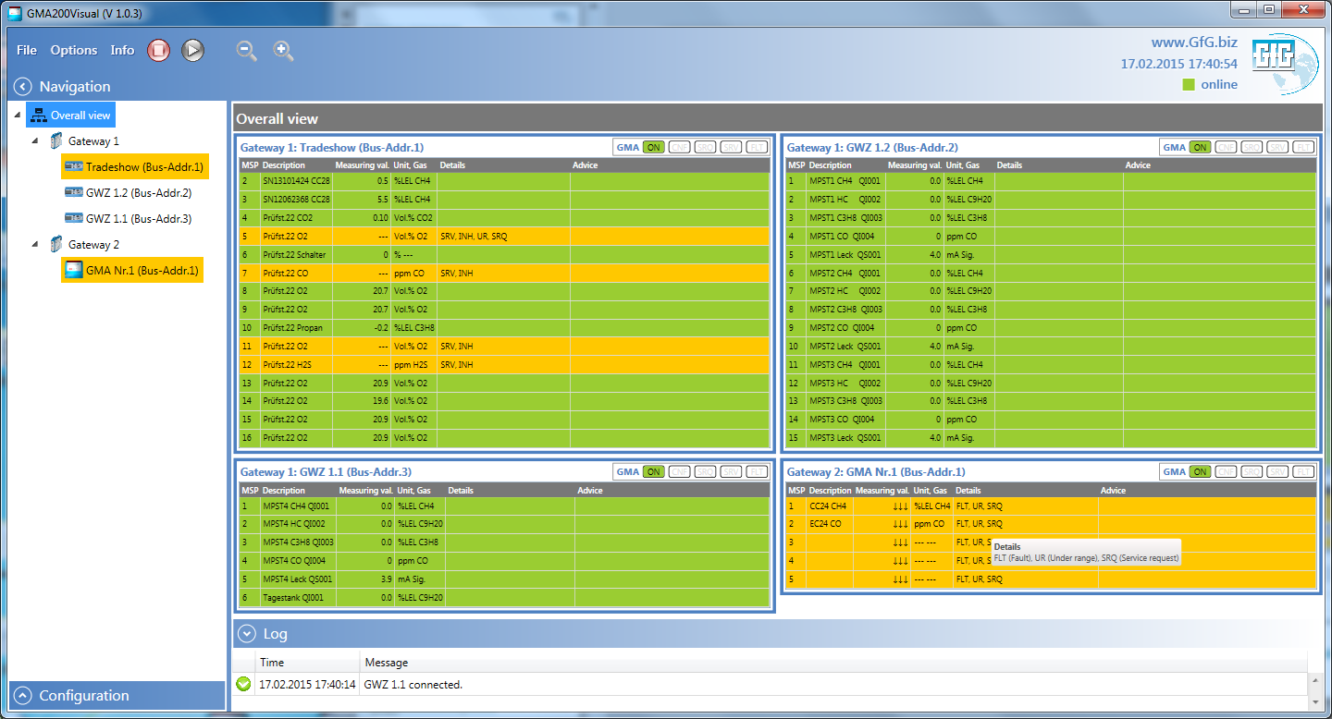
GMA200 Visualization – Overall view

Slide 14
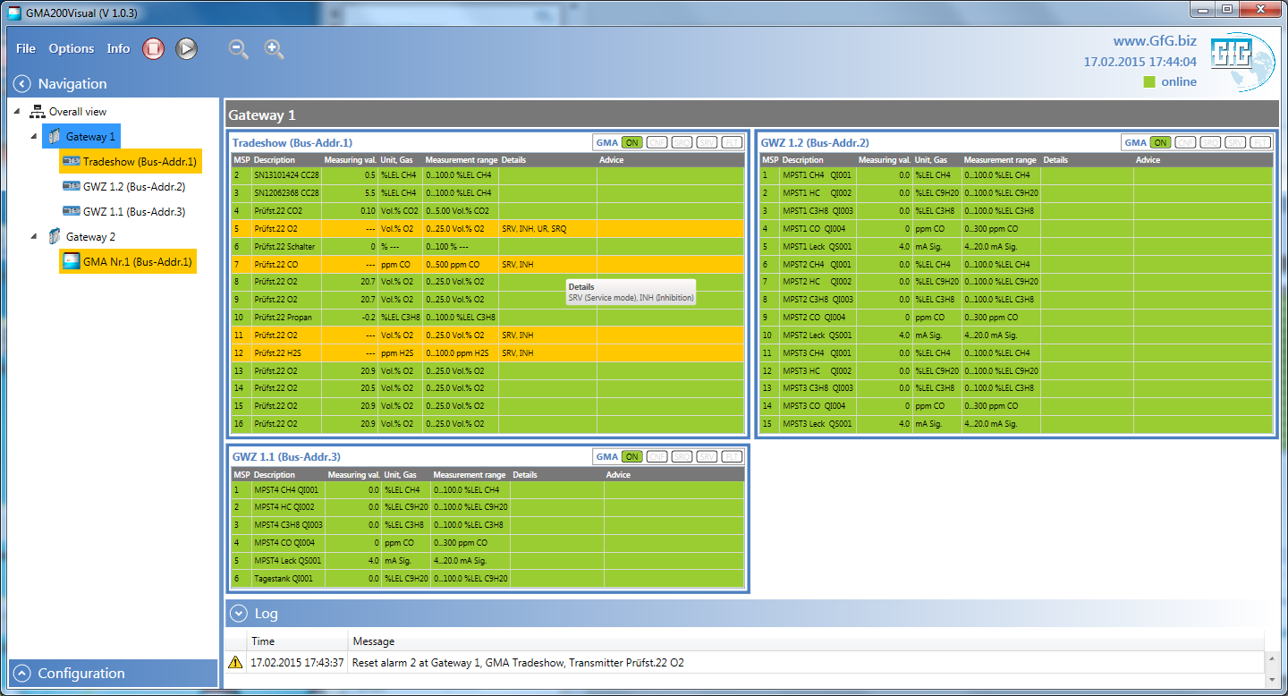
GMA200 Visualization – GMAs connected to Gateway 1

Slide 15
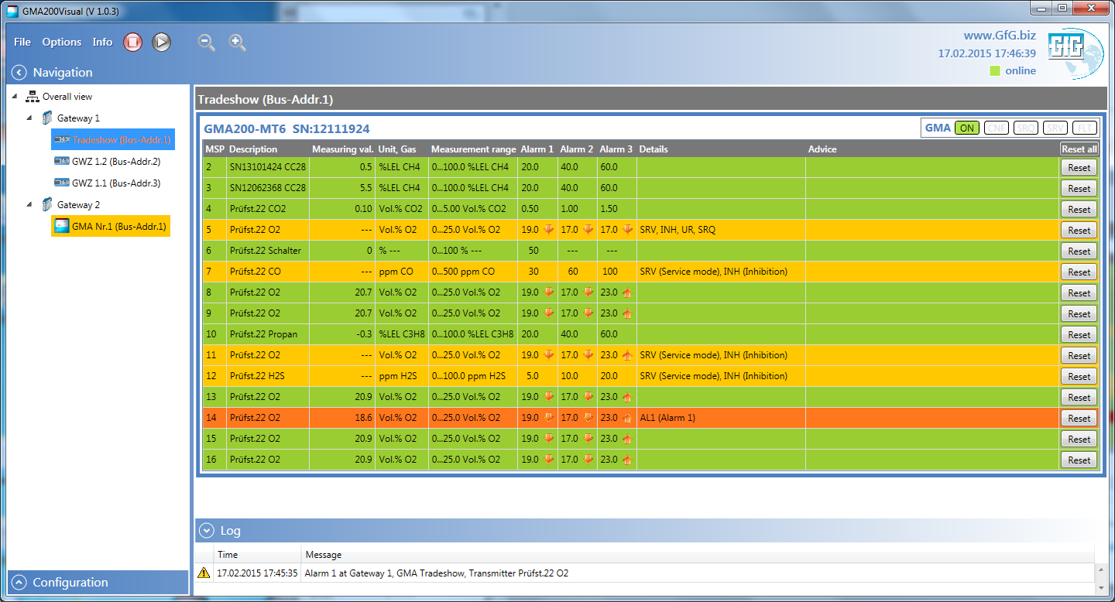
GMA200 Visualization – Single View (GMA with alarm 1)

Slide 16
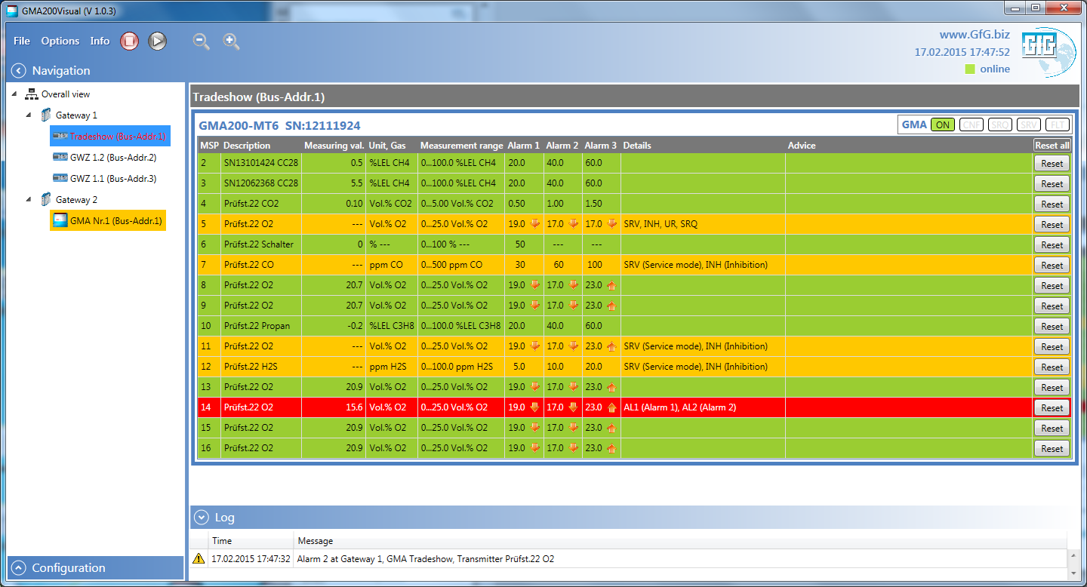
GMA200 Visualization – Single View (GMA with alarm 2)

Slide 17
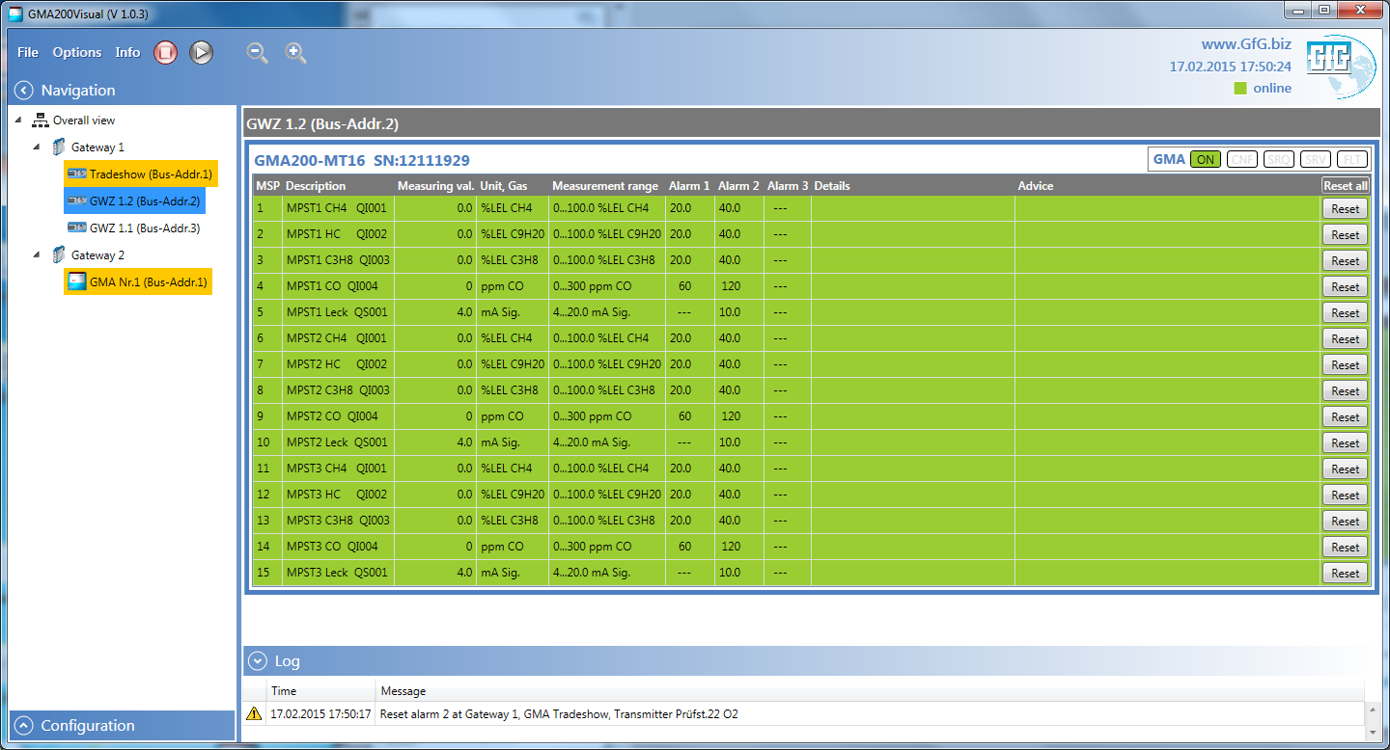
GMA200 Visualization – Single View (GMA w/o alarm)

Slide 18
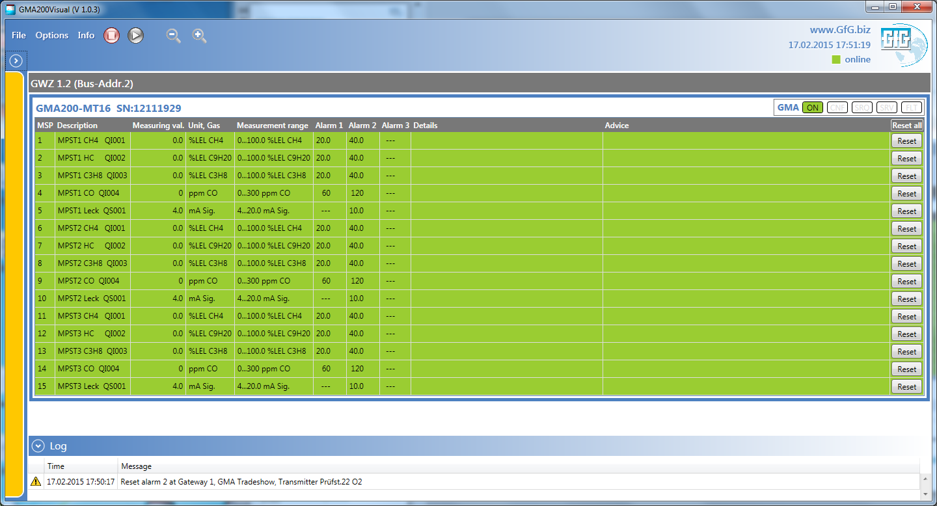
GMA200 Visualization – View w/o Navigation (Fault)

Slide 19
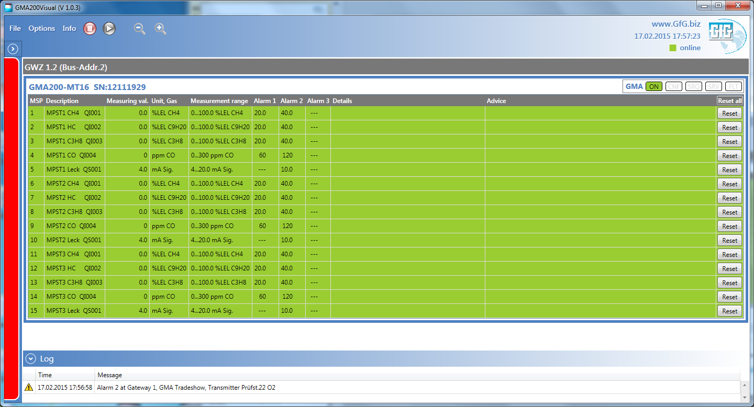
GMA200 Visualization – View w/o Navigation (Alarm)

Slide 20
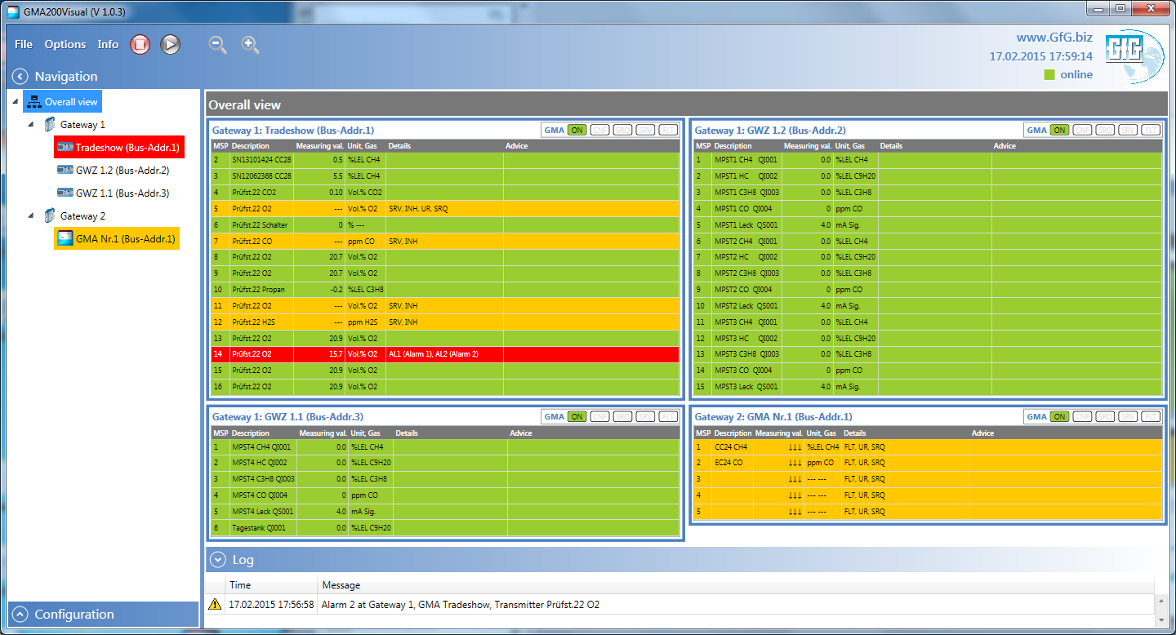
GMA200 Visualization – Overall view

Slide 21
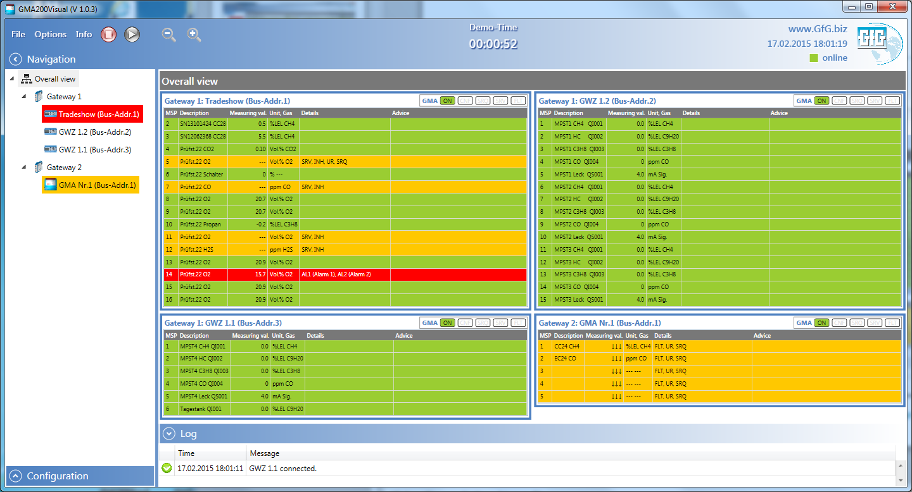
GMA200 Visualization – Software Demo-Time

Slide 22
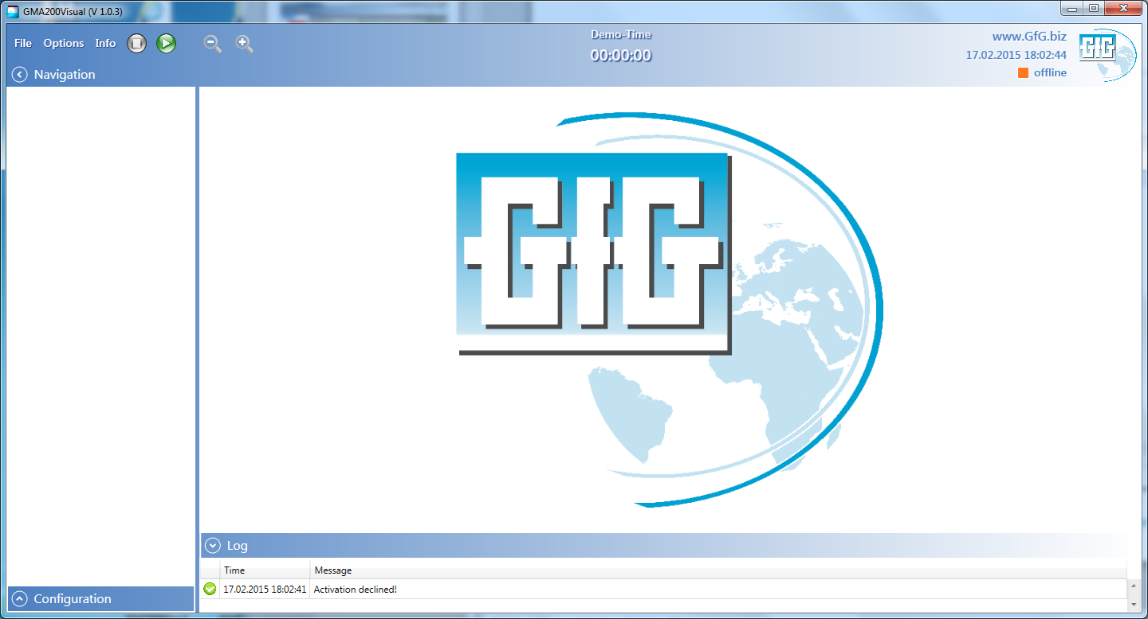
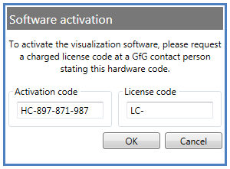
GMA200 Visualization – Software activation

Slide 23
Thank you for your attention!

