Slide 1
G450 and G460 battery pack maintenance
GFG Instrumentation Inc.
1194 Oak Valley Drive
Ann Arbor, MI 48108
Toll free: (800) 050-0329
Direct: (734) 761-0573
Internet: www.gfg-inc.com

Slide 2
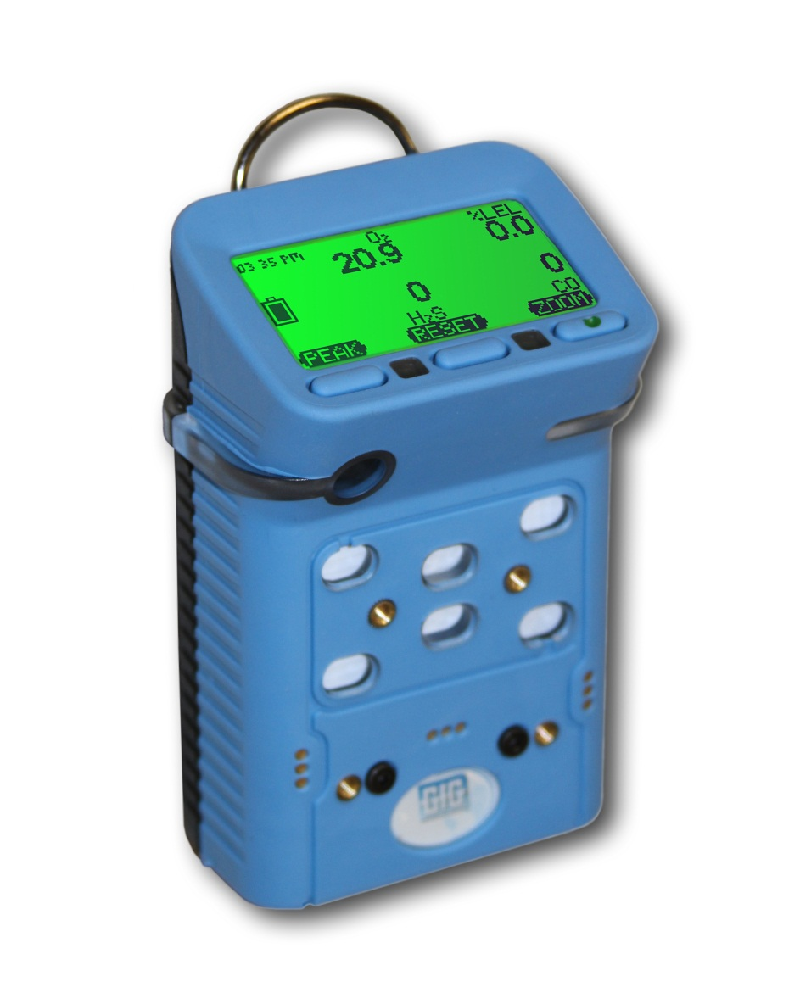
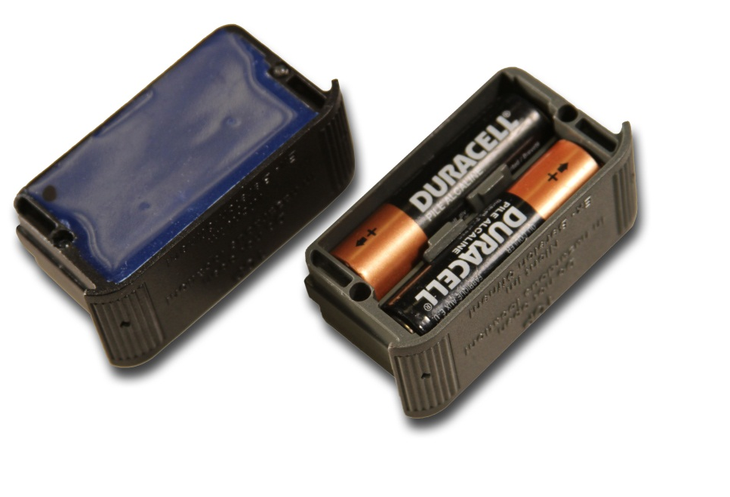
G450 / G460 Multi-Gas Detector
Interchangeable rechargeable (NiMH) and alkaline battery packs last up to 25 hours
NIMH batteries provide excellent cycle life and low temperature performance
NIMH battery packs warranted for 2-years
Typical run-time after two years for properly maintained battery pack is usually around 16 hours

Slide 3
Expected G450 / G460 run times
*All configurations include O2 and CO/H2S sensors as well as the listed “high power” sensors

Slide 4
Expected G450 run times as function of temperature

Slide 5
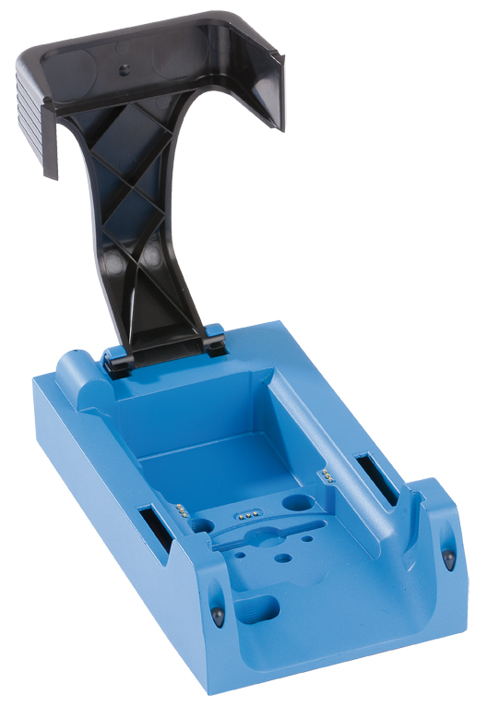
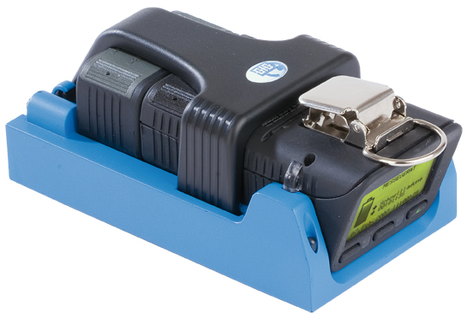
G450 / G460 Drop-in Charger
Smart charger includes trickle charge mode to prevent damage to battery pack due to overcharging
Available in single and double versions
Available for use with 12 VDC vehicle charging system

Slide 6
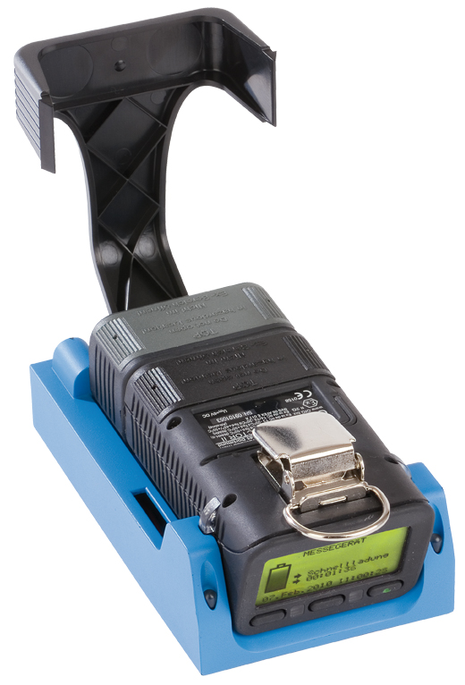
Optional G450 / G460 Drop-in Charger for Pump Equipped Instruments
Charger simultaneously charges both pump AND instrument
Available for use with 12 VDC vehicle charging system

Slide 7
G450 / G460 Charging Cycle
GfG smart chargers begin the charging cycle in the “fast charging mode”, then switch to “trickle charge mode” when the battery is charged to 90% of its full capacity
Completely discharged batteries may require up to 6 hours to reach the trickle charge stage
Note: If possible, leave the instrument in the charger for an additional one or two hours after reaching the trickle charge stage to reach 100% of the charge capacity of the battery

Slide 8
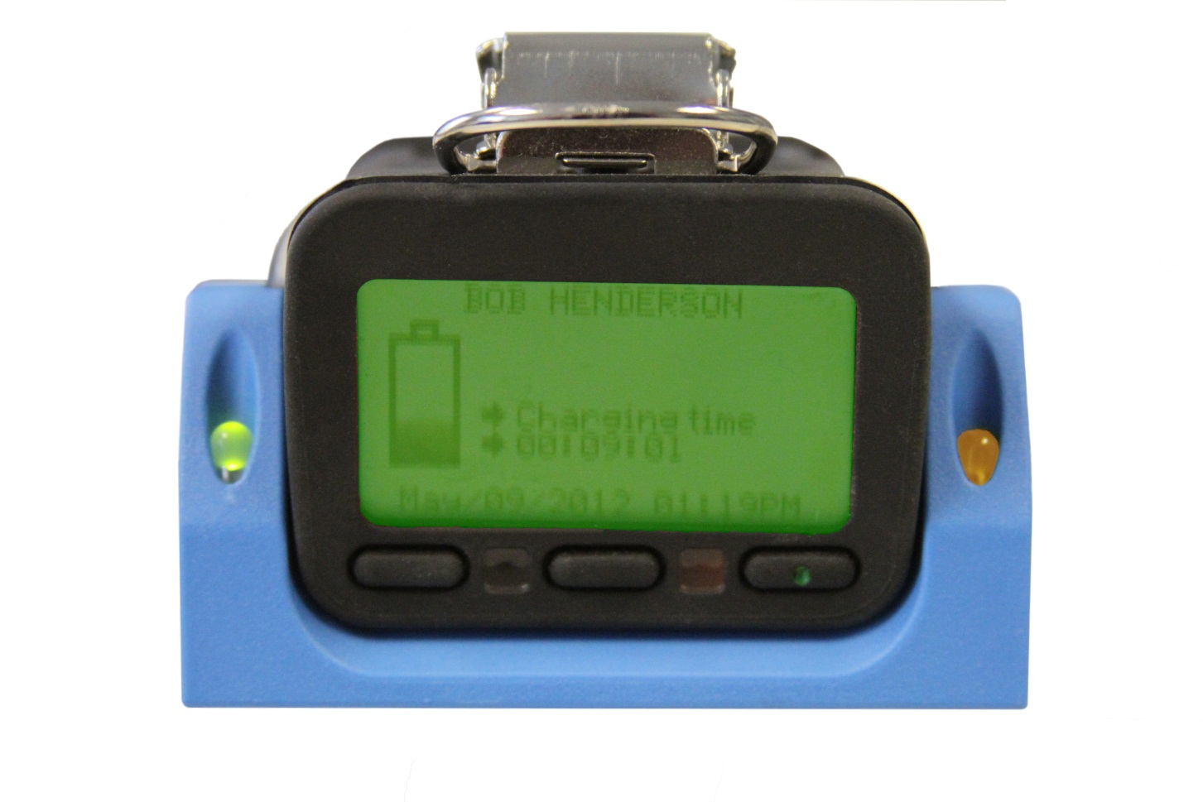
G450 / G460 Charging Cycle
The green LED in the “single” charger cradle indicates power
A solid amber LED indicates fast charging
A flashing amber LED indicates trickle charging
The instrument display indicates how long the instrument has been in each stage of the cycle
Solid amber indicates fast charging, flashing amber indicates trickle

Slide 9
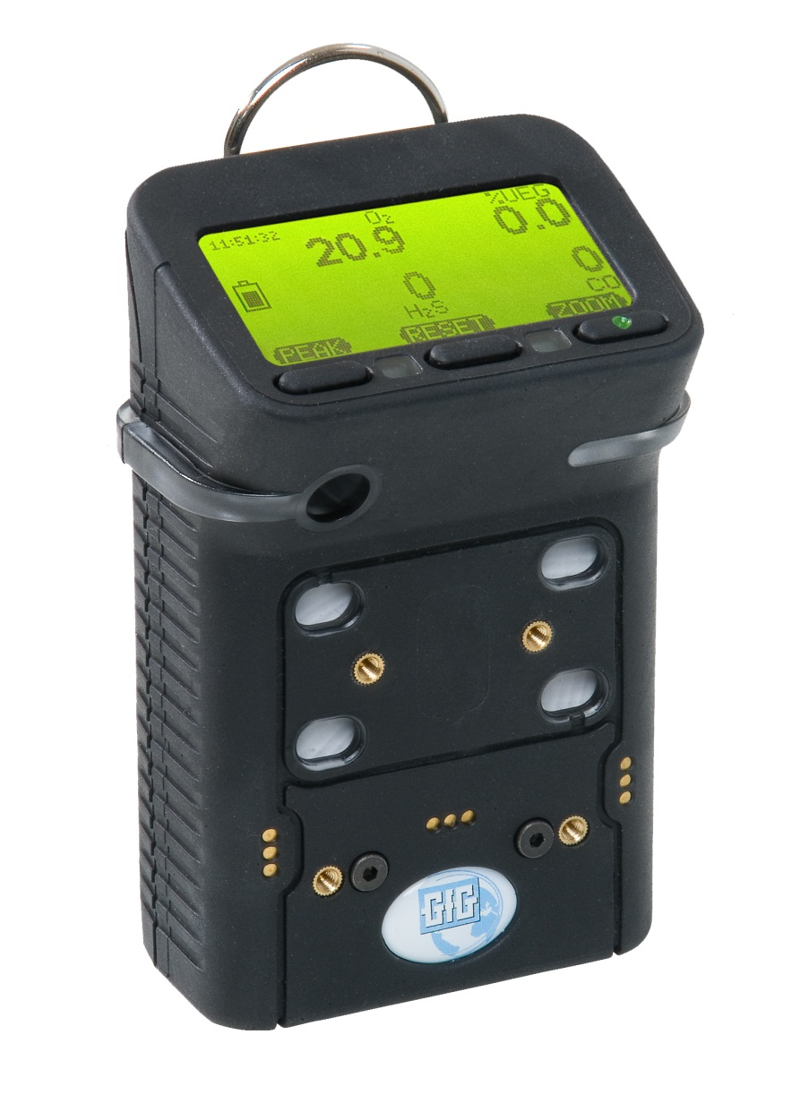
Battery pack location
Battery pack
Battery pack screws

Slide 10
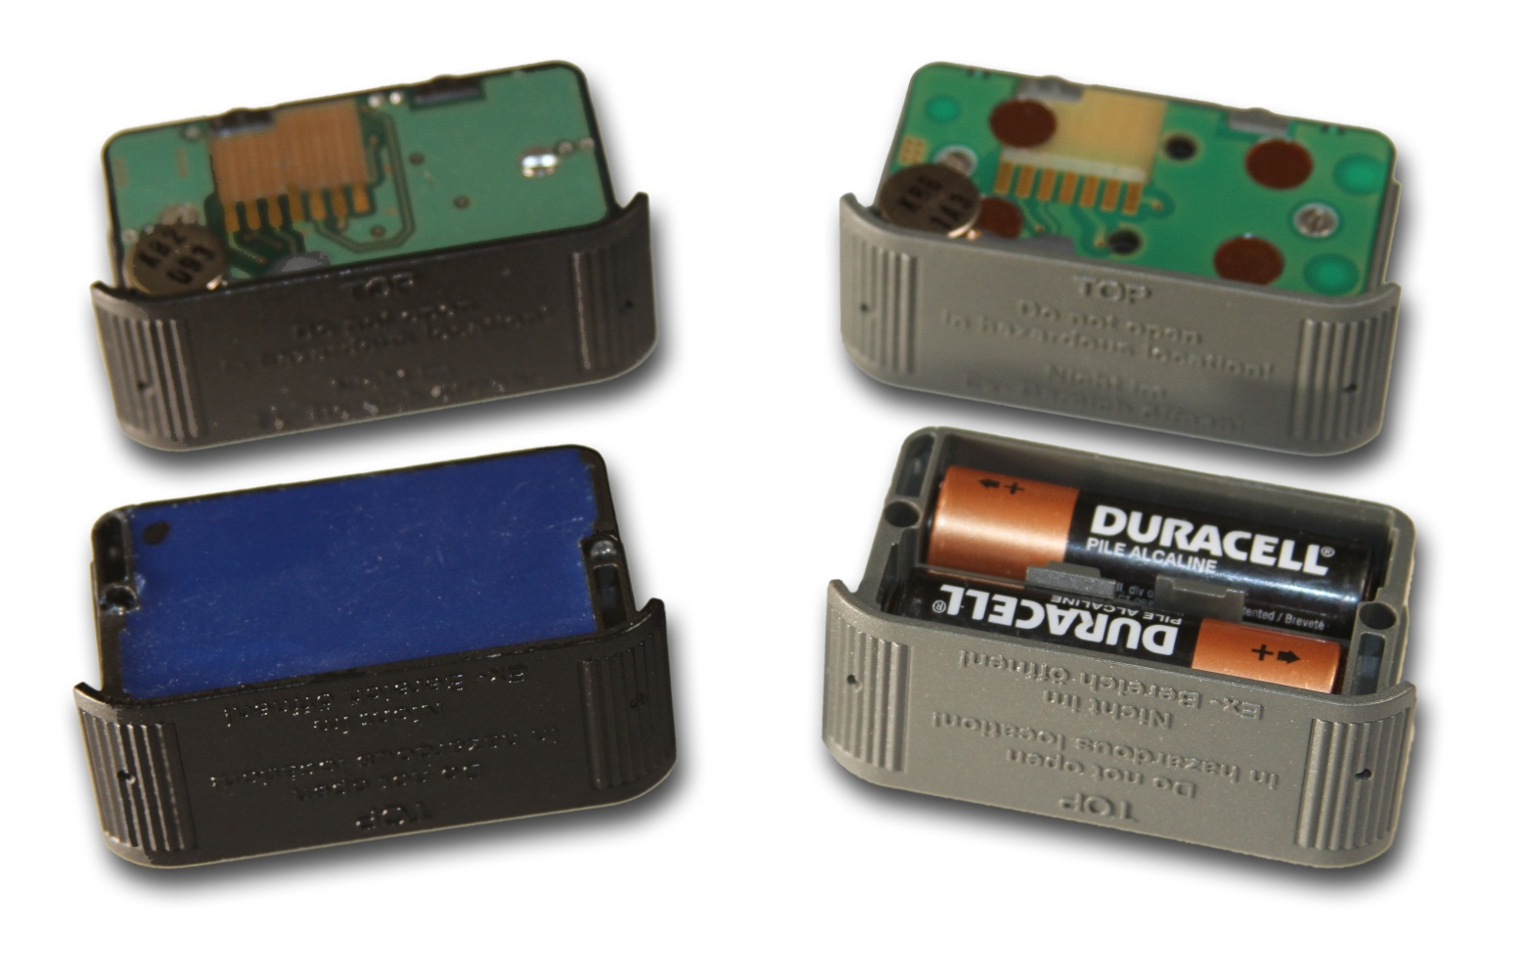
Changing battery packs
NiMH: Black
Alkaline: Gray

Slide 11
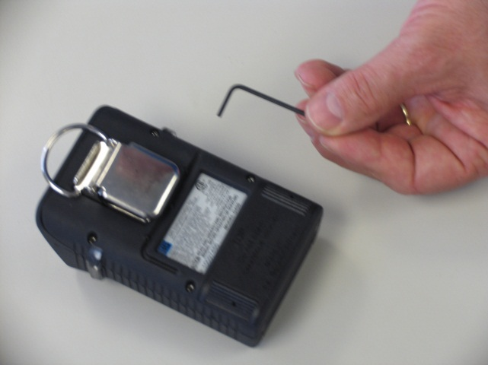
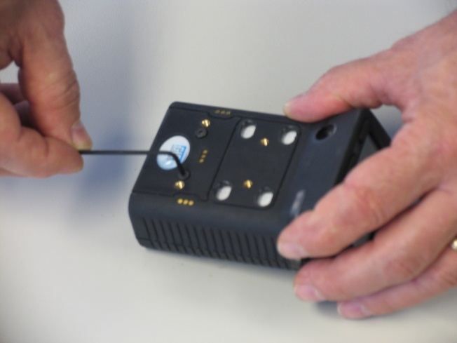
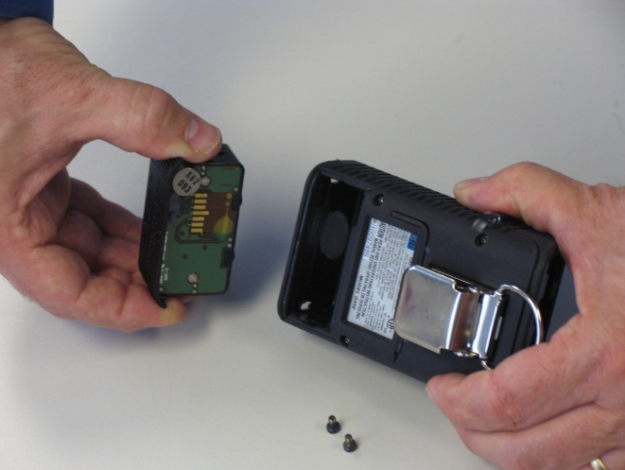
Changing battery packs
Use the hex wrench tool to loosen and remove the two screws securing the battery pack to front of the instrument housing
GENTLY remove the battery pack from the instrument
NOTE: USE YOUR FINGERS TO REMOVE THE BATTERY PACK FROM THE INSTRUMENT
NEVER USE A SCREWDRIVER OR OTHER HARD TOOL TO REMOVE THE BATTERY PACK

Slide 12
Changing battery packs
Make sure that the vibrator (the flat disc on the top of the battery pack is) is at the top when the battery pack is reinserted into the instrument
DO NOT FORCE WHEN INSERTING THE PACK INTO THE HOUSING!
Reinstall and tighten the screws
MAKE SURE SCREWS ARE SECURE BUT DO NOT OVERTIGHTEN!
Vibrator

Slide 13
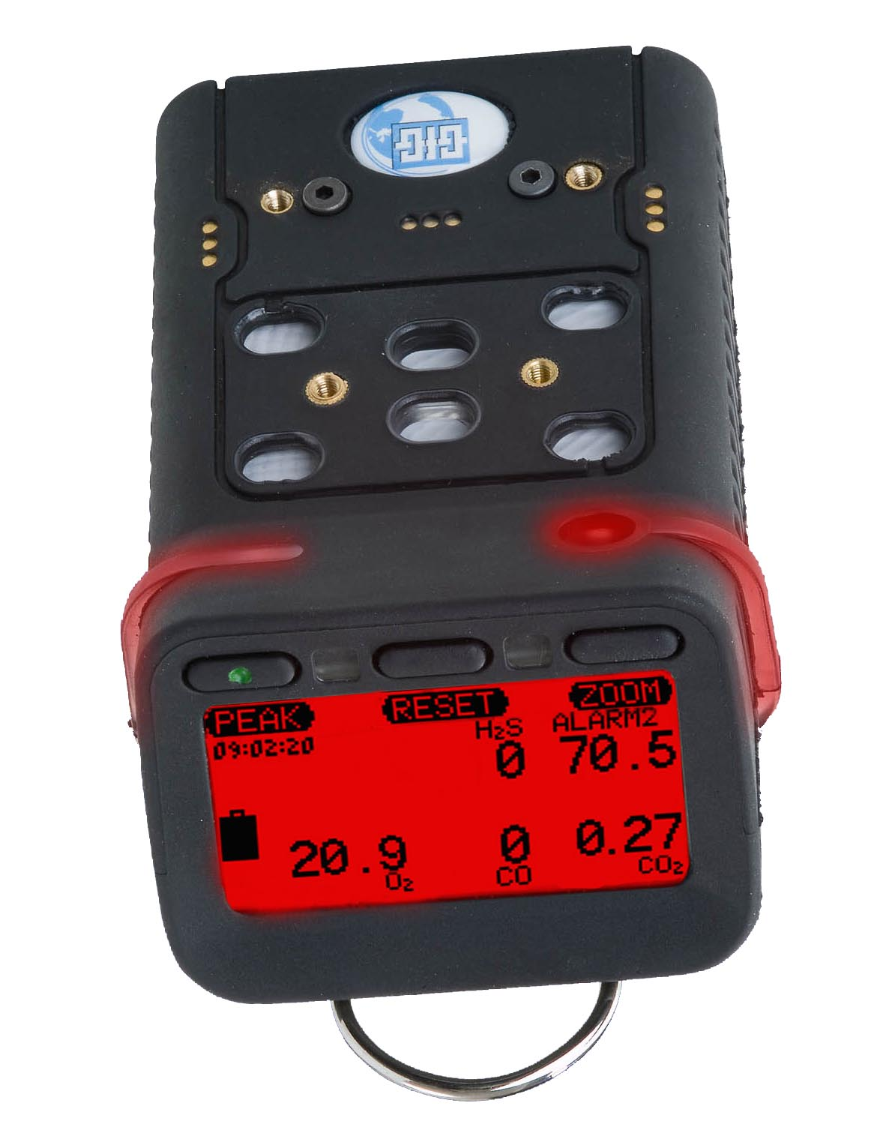
Voltage depression due to over-charging
NIMH batteries do not develop “memories”, however, if they are not exercised they may become “lazy”
Even though the normal amount of power is stored the battery, the peak voltage in “lazy” batteries drops more quickly than usual
Voltage depression is caused by the formation of small crystals of electrolyte on the plates, increasing resistance and lowering the voltage of some individual cells in the battery
To the user it appears the battery is not holding its full charge; to the instrument the rapid drop in voltage indicates that the batteries are about to run out of energy
Exercising the battery by putting it through a deep-discharge cycle can break down the crystals, and improve or restore the run time of the instrument

Slide 14
“Anti-lazy battery” deep-discharge cycle
Fully charged instruments that fail to operate for the expected time should be exercised by means of the “anti lazy battery” deep discharge cycle
Note: Instruments that are left on the charger for prolonged periods between use may benefit from being exercised by being deep discharged on a quarterly basis

Slide 15
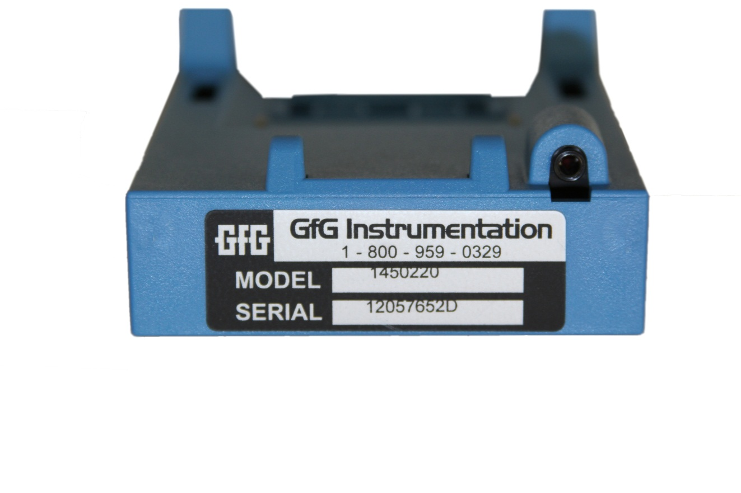
Charger cradle hardware compatibility
G450 and G460 instruments with version 3.41 and higher firmware have enhanced “anti-lazy battery” as well as other features
GfG recommends updating your instrument firmware to take advantage of these enhanced features
To take full advantage of the latest anti-lazy battery options it is also necessary to have the latest version charger cradle and power adapter
Note: Charger cradle and power adapters sold prior to October, 2011 can be updated at the GfG factory in Ann Arbor to the latest configuration
Cradle serial numbers ending in “D” indicate the latest version
Power adapter must be equipped with “stereo” type jack with two black stripes

Slide 16
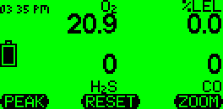
Main menu screen
Press and hold down “Reset” button until “Main menu” choices appear:
Location (use to enter a location name)
User (use to enter a user ID number)
Datalogger (use to adjust the datalogging interval)
Confidence blip (use to activate a periodic alarm “beep” while instrument is turned on
Service (use to access the “Service Menu”)
AutoCal® (use to make either fresh air or span calibration adjustment)
Options (use to adjust display contrast, alarm loudness or activate “Anti Lazy Battery” option)

Slide 17
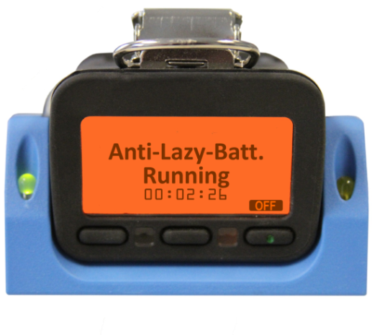
One-time deep discharge cycle for NiMH battery pack
From “Option Menu” choose “Anti-Lazy-Battery”
Press “Change” to turn on the one-time deep discharge feature
Display will show “1X” instead of “Off”
Press “Exit” to return G450 to normal operation
DO NOT TURN THE INSTRUMENT OFF!
Allow to run until battery completely drained, then recharge normally, OR
When down to last 10% of battery place instrument in charger
Do not place in charger until battery icon shows it is down to the last 10% remaining voltage
Instrument will complete anti-lazy battery deep discharge, then charge normally

Slide 18
Automatic deep discharge cycle
It is possible to program the instrument so the deep discharge cycle is always automatically activated whenever the instrument is placed in the charger when the battery is below 10% remaining voltage
From “Options” choose “Anti-Lazy-Battery” then press “Change” to activate the one-time deep discharge cycle (display will show “1X” )
Press “Change” again to choose “Days”
Anytime the instrument is placed in the charger when there is less than 10% remaining voltage the deep discharge cycle will be activated automatically

Slide 19
Limiting automatic deep discharge cycle to certain days
Since deep-discharge can take up to 20 hours to complete, it may be advisable to limit automatic deep-discharge to certain days of the week (i.e. enabling the feature for Fridays to give the instrument a full weekend to complete discharging and recharging)
Press the “down arrow” key to highlight the “Anti-Lazy days” choice, then press “Change”
The instrument will display the days of the week
Select the desired days for the automatic activation of this feature, then “Exit” to return to normal operation

Slide 20
Automatic deep discharge cycle
Pressing “Off” while the instrument is in the charger immediately ends the deep-discharge cycle, and returns the instrument to normal charging
Press “Off” to immediately end deep discharge

Slide 21
Questions?

