Slide 1
G450 / G460
Overview of features and capabilities
GfG Instrumentation, Inc.
1194 Oak Valley Drive, Suite 20
Ann Arbor, Michigan 48108
Toll free (USA and Canada): (800) 959-0329
Direct: +1-734-769-0573
Service e-mail: service@gfg-inc.com
Internet: www.gfg-inc.com
Technical documentation and download site: www.goodforgas.com

Slide 2
Overview of G450 / G460 Features

Slide 3
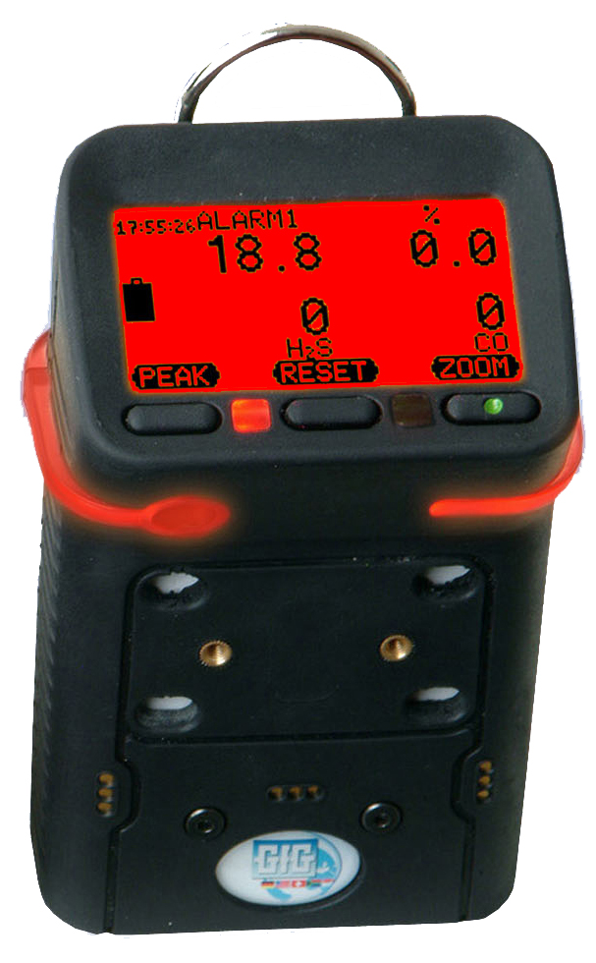
G450 Confined Space Gas Detector
One to four sensors
Full 3-year warranty on all sensors
Optional 6-year warranty on all sensors
O2 sensor rated for continuous use in – 30°C temperatures
Interchangeable reechargeable (NiMH) or alkaline battery packs last 25 hours per charge
Super durable IP-67 water resistant design
Only $695.00 USD list price (alkaline)
Only $745.00 USD list price (rechargeable)

Slide 4
G460 Multi-gas Monitor
Up to SEVEN channels detection
Comprehensive range of interchangeable smart sensors:
LEL, O2, CO, H2S: 3-year warranty
Infrared combustible gas: 3-year warranty
Infrared CO2: 3-year warranty
Most other substance-specific EC toxic: 2-year warranty
PID lamp: 1-year warranty

Slide 5
G450 / G460 Optional 6-year Sensor Warranty
3-year warranty on O₂, LEL, CO and H2S sensors still standard
Standard lifetime warranty on instrument
6-year sensor warranty option available for additional $250.00 at time of purchase

Slide 6
G450 / G460 Optional 6-year Sensor Warranty

Slide 7
Easy to use!
Basic operation is extremely simple
Single on-off button all that is needed for most day to day use
Every instrument shipped complete with operations manual

Slide 8
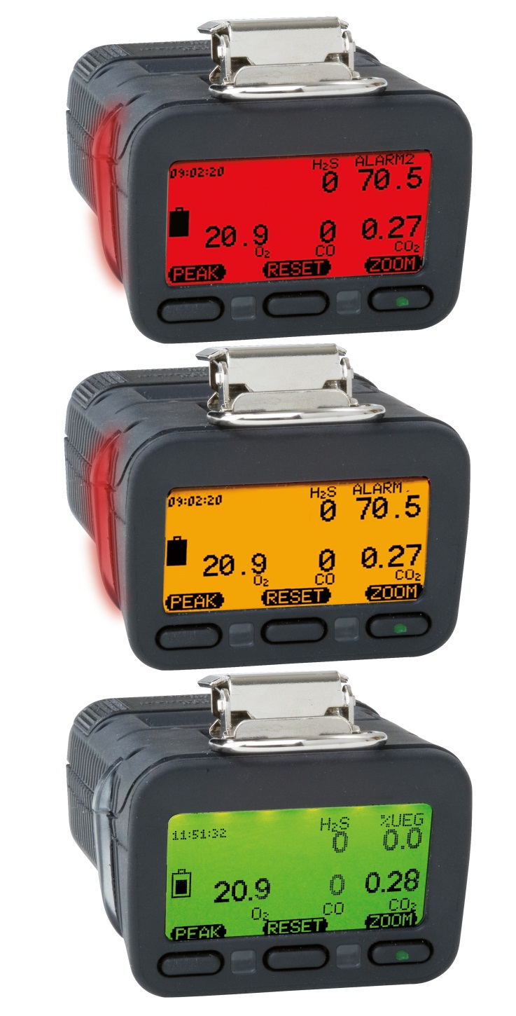
Three color "Traffic Signal" display
Back lit three-color full graphics LCD
Top mounted display with wrap around (360º) LED alarm indicator
LCD includes flip and zoom functions

Slide 9
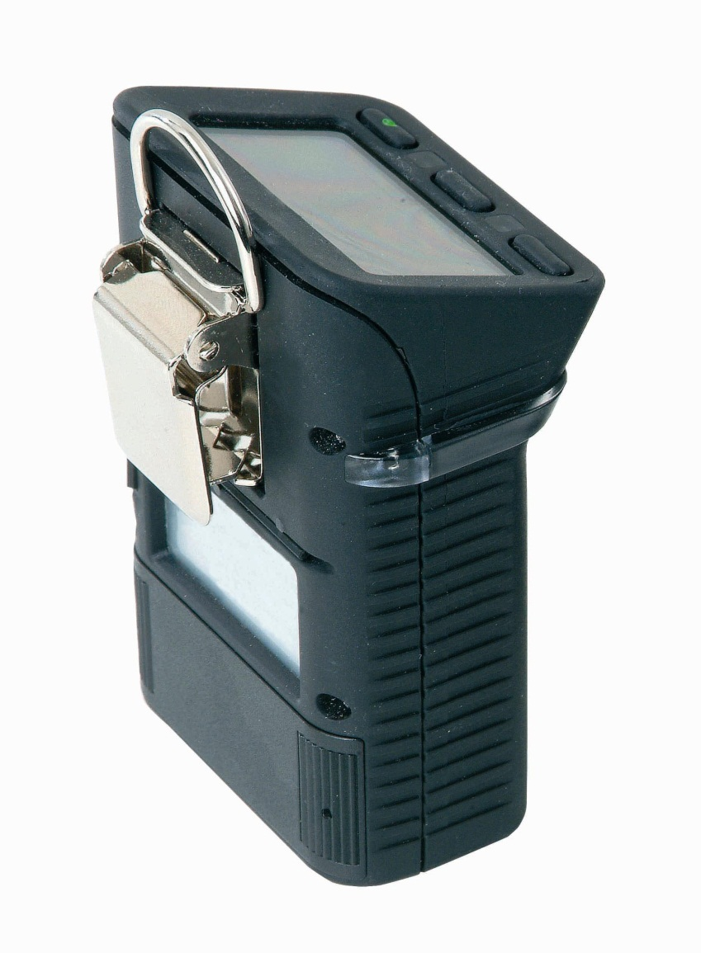
Rugged design
Rugged, double shot molded housing includes integral rubberized boot
Durable high tension steel alligator belt clip

Slide 10
G450 / G460 Multi-Gas Detector
Interchangeable rechargeable (NiMH) or alkaline battery packs last up to 25 hours per charge
Top-mounted, three color, full graphics LCD
Durable IP-67 water resistant design
O2 sensor rated for continuous use in –30°C temperatures

Slide 11
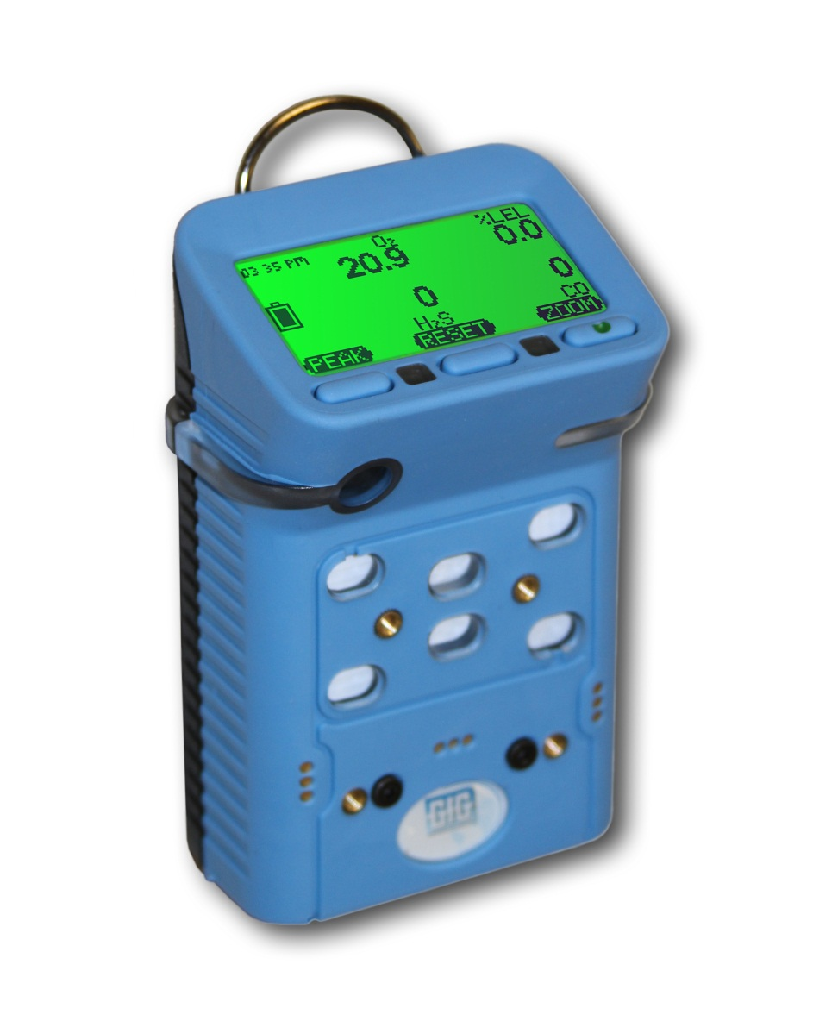
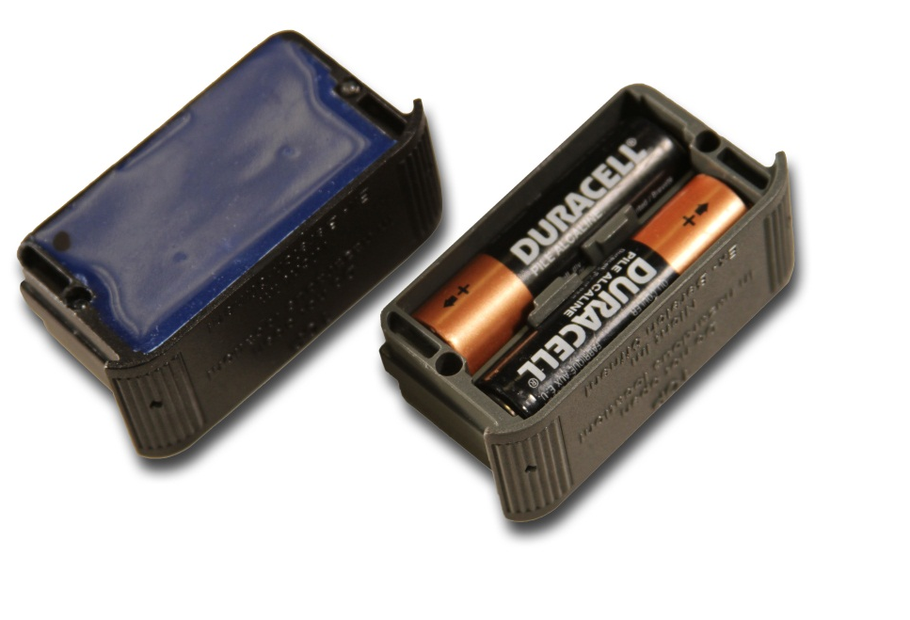
G450 / G460 battery packs
Interchangeable rechargeable (NiMH) and alkaline battery packs last up to 25 hours
NiMH batteries provide excellent cycle life and low temperature performance
NiMH battery packs warranted for 2-years
Typical run-time after two years for properly maintained NiMH battery packs is usually around 16 hours

Slide 12
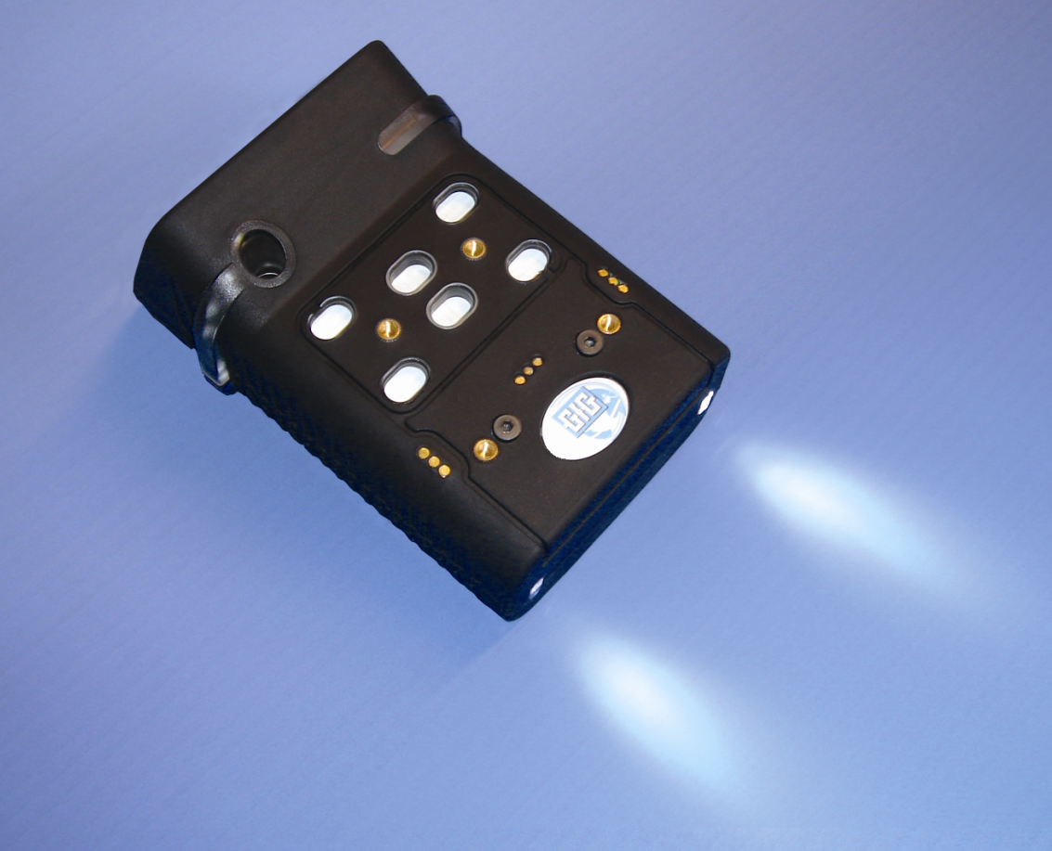
Rechargeable battery pack
Available with optional built-in flashlight LEDs
LED location

Slide 13
Expected G450 / G460 run times
*All configurations include O2 and CO/H2S sensors as well as the listed “high power” sensors

Slide 14
Expected G450 run times as function of temperature

Slide 15
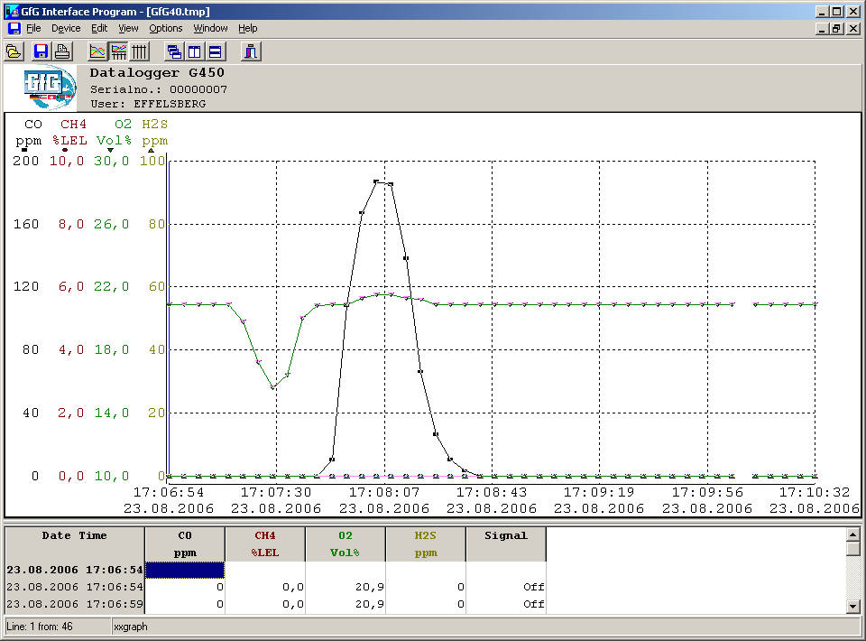
Datalogging Standard
Mode:
Average
Peak
Instantaneous
Interval:
1 sec. – 60 min.
Internal capacity:
1,890 intervals
63 hours continuous at 2 min. Interval
G460:
Built-in expansion slot for 2GB additional data storage capacity

Slide 16
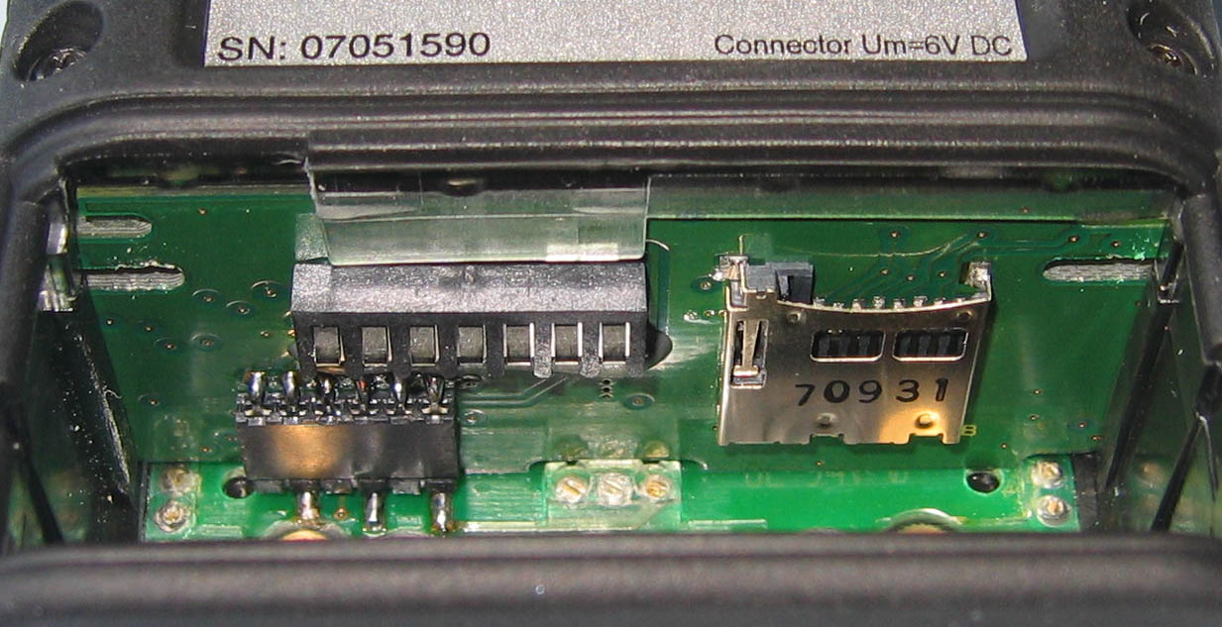
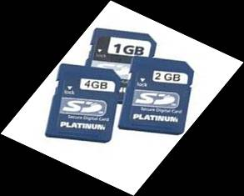
G460 Optional Extended Datalogging Storage Capacity
Built-in slot for optional high capacity extended memory card
Memory expansion card slot

Slide 17
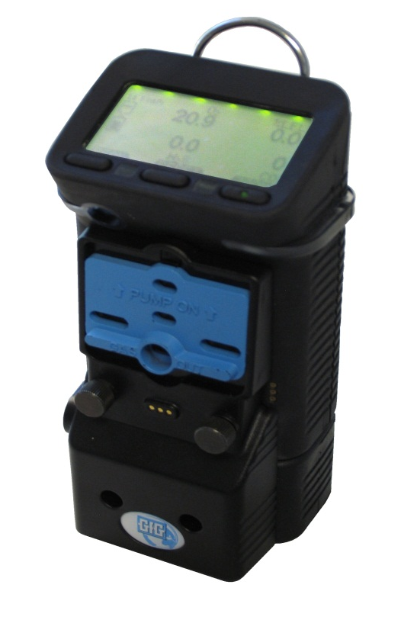
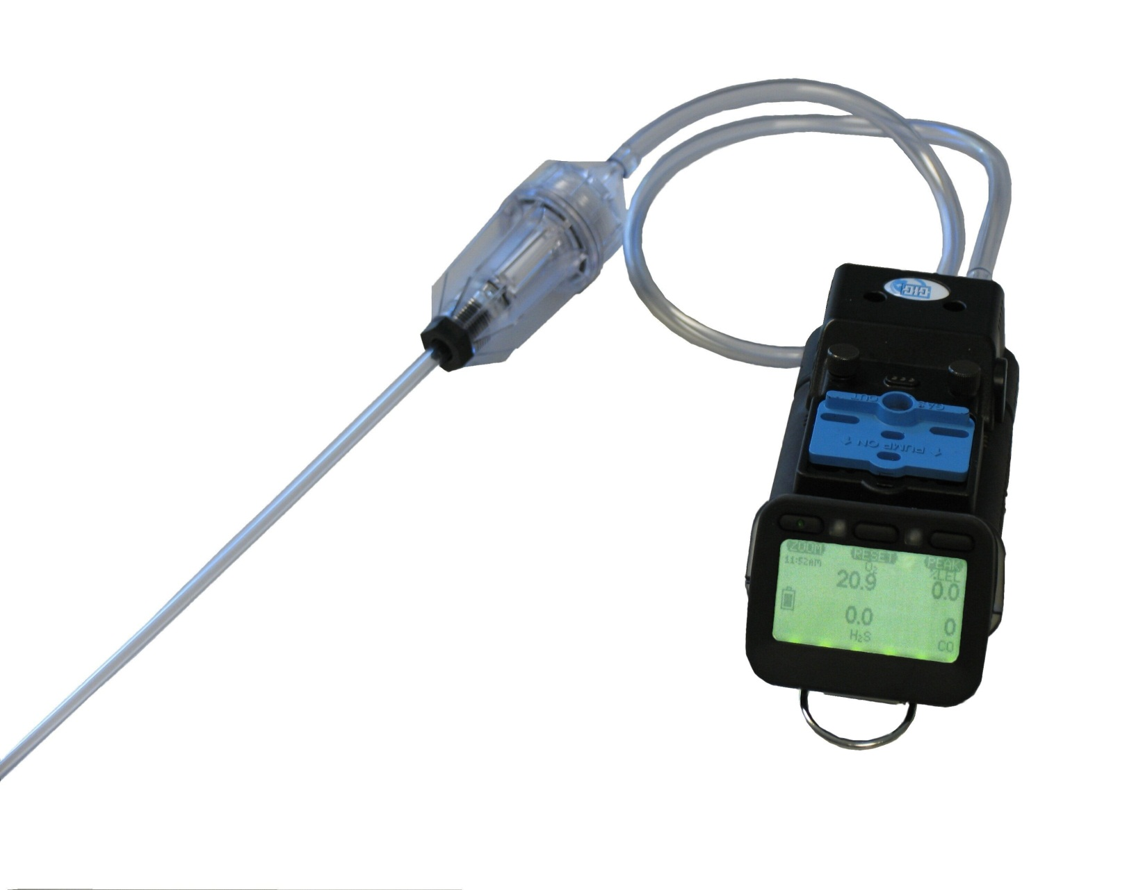
G450 / G460 Motorized Pump
Powerful motorized "smart pump" with its own battery pack
Sliding up the shutter turns on the pump and covers the diffusion ports
Motorized pump can be attached or removed from instrument as needed

Slide 18
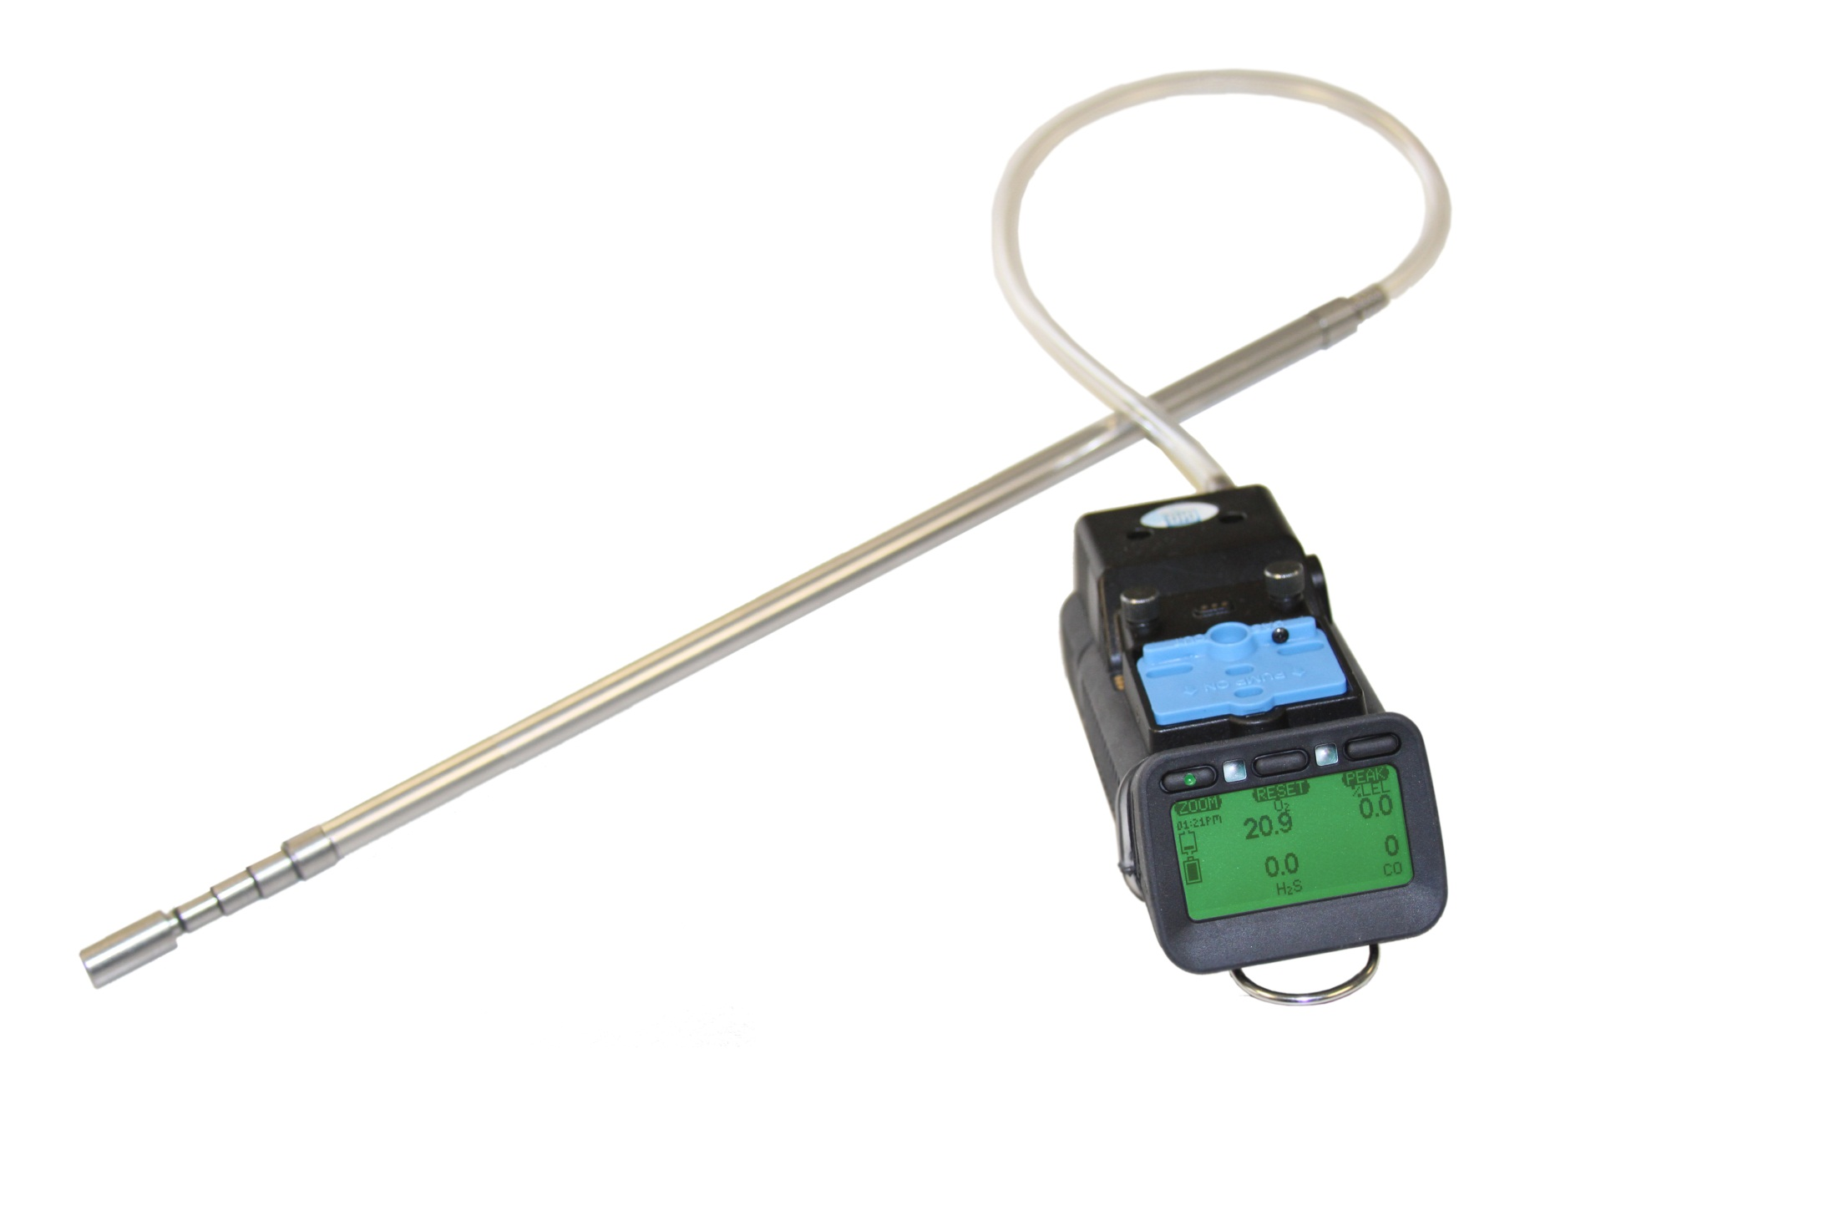
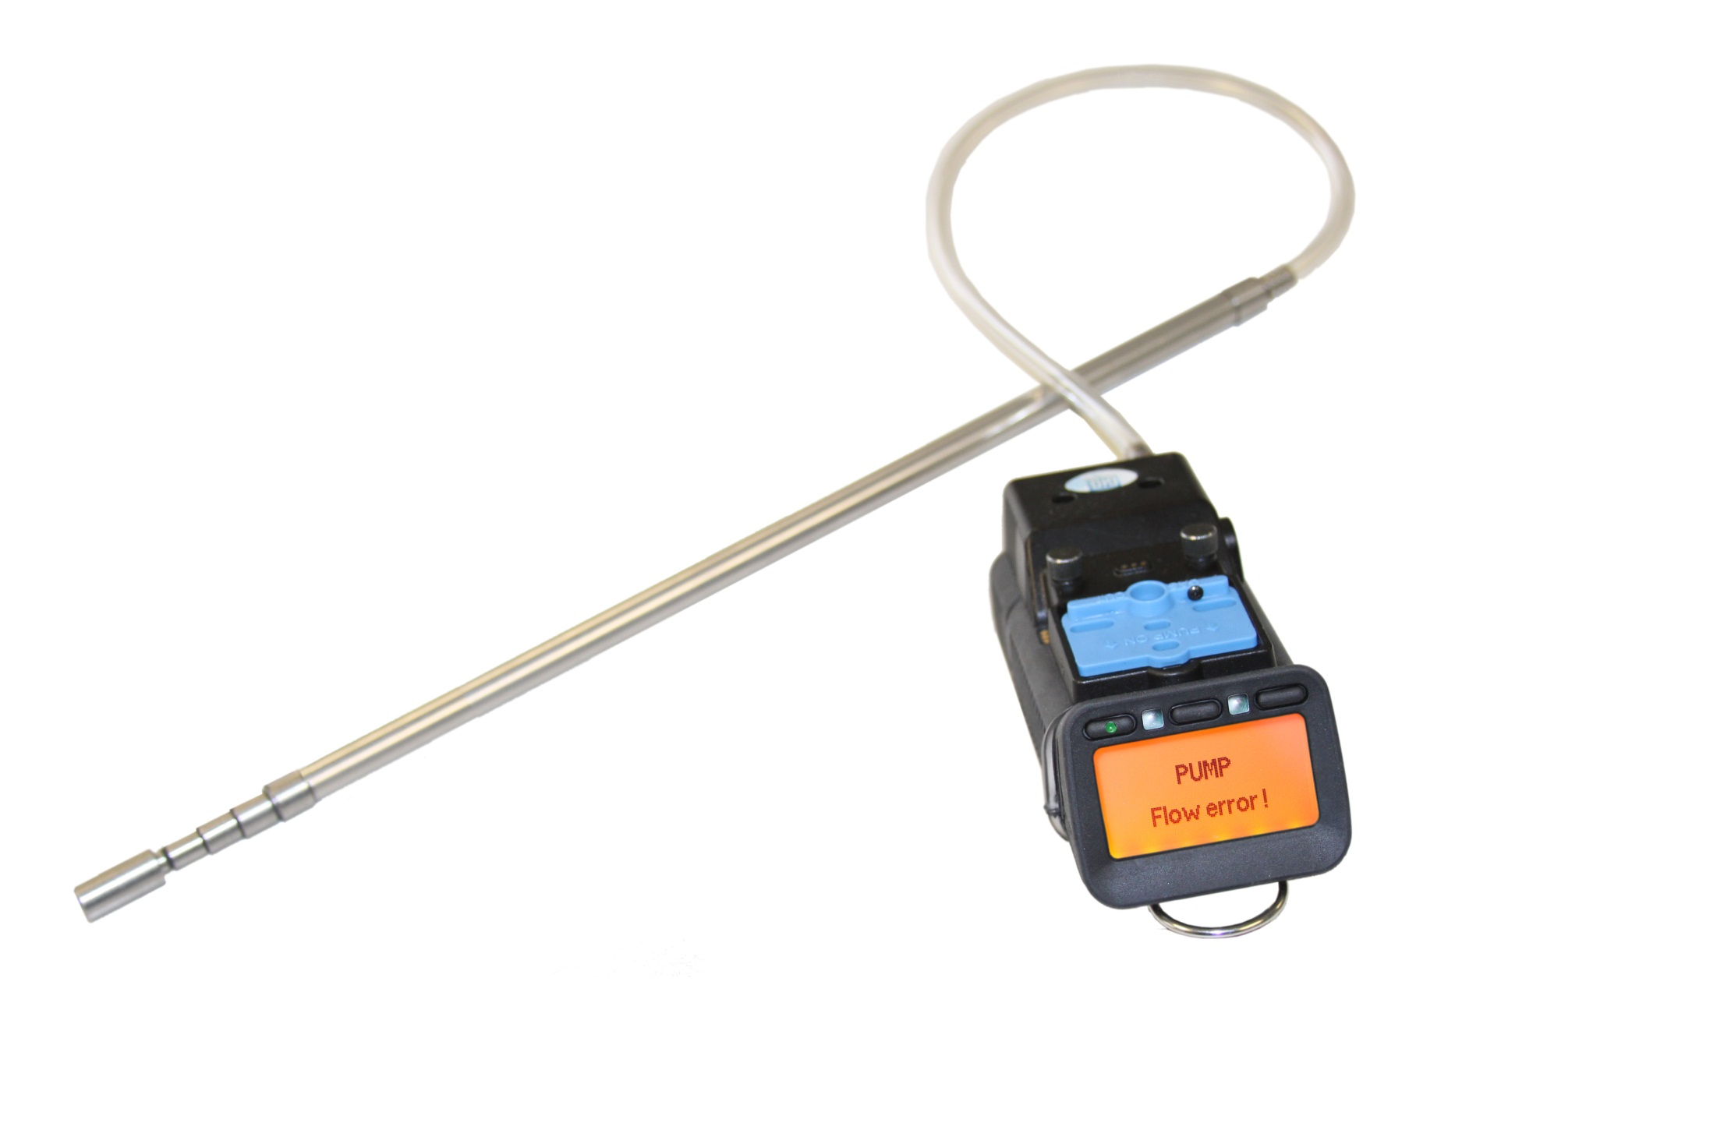
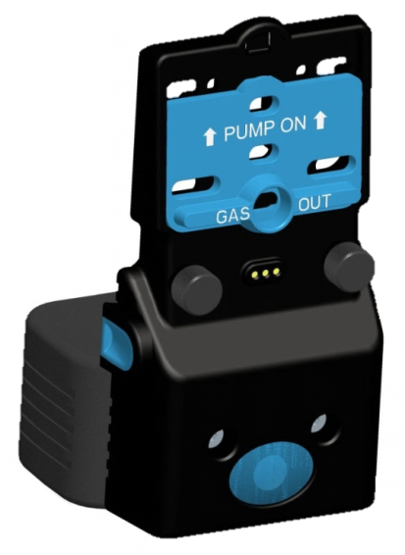
G450 / G460 Motorized Pump
"Smart" motorized pump directly monitored by instrument for proper performance
Low flow and pump malfunction alarms

Slide 19
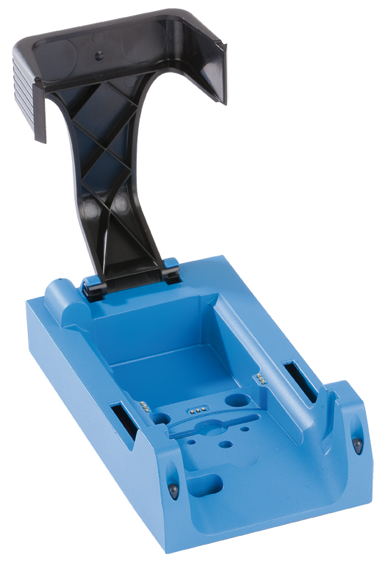
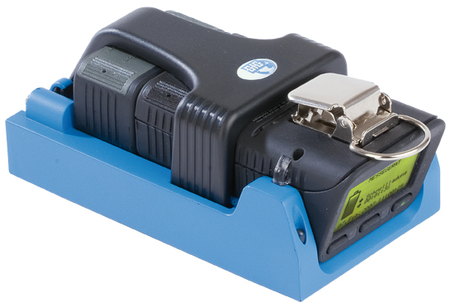
G450 / G460 Drop-in Charger
Smart charger includes trickle charge mode to prevent damage to battery pack due to overcharging
Available in single and double versions
Available for use with 12 VDC vehicle charging system

Slide 20
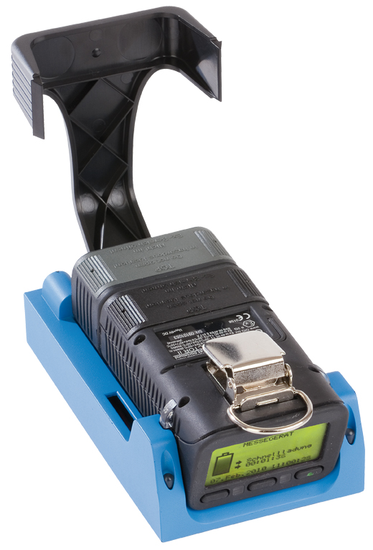
Optional G450 / G460 Drop-in Charger for Pump Equipped Instruments
Charger simultaneously charges both pump AND instrument
Available for use with 12 VDC vehicle charging system

Slide 21
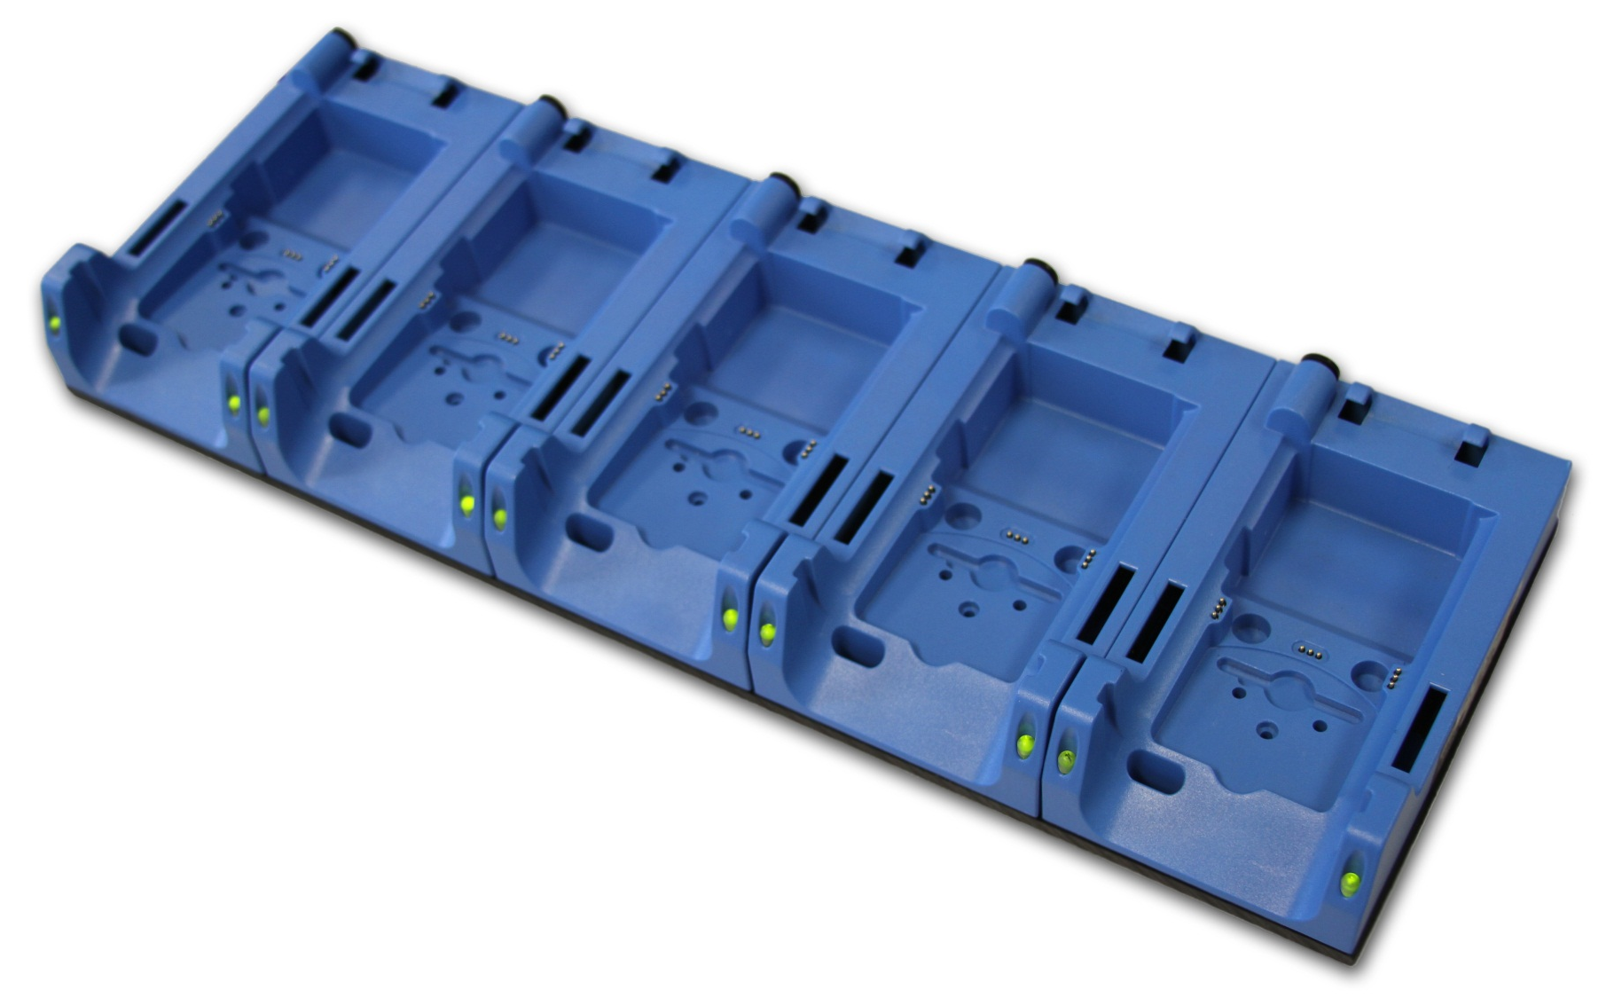
G450 / G460 Five-Unit Multi-Charger
Five instrument multi-charger

Slide 22
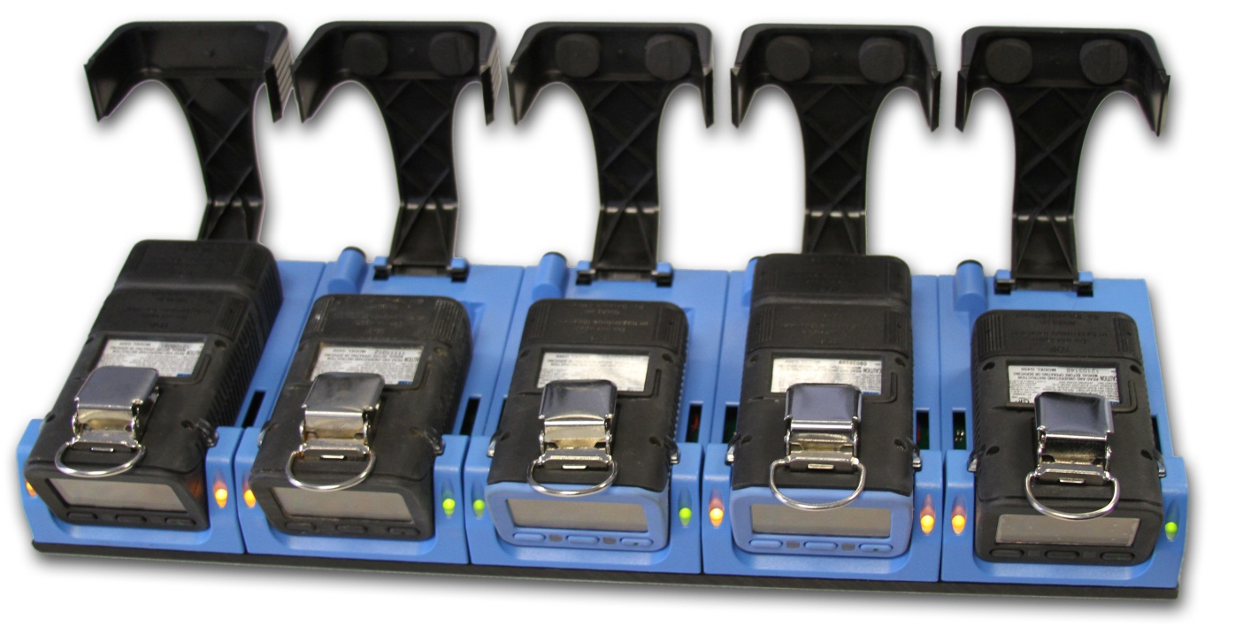
Five instrument multi-charger
Can be substituted in place of standard cradle chargers with orders of 5 or more instruments

Slide 23
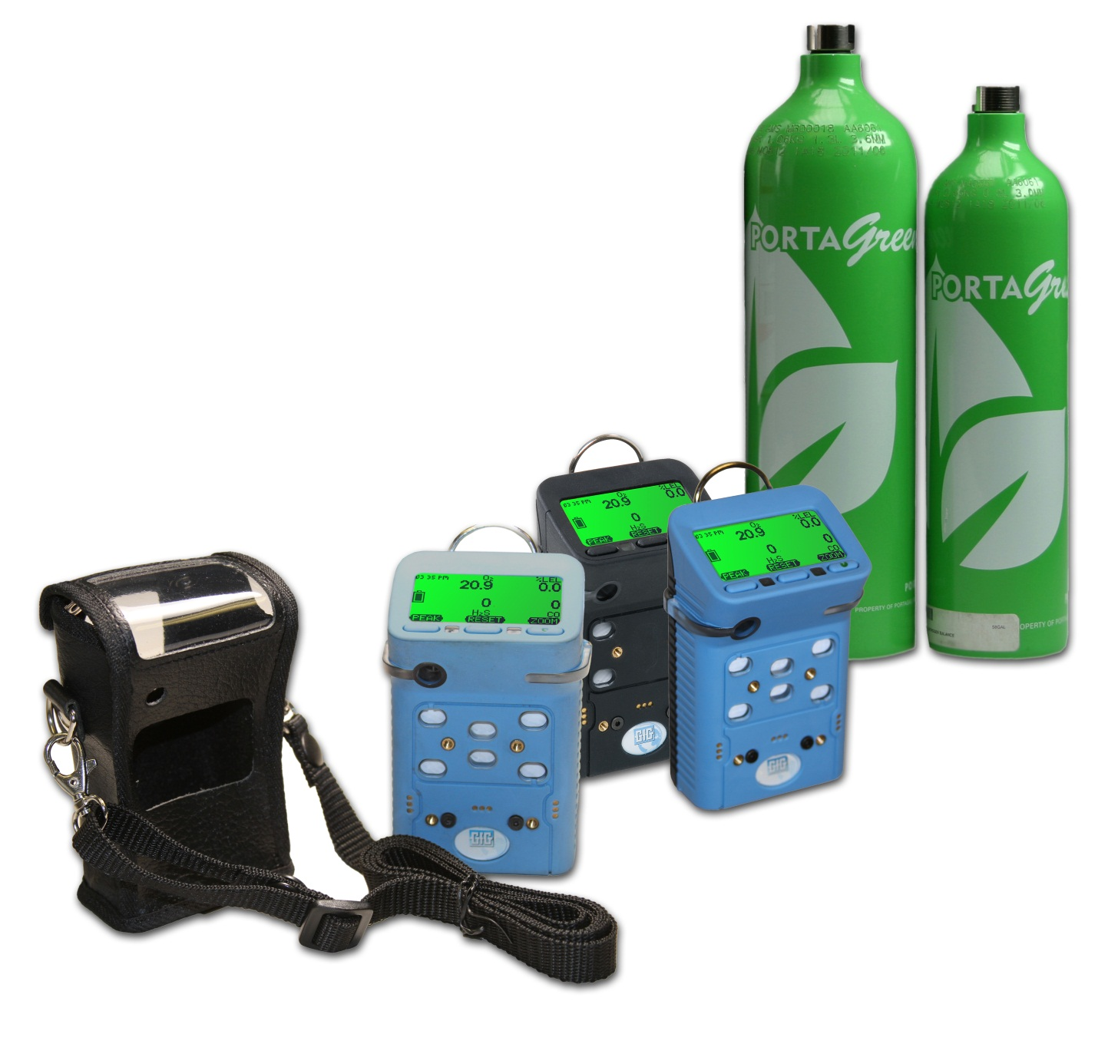
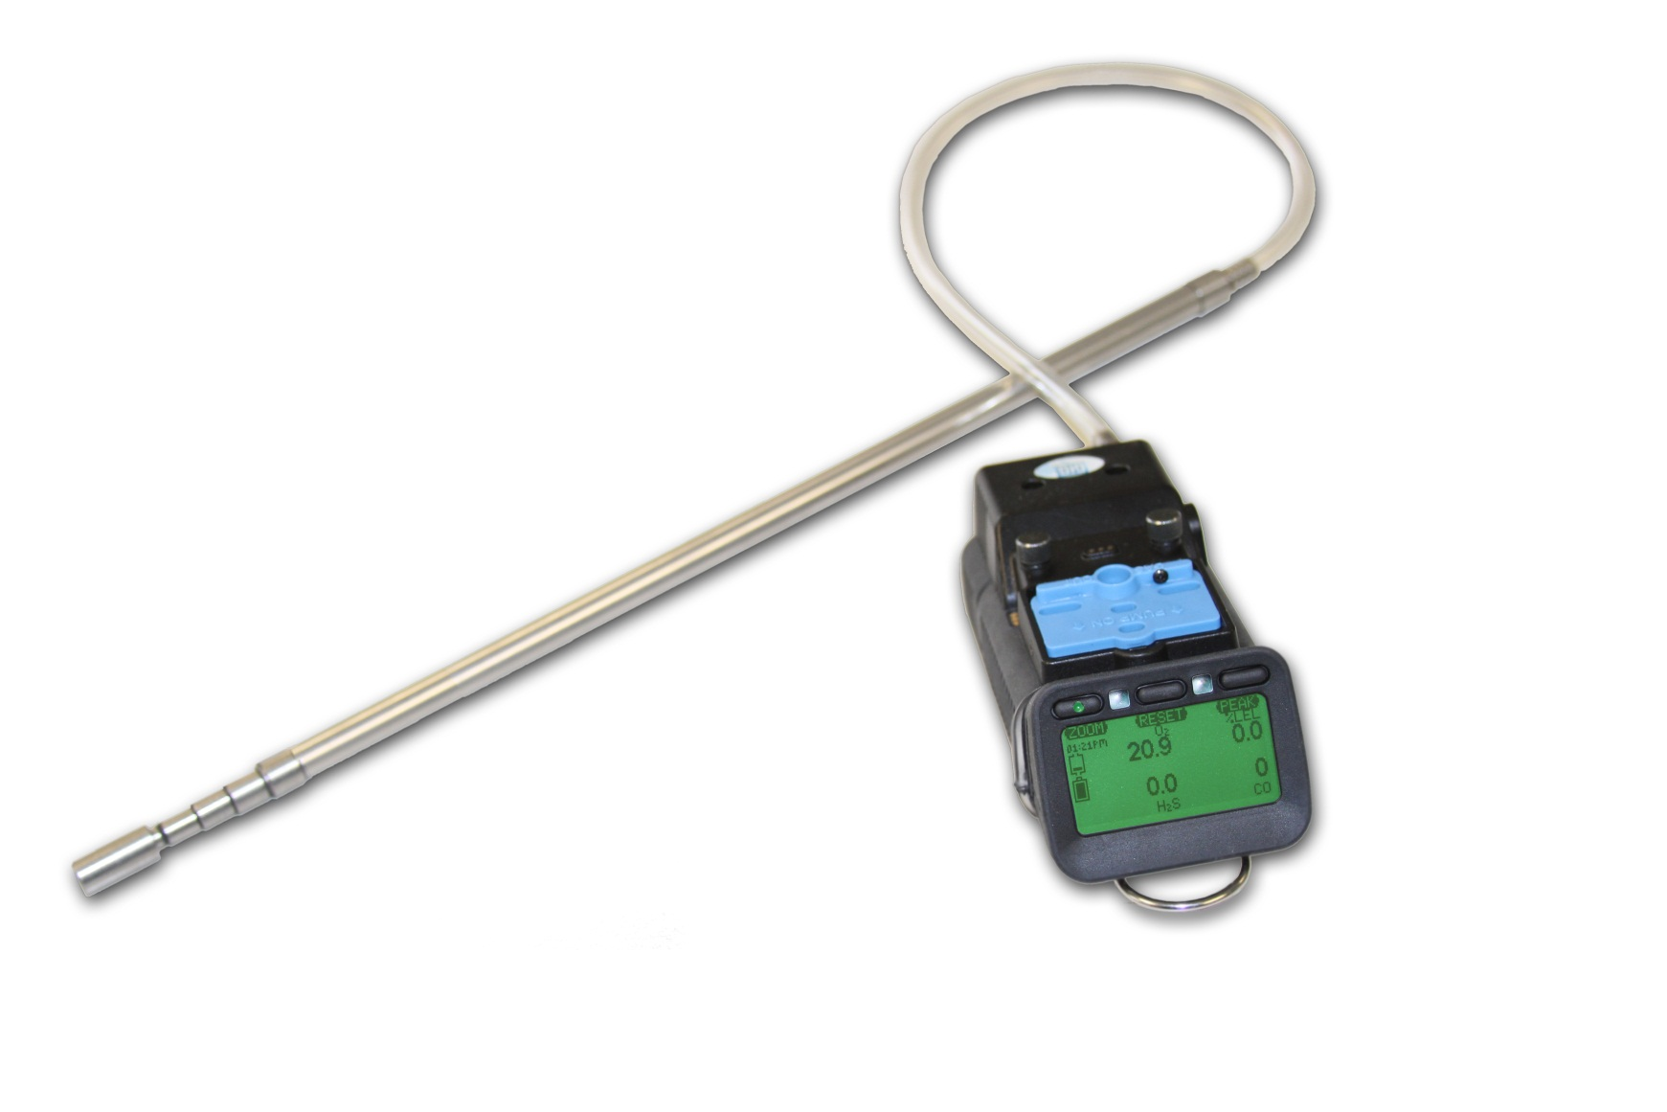
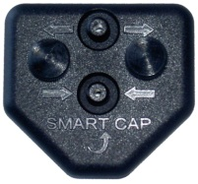
Other accessories
Calibration adapters
Sampling probes
Leather holsters
Calibration kits

Slide 24
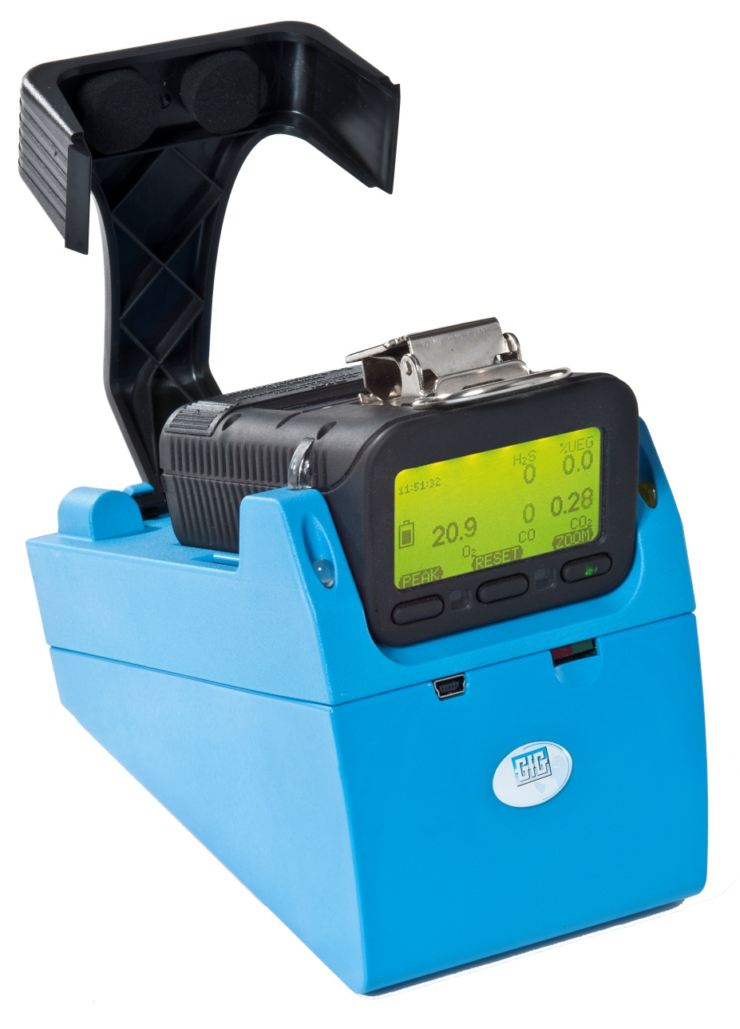
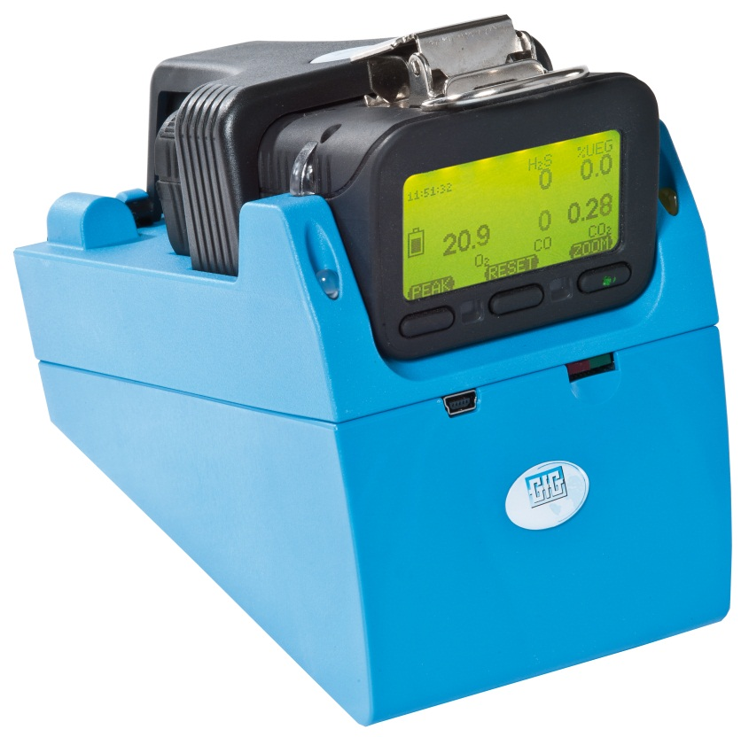
Use TS-400 Test Station for daily bump check
Standalone operation - No PC required!
Automatic bump-test only
Success / failure indication after each test
Economic use of test gas
Easy collection of unit test and logged data

Slide 25
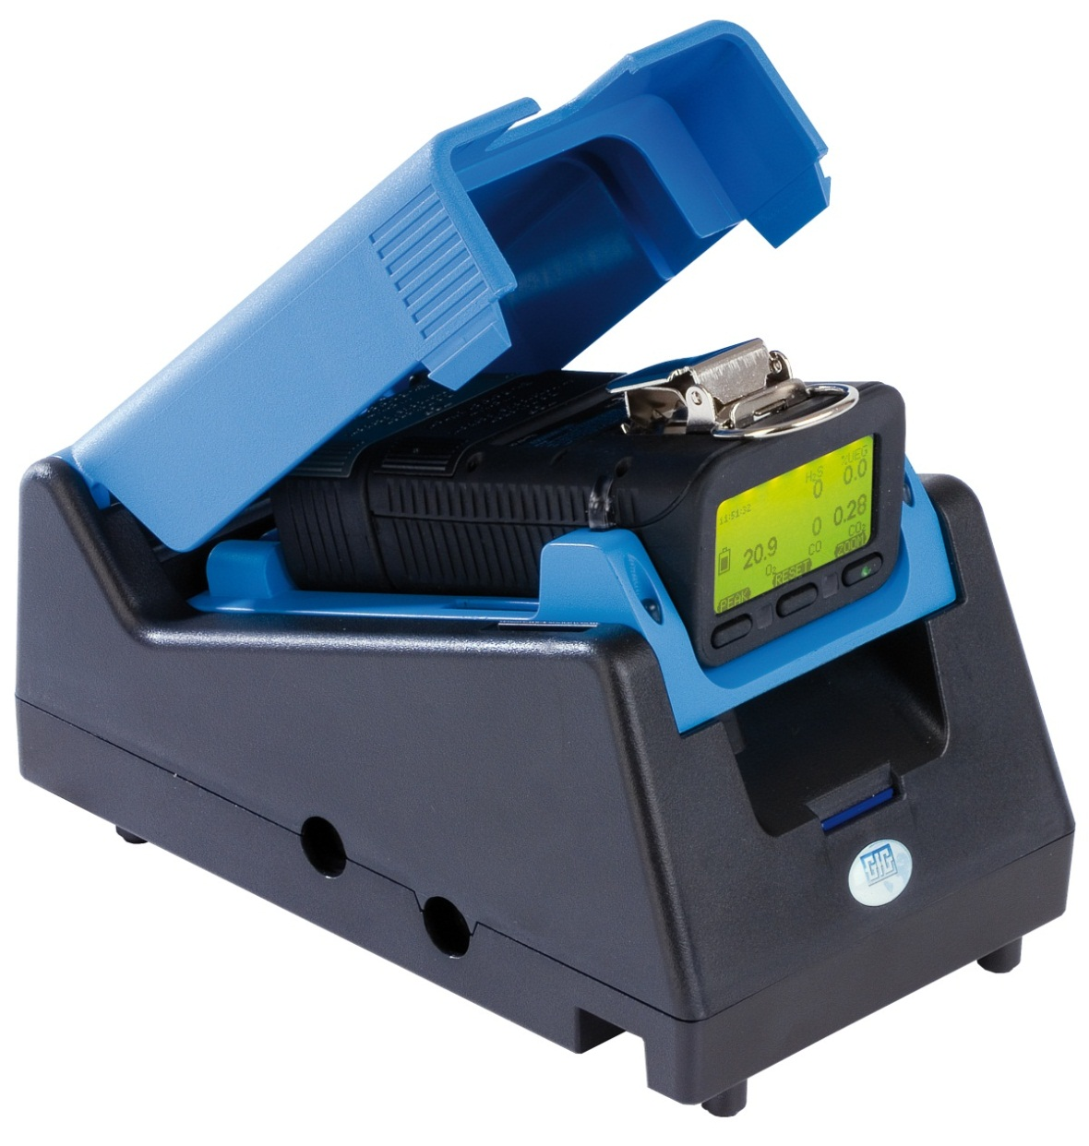
Use DS400 Docking Station for daily bump check and / or periodic calibration
Standalone operation:
No PC required
Automatic bump-test
Automatic span calibration
Success / failure indication after each test
Economic use of test gas
Easy collection of unit test and logged data
Reduced maintenance cost

Slide 26
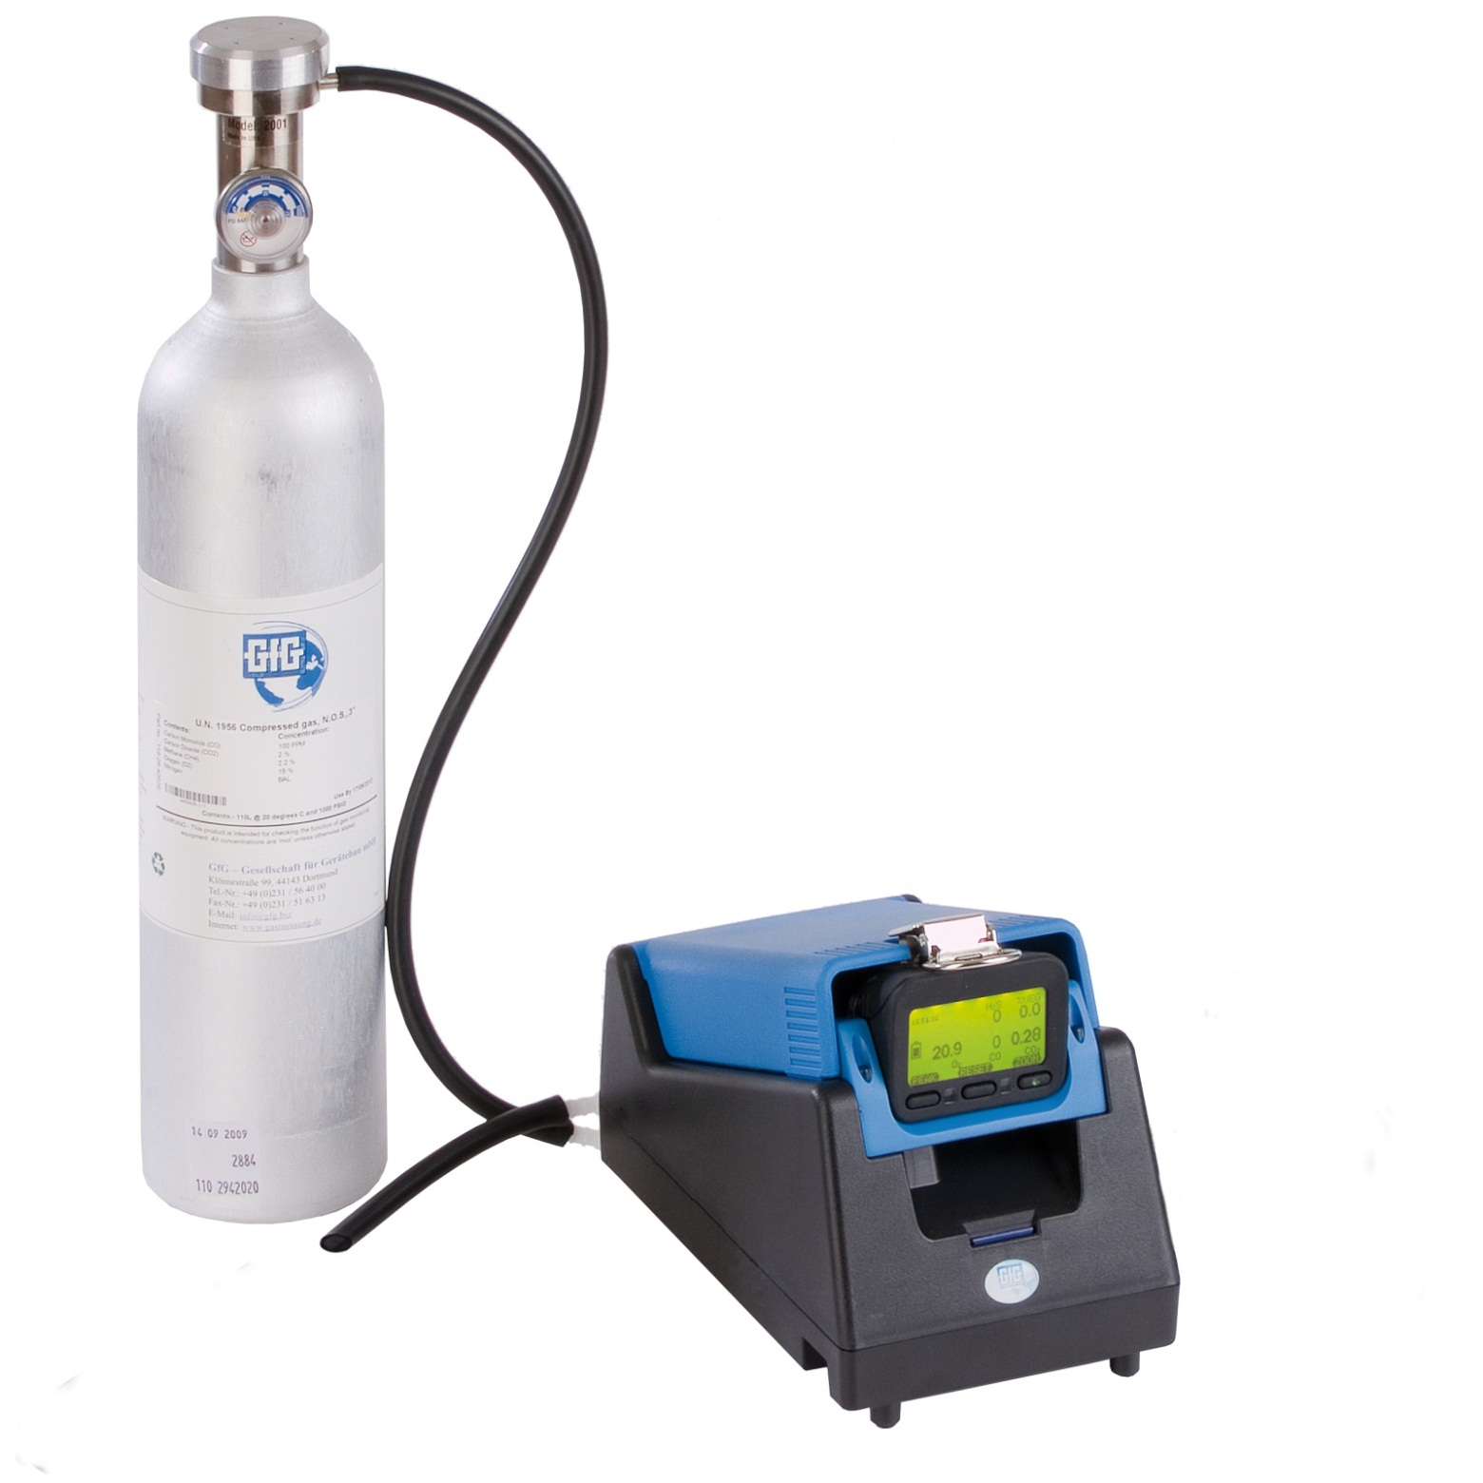
DS-400 Docking Station for daily bump check and / or periodic calibration
No computer required!
Docking station controlled by instrument’s control buttons:
Push "Test" for Bump Test
Push "Cal" for Auto Cal
Push "Cancel" to charge only

Slide 27
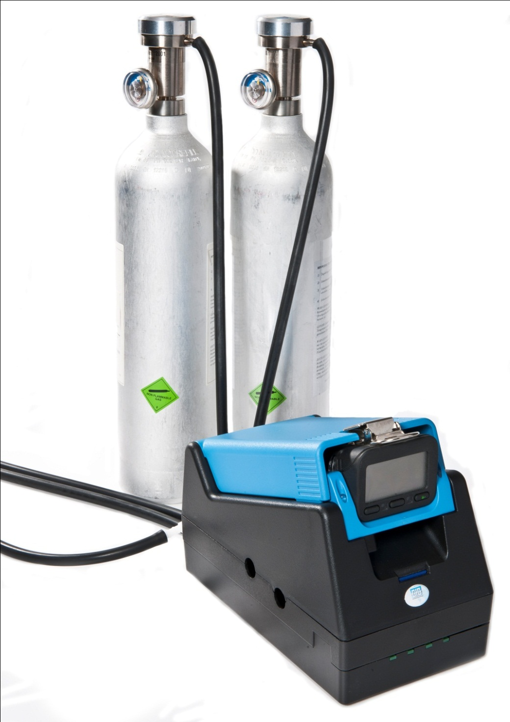
DS-404 Multi-inlet Docking Station for bump check and periodic calibration
Inlets for 4 cylinders of gas
Automatic Bump and Cal for 5, 6 and 7 channel instruments
Supports:
Quad mix (O₂, LEL, CO, H₂S)
5-mix with SO₂
5-mix with CO₂
Isobutylene
HCN
NO₂
And other individual gases

Slide 28
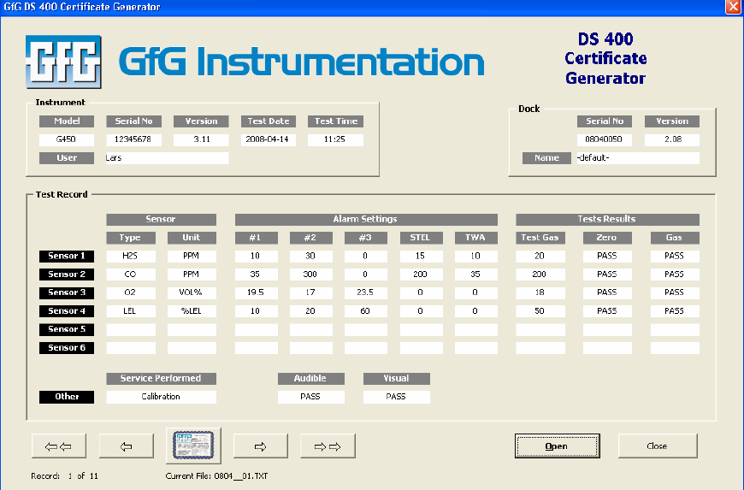
Comprehensive Test Reports
Easy to generate custom test reports

Slide 29
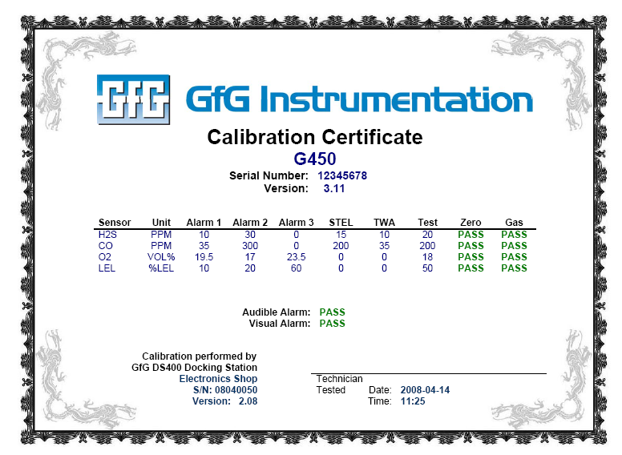
Automatically generate calibration and bump test certificates

Slide 30
Basic operation
Basic operation is extremely simple
Single on-off button all that is needed for most day to day use
Every instrument shipped complete with operations manual

Slide 31
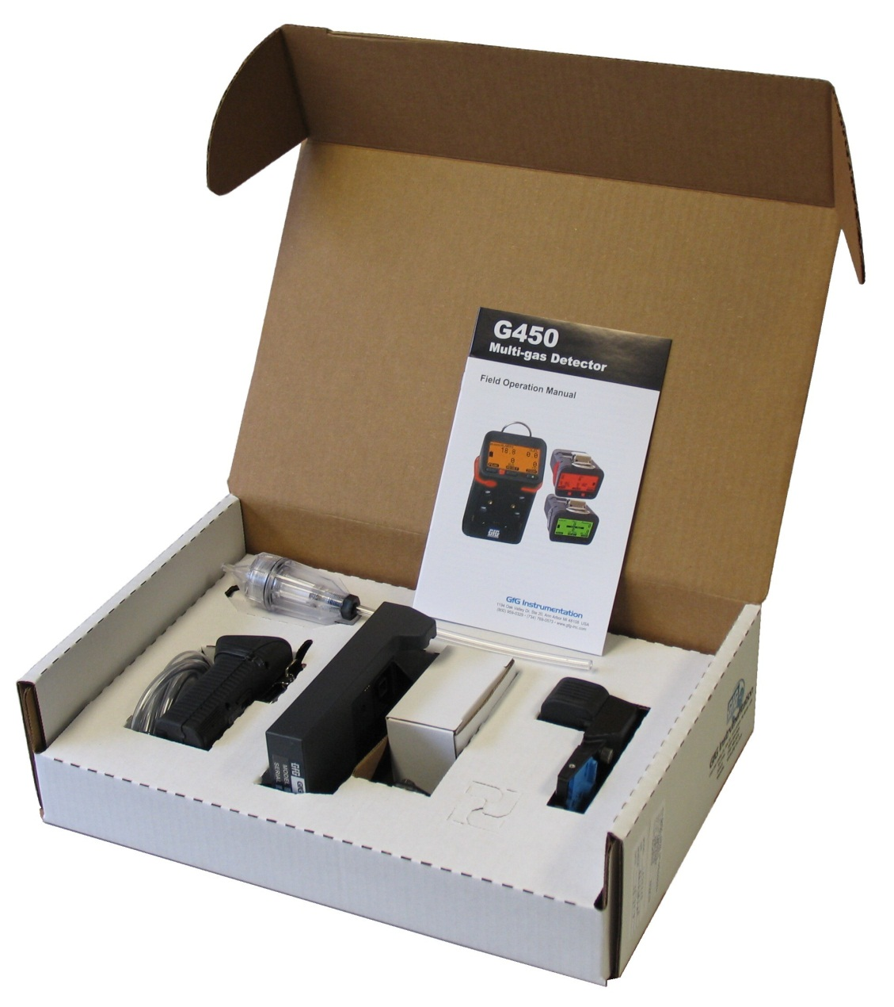
Accessories included with every instrument
Instrument with CO, H₂S, LEL and O₂ sensors (installed)
Operations manual
Battery pack (installed)
Rechargeable NiMH or
Alkaline
Charging cradle (when instrument has rechargeable battery pack)
110 VAC wall-cube power source
Calibration adapter

Slide 32
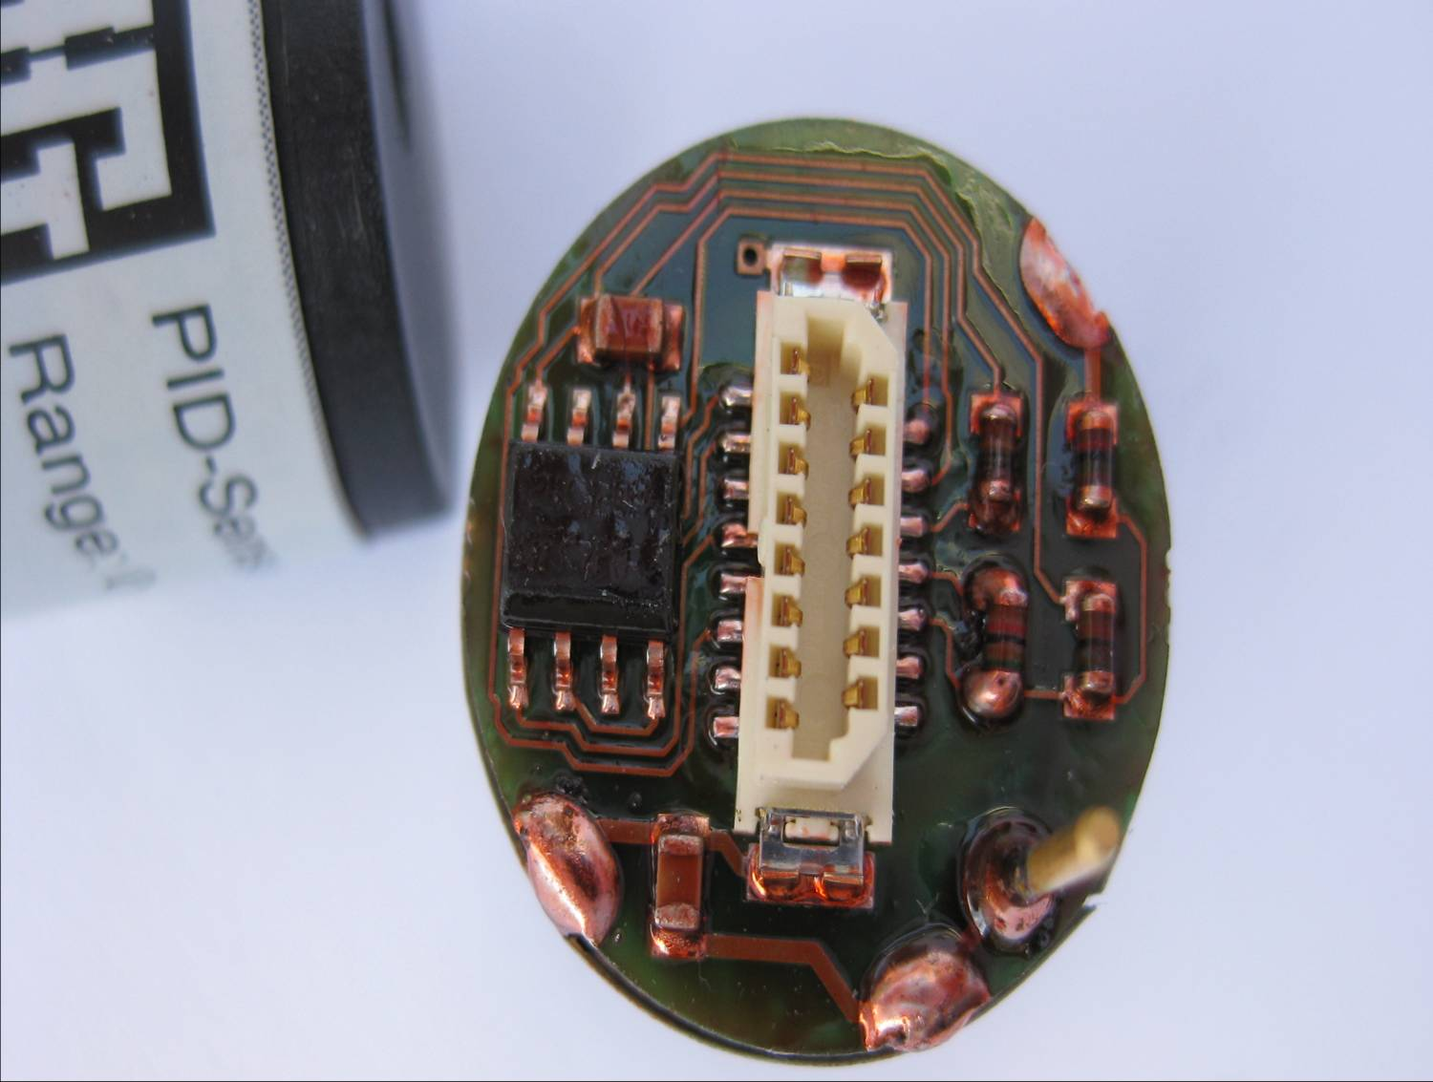
Traditional Electrochemical Toxic Gas Sensors
More types of sensors available every year
Toxic gas sensors designed to detect target gases at ever lower concentrations

Slide 33
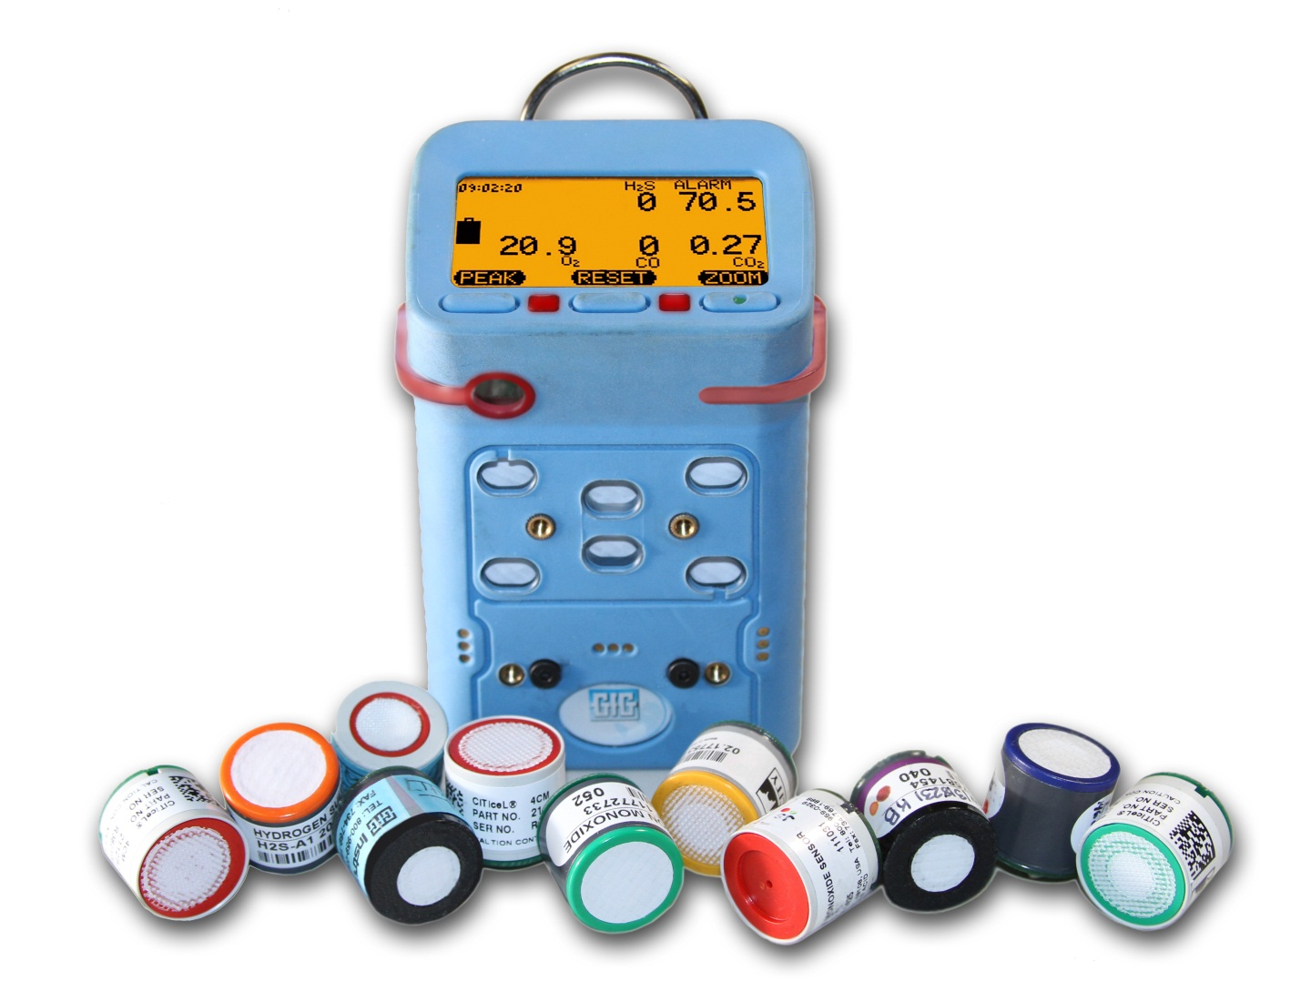
G460 Interchangeable Plug-and-Play Smart Sensors
Available sensors include:
O₂
Catalytic LEL
Infrared LEL
Infrared CO₂
CO
H₂S
COSH
PID
SO₂
Cl₂
ClO₂
NH₃
H₂
PH₃
HCN
NO
NO₂
HCL
HF
EtO
O₃
COCl₂
HBr
THT
and more!

Slide 34
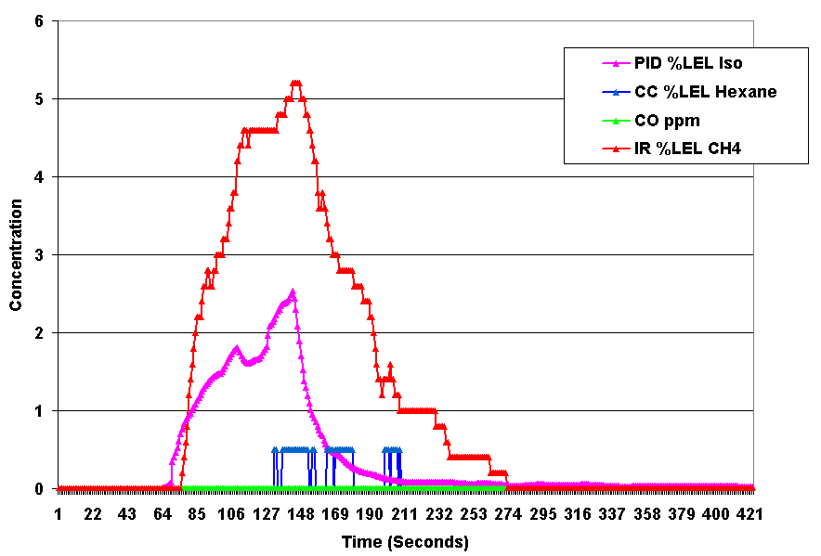
G460 has the flexibility to support the right sensor technology for the job!

Slide 35
GfG wins hands down when it comes to features AND three year cost of ownership!

Slide 36
Sales Support: www.Goodforgas.com
Data sheets
Price lists
Manuals
Application Notes
Product images
Print ads
...and more!

Slide 37
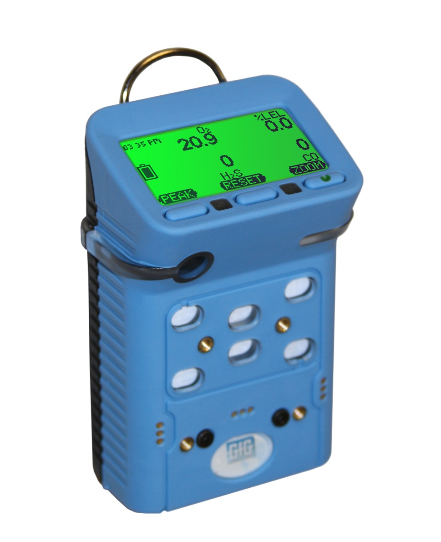
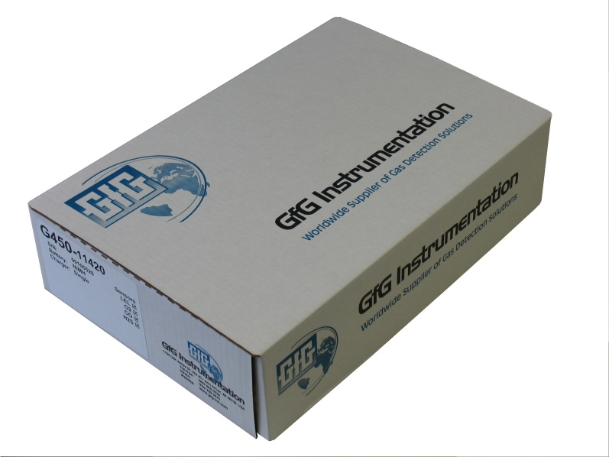
Questions?

