Slide 1
G450 / G460
Advanced / Technician Training
GfG Instrumentation, Inc.
1194 Oak Valley Drive, Suite 20
Ann Arbor, Michigan 48108
Toll free (USA and Canada): (800) 959-0329
Direct: +1-734-769-0573
Service e-mail: service@gfg-inc.com
Internet: www.gfg-inc.com
Technical documentation and download site: www.goodforgas.com

Slide 2
Overview of G450 / G460 Features

Slide 3
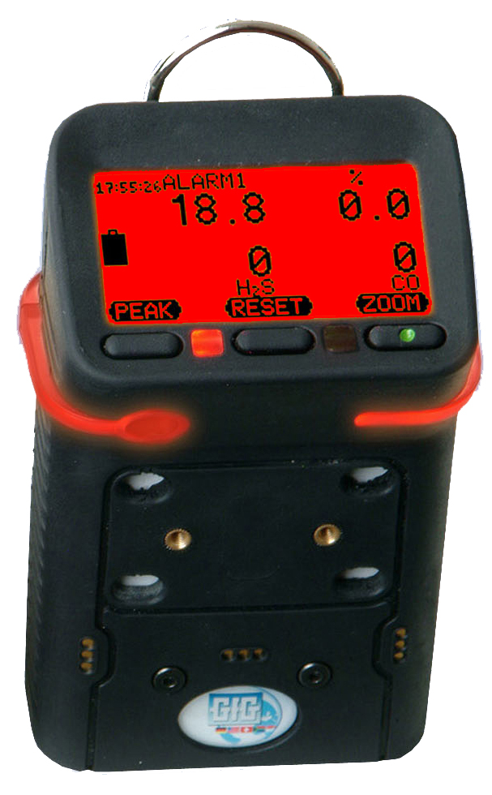
G450 Confined Space Gas Detector
One to four sensors
Full 3-year warranty on all sensors
Optional 6-year warranty on all sensors
O2 sensor rated for continuous use in – 30°C temperatures
Interchangeable reechargeable (NiMH) or alkaline battery packs last 25 hours per charge
Super durable IP-67 water resistant design
Only $695.00 USD list price (alkaline)
Only $745.00 USD list price (rechargeable)

Slide 4
G460 Multi-gas Monitor
Up to SEVEN channels detection
Comprehensive range of interchangeable smart sensors:
LEL, O2, CO, H2S: 3-year warranty
Infrared combustible gas: 3-year warranty
Infrared CO2: 3-year warranty
Most other substance-specific EC toxic: 2-year warranty
PID lamp: 1-year warranty

Slide 5
G450 / G460 Optional 6-year Sensor Warranty
3-year warranty on O₂, LEL, CO and H2S sensors still standard
Standard lifetime warranty on instrument
6-year sensor warranty option available for additional $250.00 at time of purchase

Slide 6
G450 / G460 Optional 6-year Sensor Warranty
Cost of Ownership
Product |  |  | MSA Altair 4X |  | ISC MX4 |  | BW Quattro |  | X-am 2000 |  | GfG G450
List price of rechargeable 4 channel instrument |  |  | $915.00 |  | $695.00 |  | $745.00 |  | $795.00 |  | $745.00
Standard sensor warranty & price
 |  | LEL | 3-year | $210 | 2-year | $220 | 2-year | $185 | 3-year | $175 | 3-year | $100*
 |  | Oxygen | 3-year | $180 | 2-year | $165 | 2-year | $135 | 5-year | $145 | 3-year | $100*
 |  | CO | NA | NA | 2-year | $275 | 2-year | $200 | 5-year | $145 | 3-year | $100*
 |  | H2S | NA | NA | 2-year | $275 | 2-year | $150 | 5-year | $145 | 3-year | $100*
 |  | COSH | 3-year | $210 | NA | NA | NA | NA | NA | NA | NA
Instrument price Pricing* |  |  | $915.00 |  | $695.00 |  | $745.00 |  | $805.00 |  | $745.00
Three year cost of ownership |  |  | $915.00 |  | Between $860.00 and $1,630.00** |  | Between $880.00 and $1,415.00*** |  | $805.00 |  | $745.00
Extended warranty option: |  |  | Yes |  | No |  | No |  | No |  | Yes
 | How long? |  | 1-year additional |  | NA |  | NA |  | NA |  | 3-year additional
 | How much? |  | $315.00 |  | NA |  | NA |  | NA |  | $250.00
Total cost of ownership with extended warranty |  |  | $1,230.00 (4-years) |  | NA |  | NA |  | $980.00 (5-year)*** |  | $995.00 (6-years)
Total six year cost of ownership |  |  | $1,515.00 (6-years) |  | Between $1,795.00 and $2,565.00 (6-years) |  | Between $1,550.00 and $2,085.00 (6-years) |  | Between $980.00 and $1,475.00 (6-years) |  | $995.00 (6-years)

Slide 7
Easy to use!
Basic operation is extremely simple
Single on-off button all that is needed for most day to day use
Every instrument shipped complete with operations manual

Slide 8
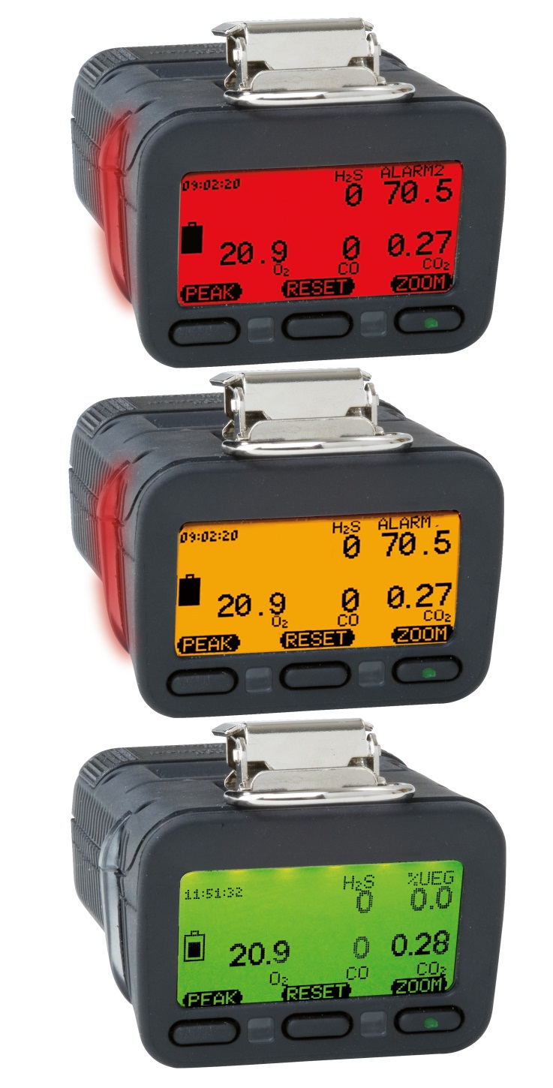
Three color "Traffic Signal" display
Back lit three-color full graphics LCD
Top mounted display with wrap around (360º) LED alarm indicator
LCD includes flip and zoom functions

Slide 9
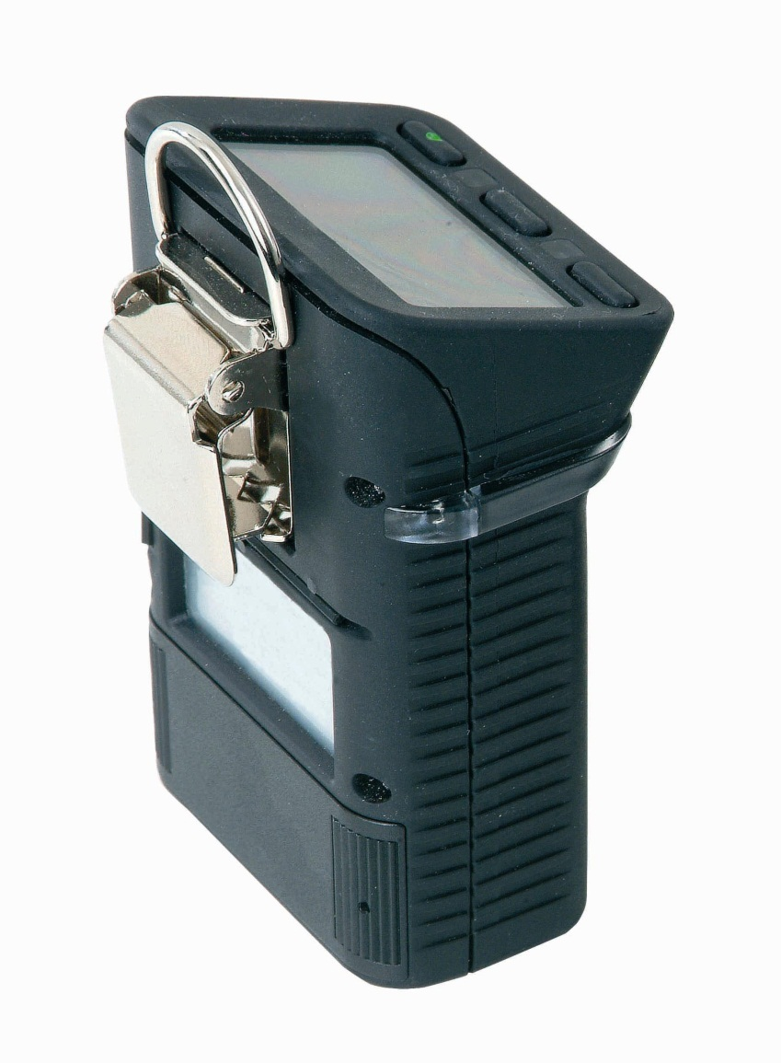
Rugged design
Rugged, double shot molded housing includes integral rubberized boot
Durable high tension steel alligator belt clip

Slide 10
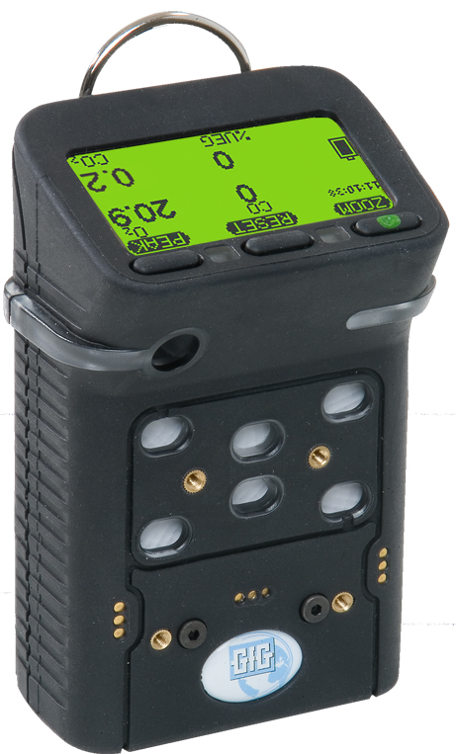
G460 Multi-gas Monitor
Standard G460 housing color now “GfG Blue”
Optionally still available in “GfG Black”

Slide 11
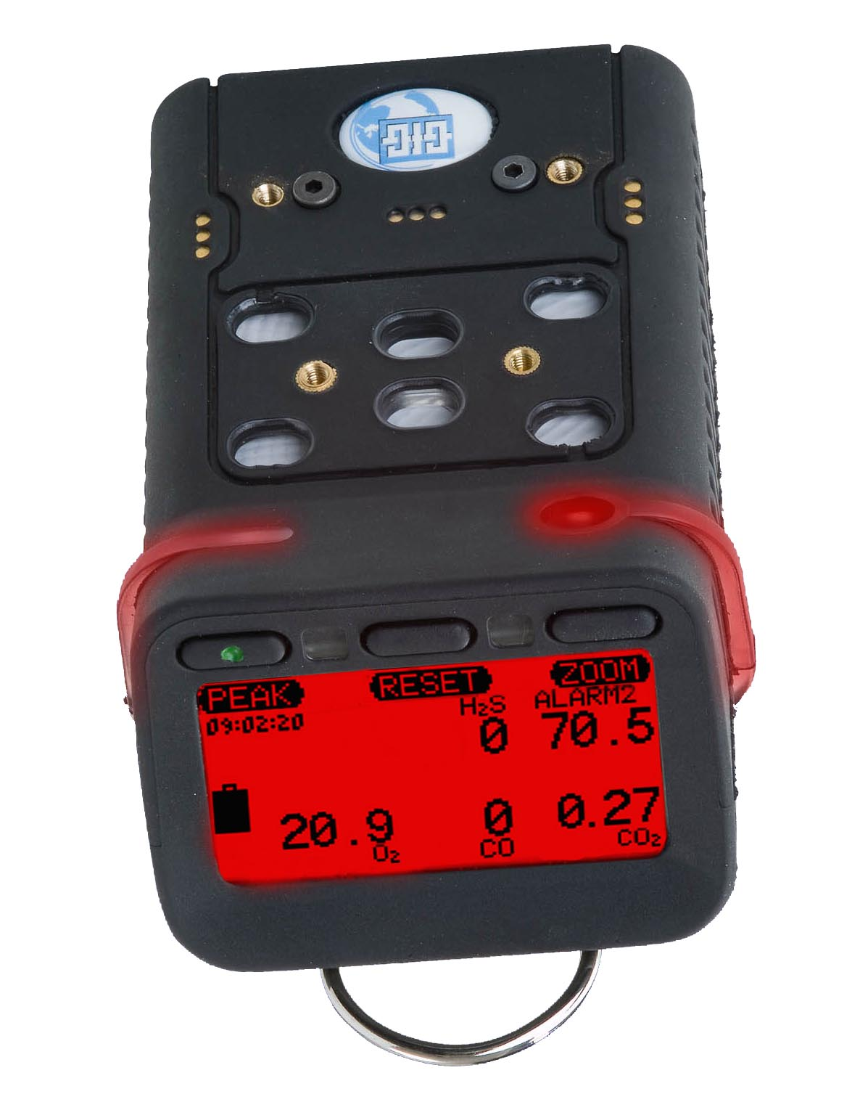
G450 / G460 Multi-Gas Detector
Interchangeable rechargeable (NiMH) or alkaline battery packs last up to 25 hours per charge
Top-mounted, three color, full graphics LCD
Durable IP-67 water resistant design
O2 sensor rated for continuous use in –30°C temperatures

Slide 12
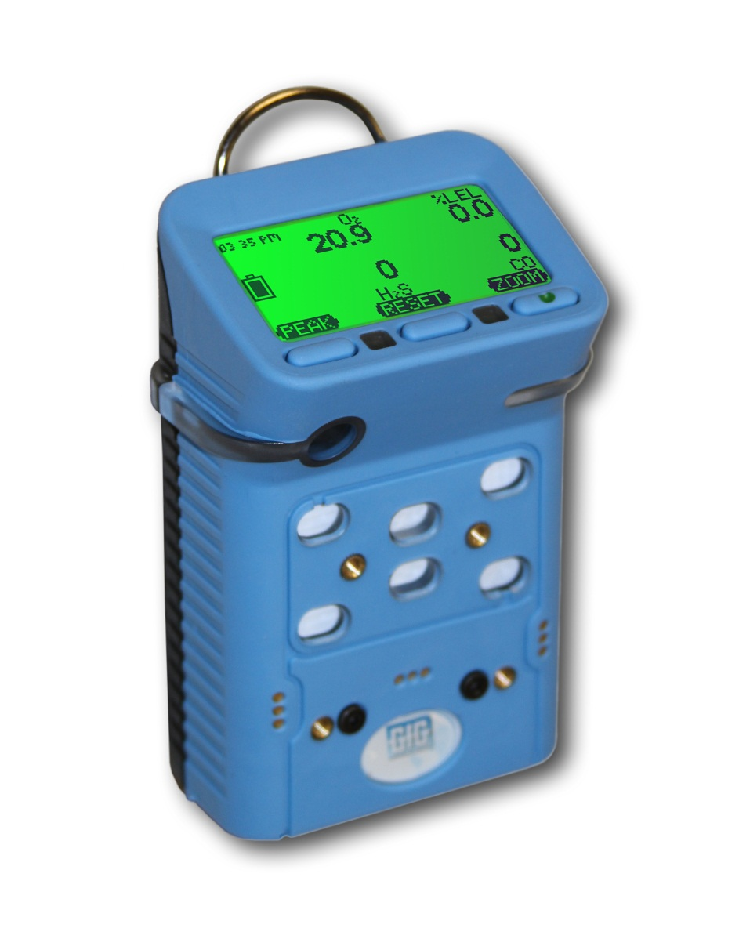
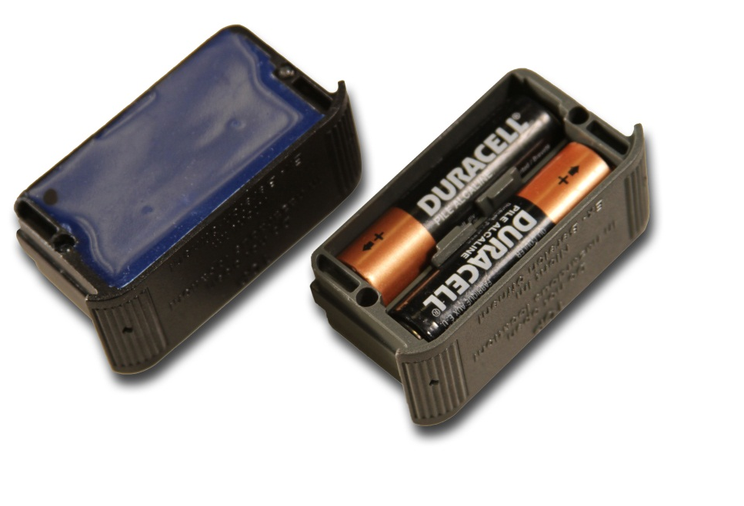
G450 / G460 battery packs
Interchangeable rechargeable (NiMH) and alkaline battery packs last up to 25 hours
NiMH batteries provide excellent cycle life and low temperature performance
NiMH battery packs warranted for 2-years
Typical run-time after two years for properly maintained NiMH battery packs is usually around 16 hours

Slide 13
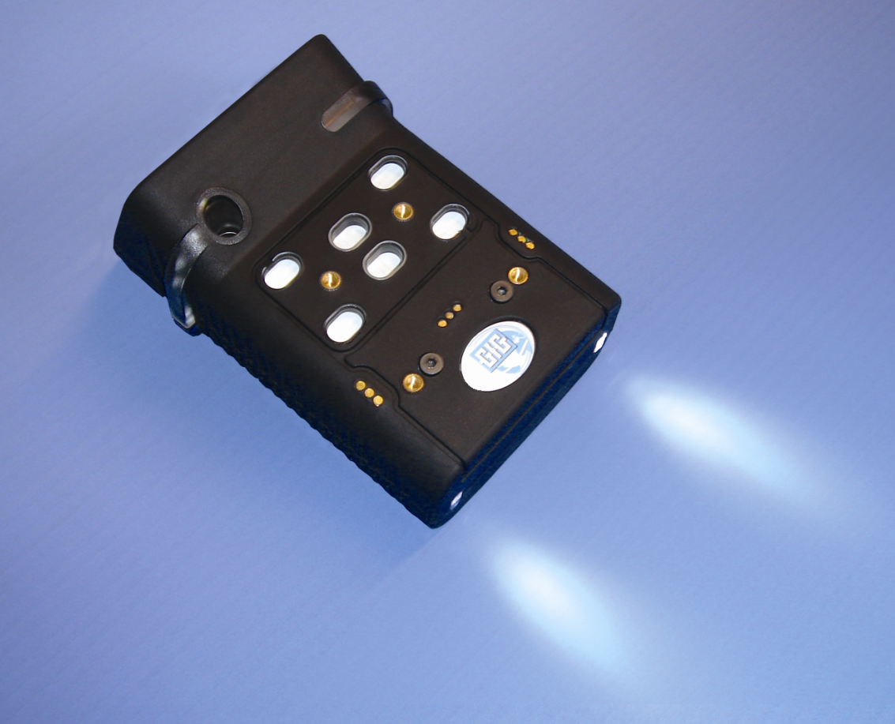
Rechargeable battery pack
Available with optional built-in flashlight LEDs
LED location

Slide 14
Expected G450 / G460 run times
*All configurations include O2 and CO/H2S sensors as well as the listed “high power” sensors

Slide 15
Expected G450 run times as function of temperature

Slide 16
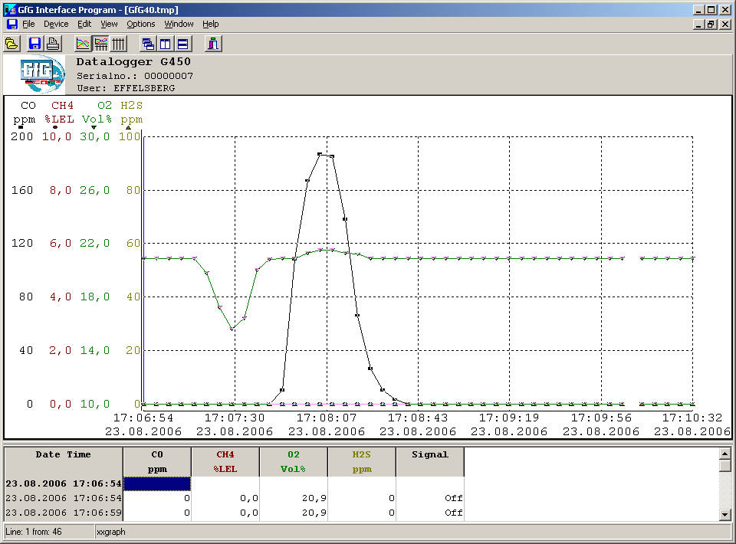
Datalogging Standard
Mode:
Average
Peak
Instantaneous
Interval:
1 sec. – 60 min.
Internal capacity:
1,890 intervals
63 hours continuous at 2 min. Interval
G460:
Built-in expansion slot for 2GB additional data storage capacity

Slide 17
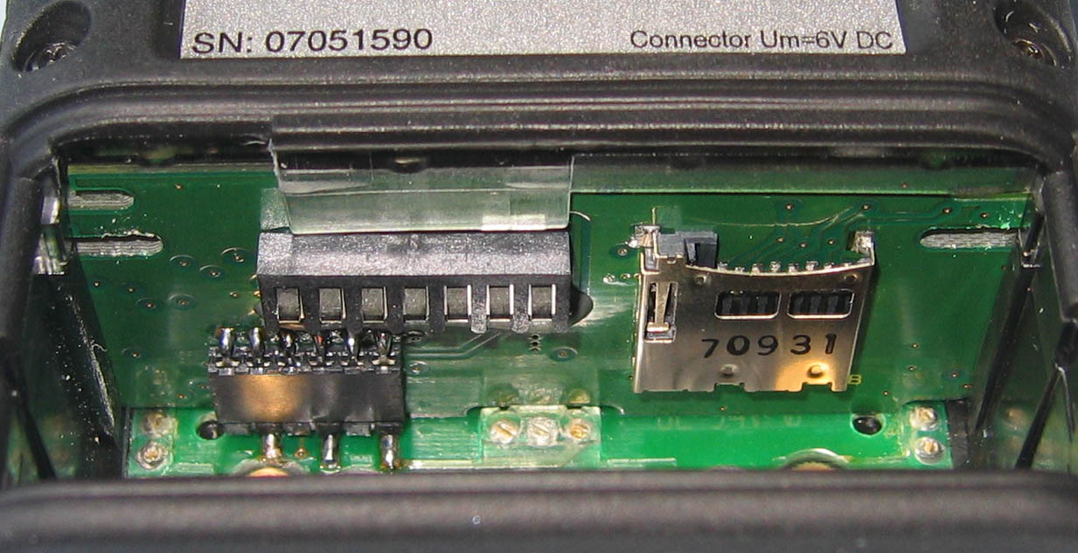
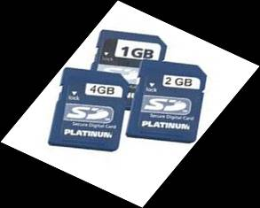
G460 Optional Extended Datalogging Storage Capacity
Built-in slot for optional high capacity extended memory card
Memory expansion card slot

Slide 18
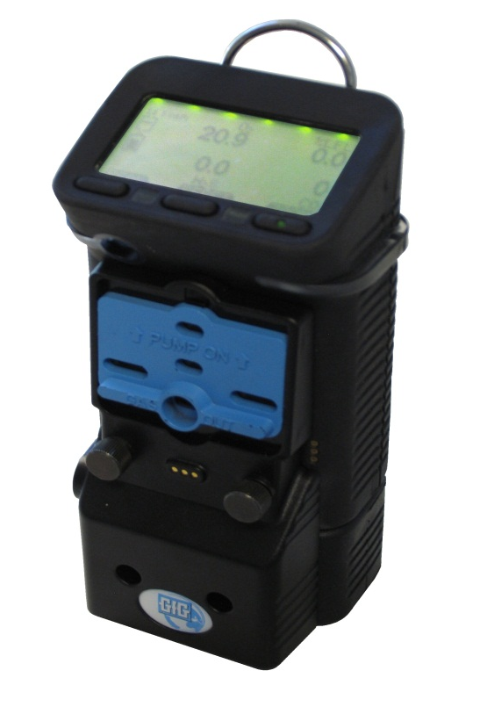
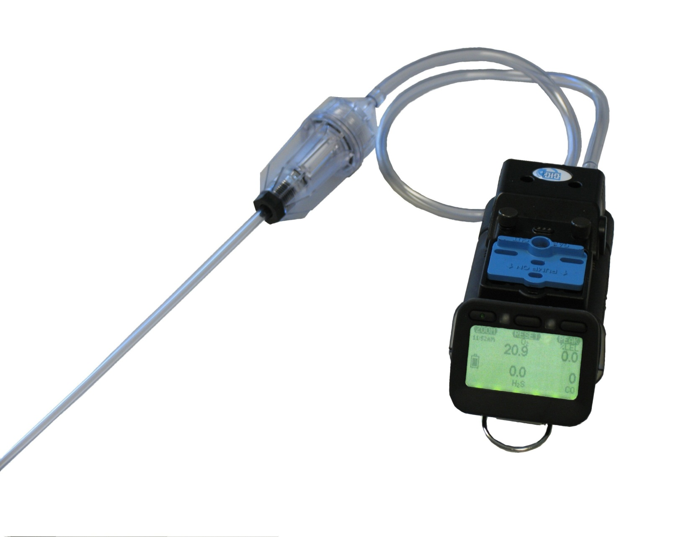
G450 / G460 Motorized Pump
Powerful motorized "smart pump" with its own battery pack
Sliding up the shutter turns on the pump and covers the diffusion ports
Motorized pump can be attached or removed from instrument as needed

Slide 19
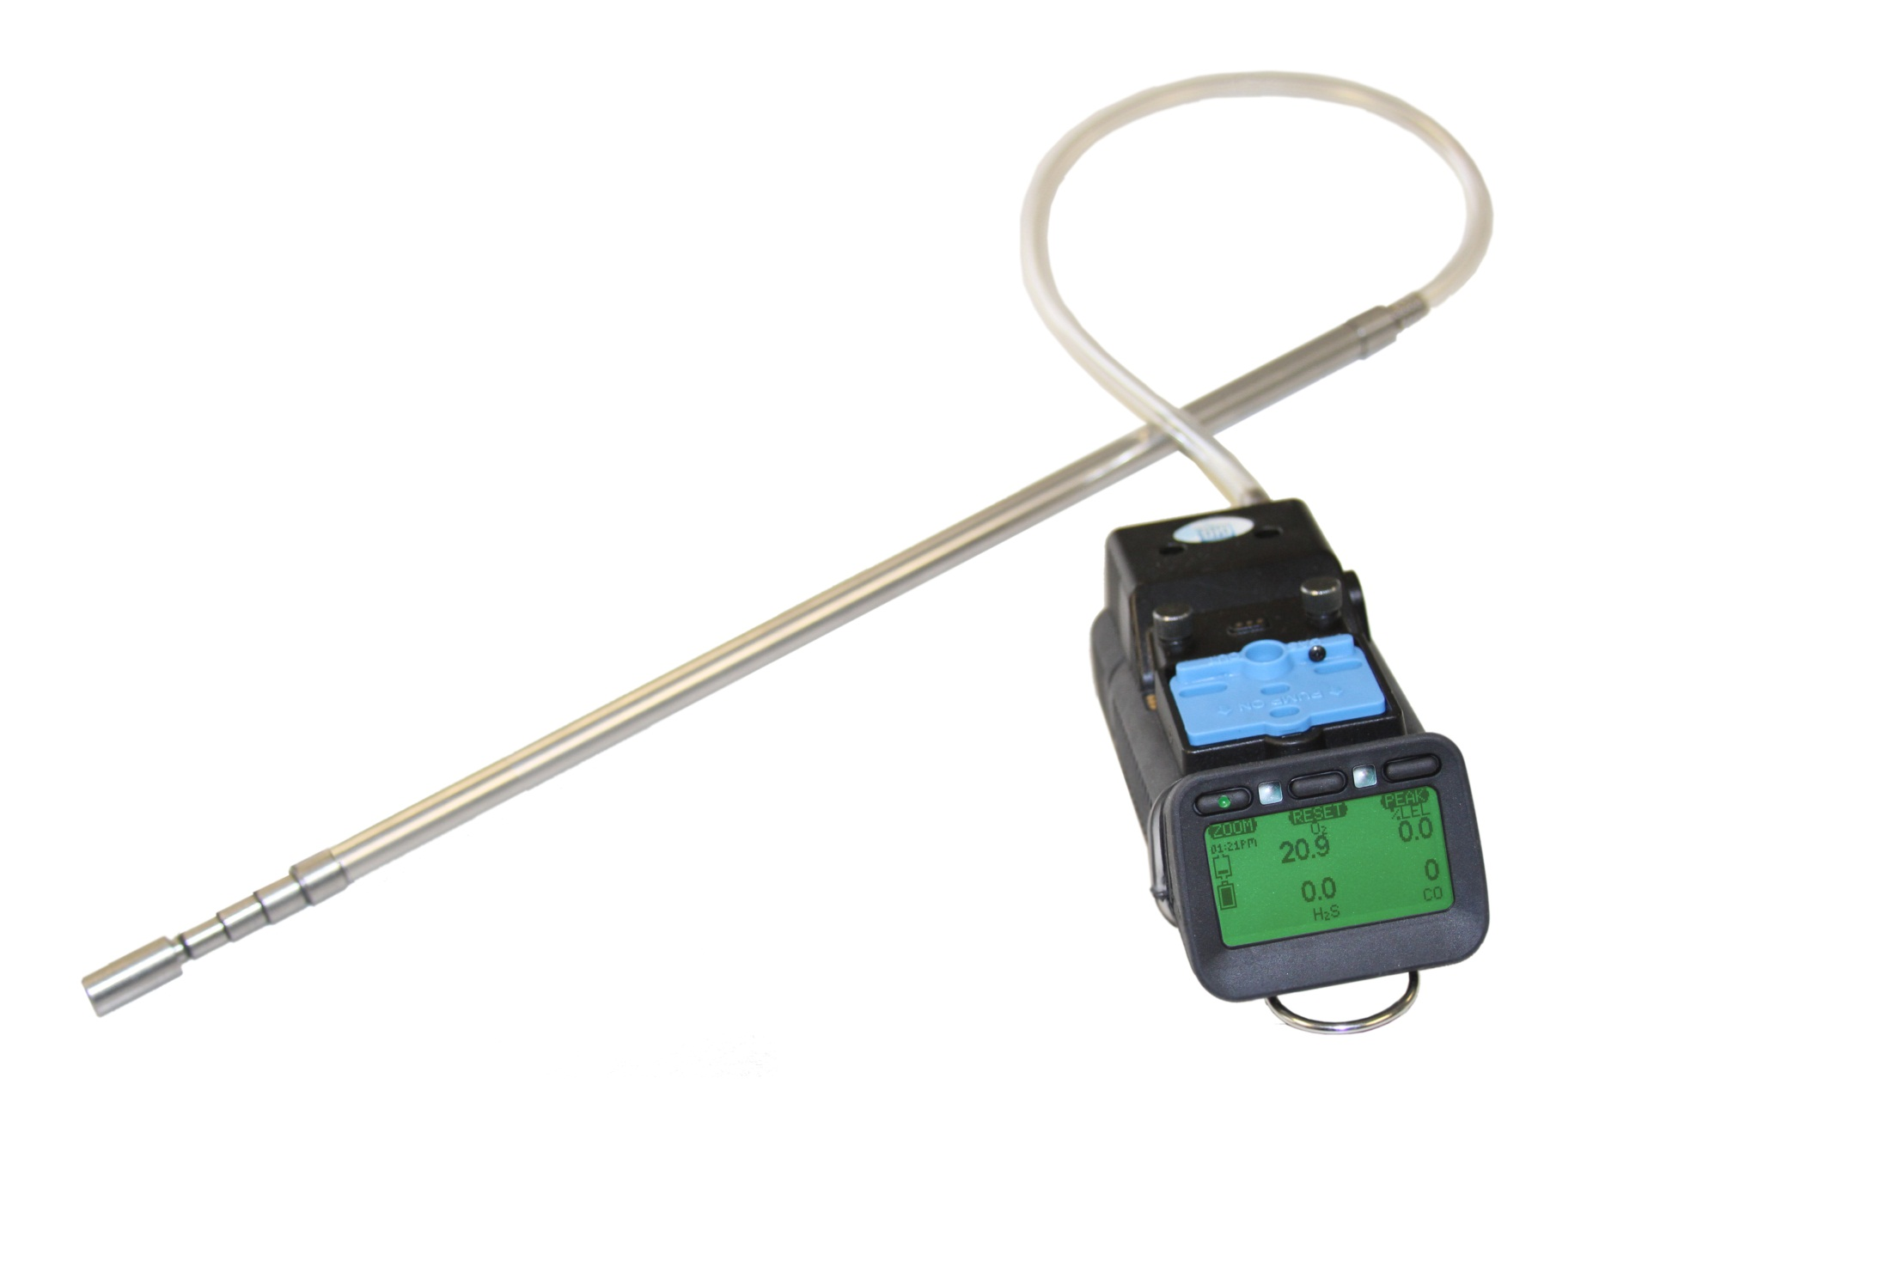
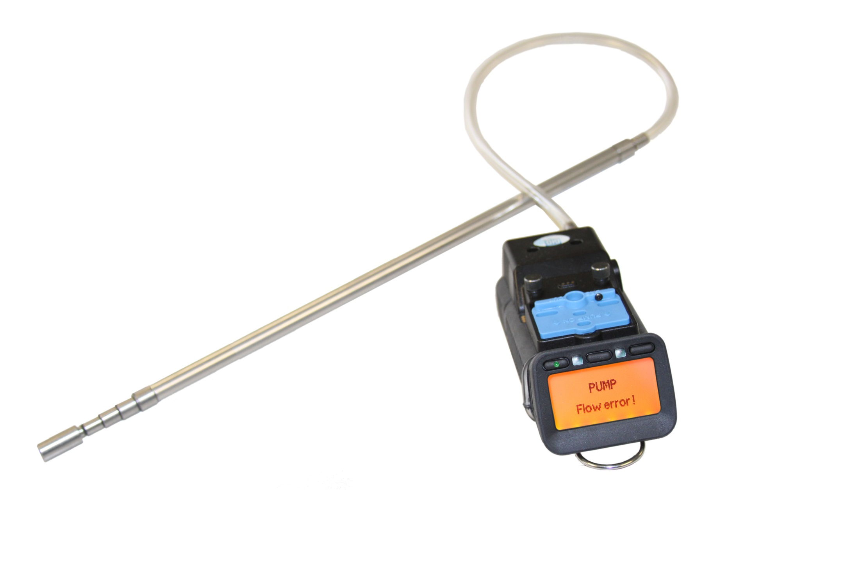
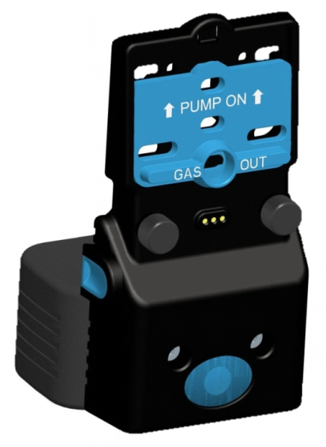
G450 / G460 Motorized Pump
"Smart" motorized pump directly monitored by instrument for proper performance
Low flow and pump malfunction alarms

Slide 20
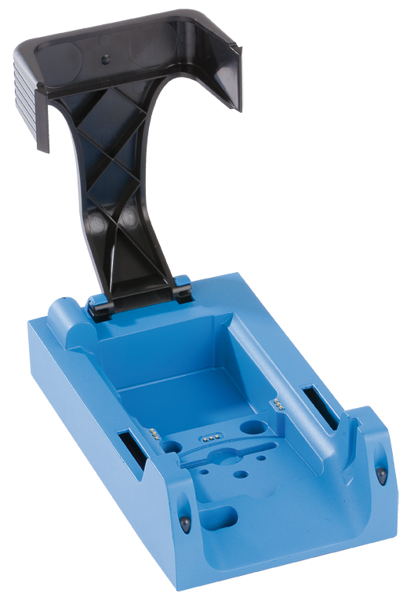
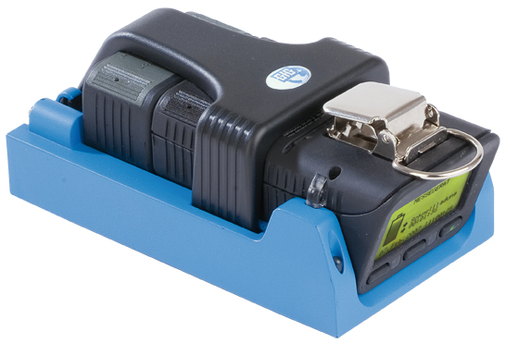
G450 / G460 Drop-in Charger
Smart charger includes trickle charge mode to prevent damage to battery pack due to overcharging
Available in single and double versions
Available for use with 12 VDC vehicle charging system

Slide 21
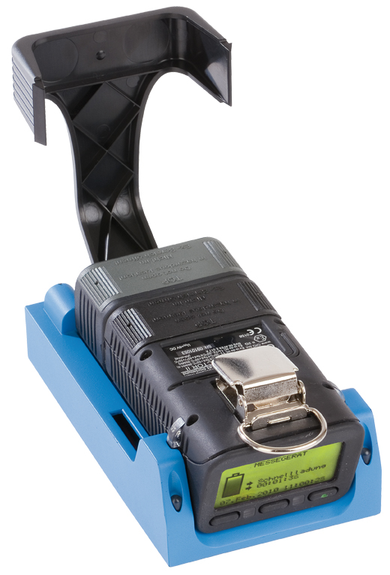
Optional G450 / G460 Drop-in Charger for Pump Equipped Instruments
Charger simultaneously charges both pump AND instrument
Available for use with 12 VDC vehicle charging system

Slide 22
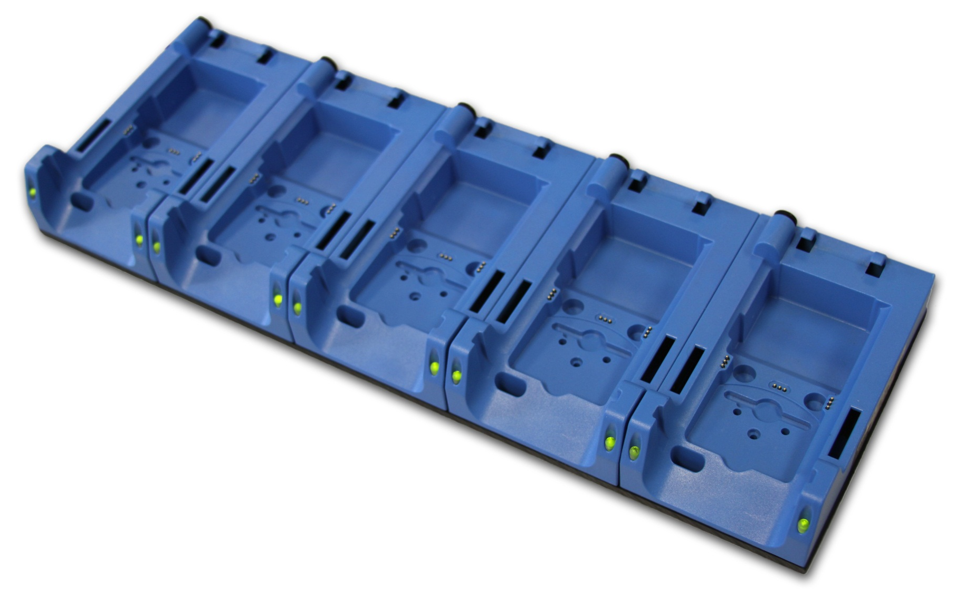
G450 / G460 Five-Unit Multi-Charger
Five instrument multi-charger

Slide 23
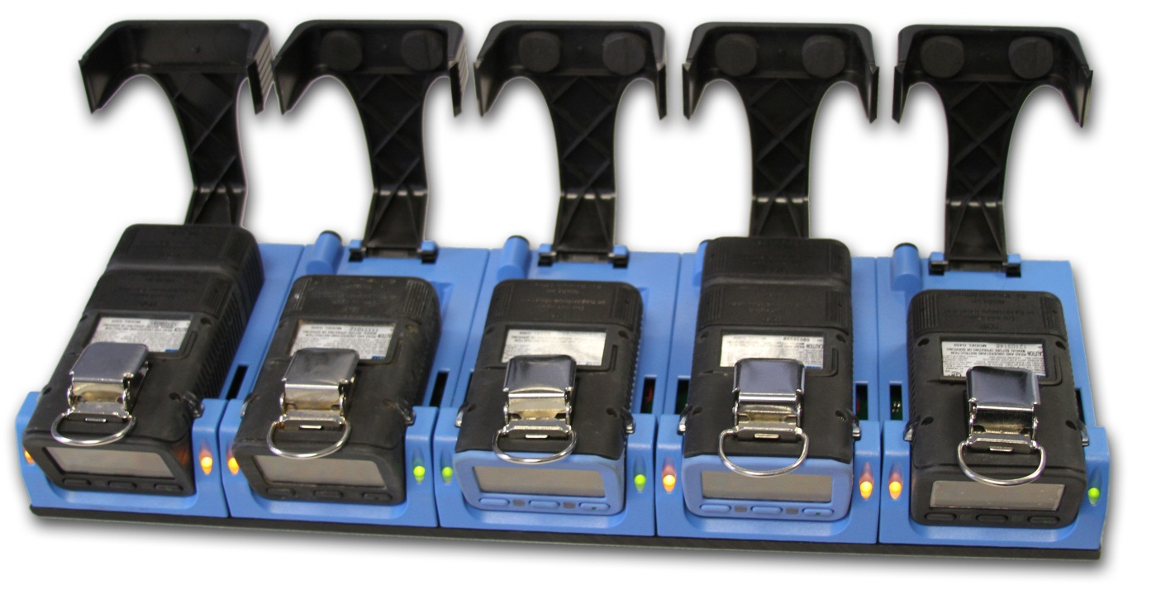
Five instrument multi-charger
Can be substituted in place of standard cradle chargers with orders of 5 or more instruments

Slide 24
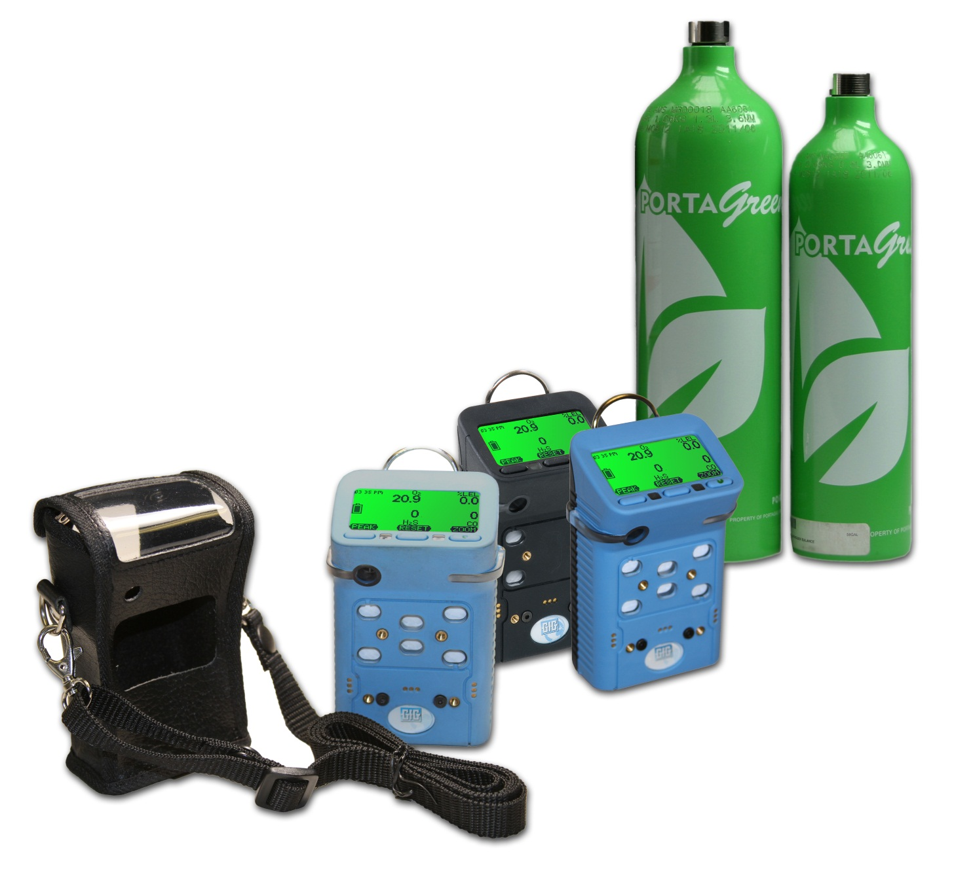
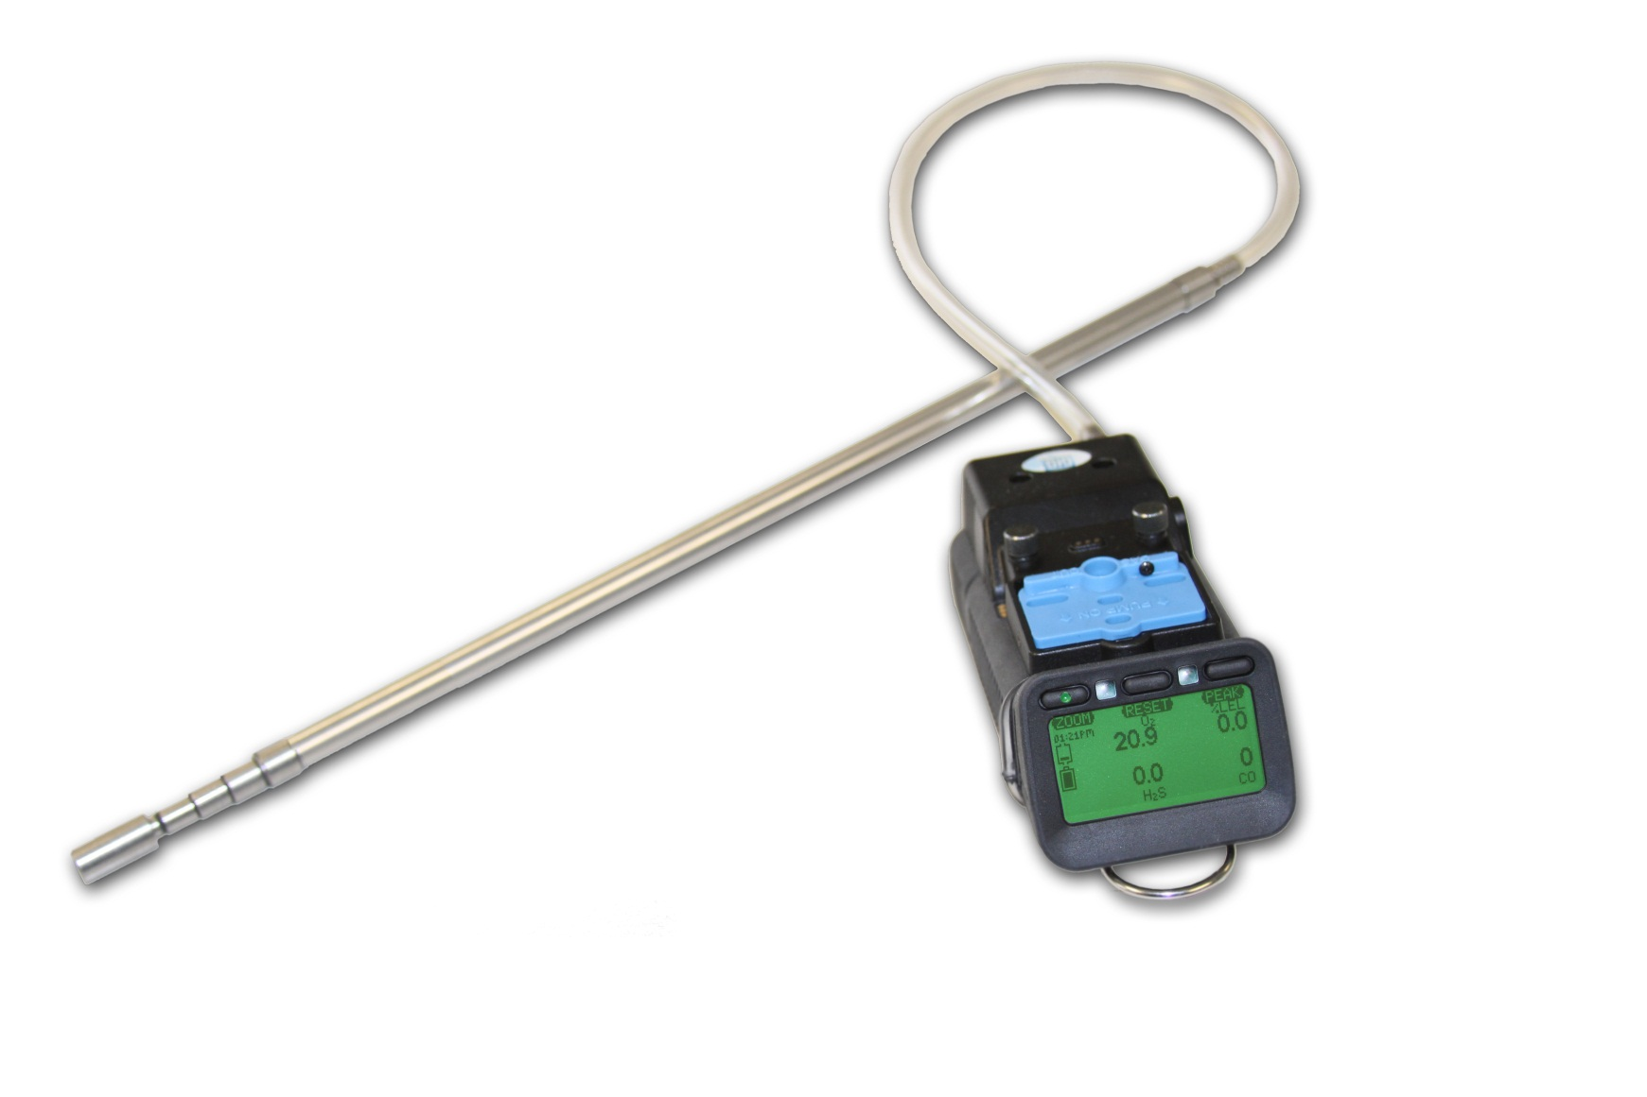
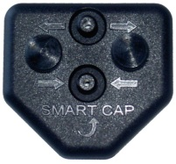
Other accessories
Calibration adapters
Sampling probes
Leather holsters
Calibration kits

Slide 25
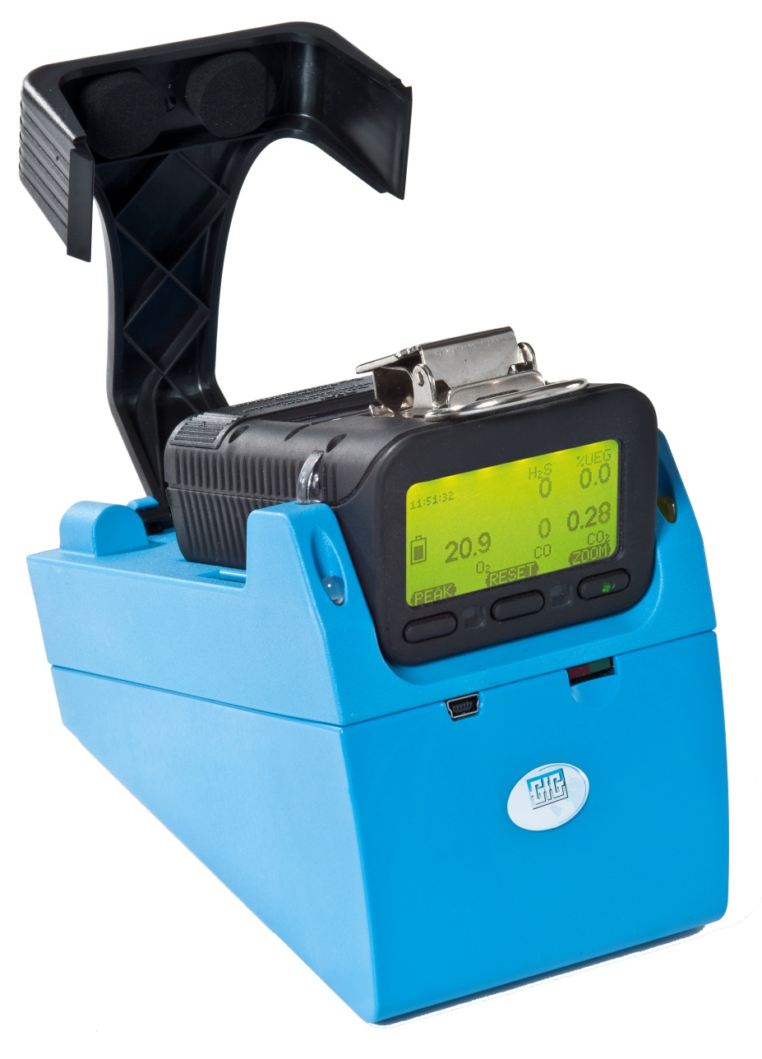
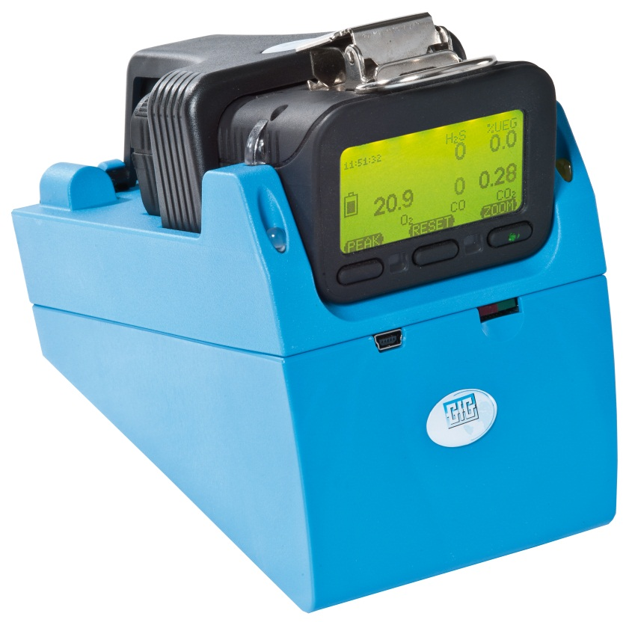
Use TS-400 Test Station for daily bump check
Standalone operation - No PC required!
Automatic bump-test only
Success / failure indication after each test
Economic use of test gas
Easy collection of unit test and logged data

Slide 26
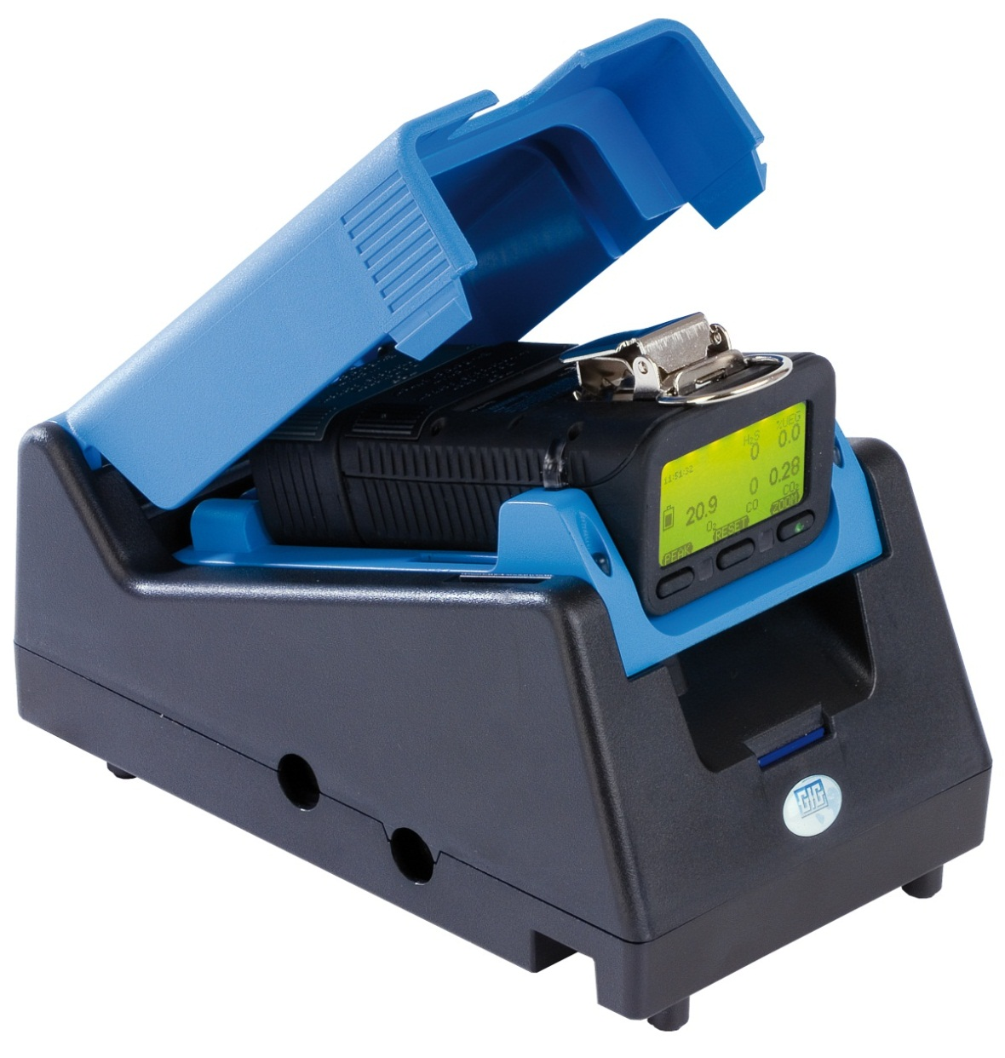
Use DS400 Docking Station for daily bump check and / or periodic calibration
Standalone operation:
No PC required
Automatic bump-test
Automatic span calibration
Success / failure indication after each test
Economic use of test gas
Easy collection of unit test and logged data
Reduced maintenance cost

Slide 27
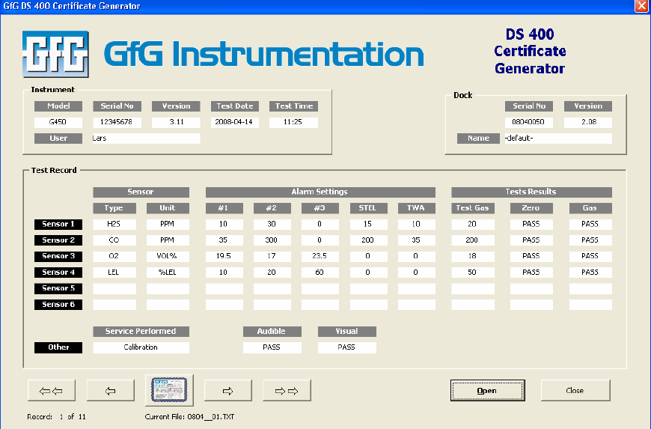
Comprehensive Test Reports
Easy to generate custom test reports

Slide 28
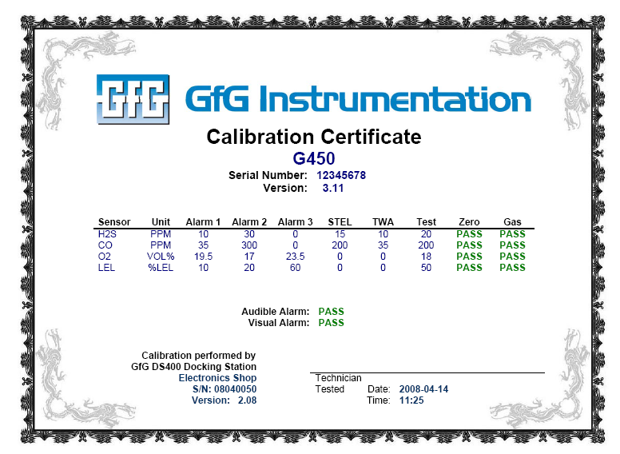
Automatically generate calibration and bump test certificates

Slide 29
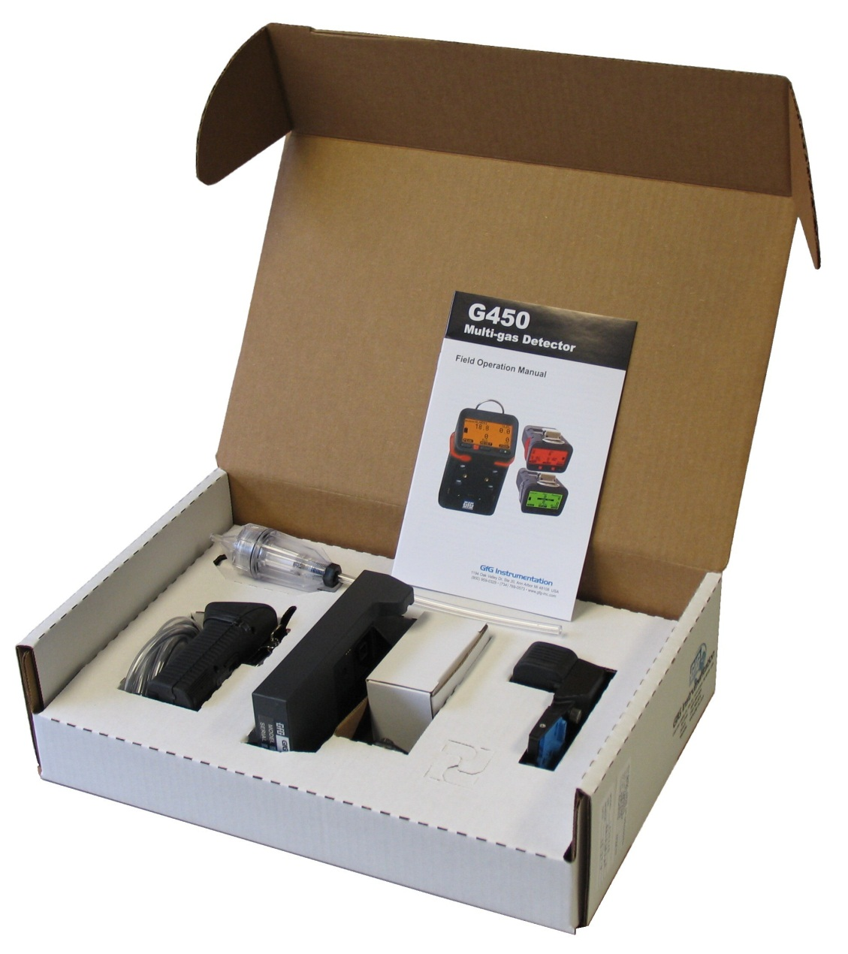
Accessories included with every instrument
Instrument with CO, H₂S, LEL and O₂ sensors (installed)
Operations manual
Battery pack (installed)
Rechargeable NiMH or
Alkaline
Charging cradle (when instrument has rechargeable battery pack)
110 VAC wall-cube power source
Calibration adapter

Slide 30
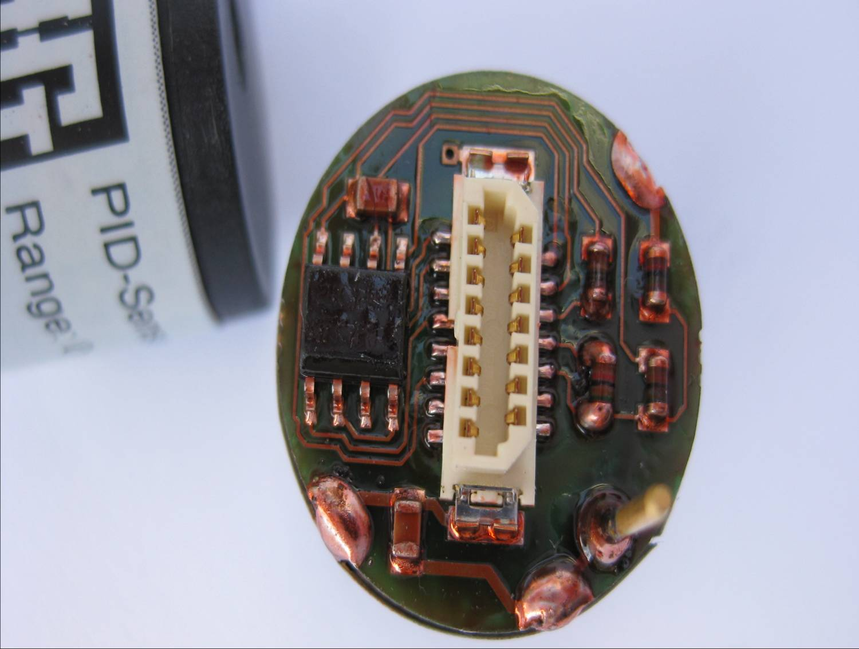
Traditional Electrochemical Toxic Gas Sensors
More types of sensors available every year
Toxic gas sensors designed to detect target gases at ever lower concentrations

Slide 31
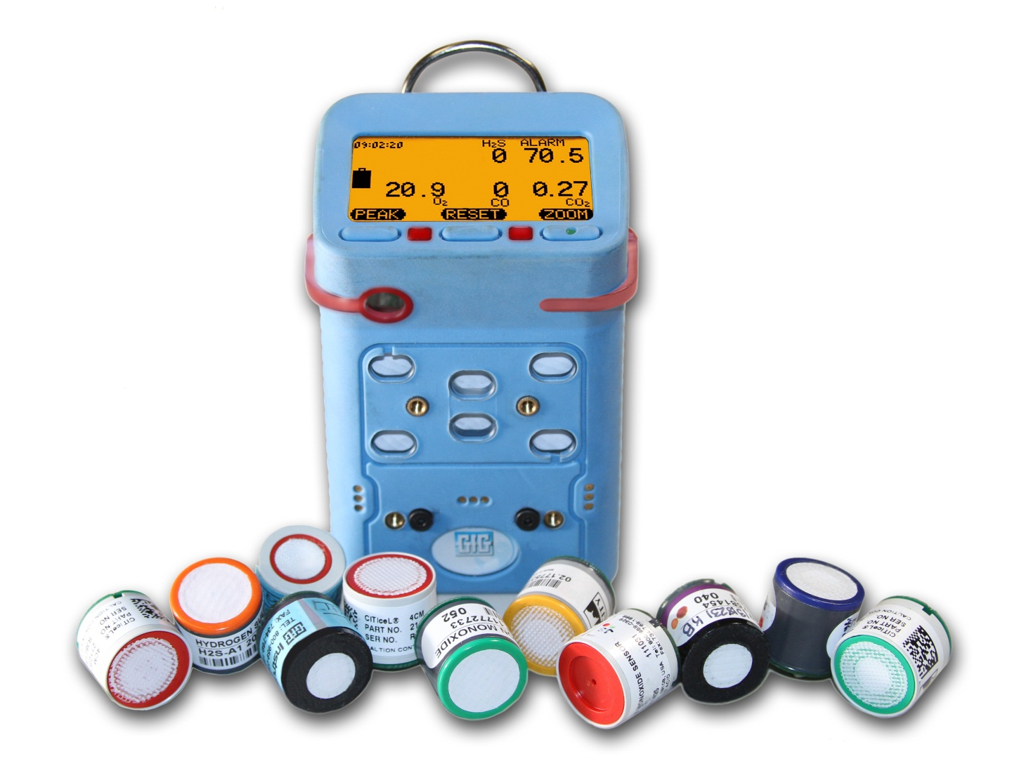
G460 Interchangeable Plug-and-Play Smart Sensors
Available sensors include:
O₂
Catalytic LEL
Infrared LEL
Infrared CO₂
CO
H₂S
COSH
PID
SO₂
Cl₂
ClO₂
NH₃
H₂
PH₃
HCN
NO
NO₂
HCL
HF
EtO
O₃
COCl₂
HBr
THT
and more!

Slide 32
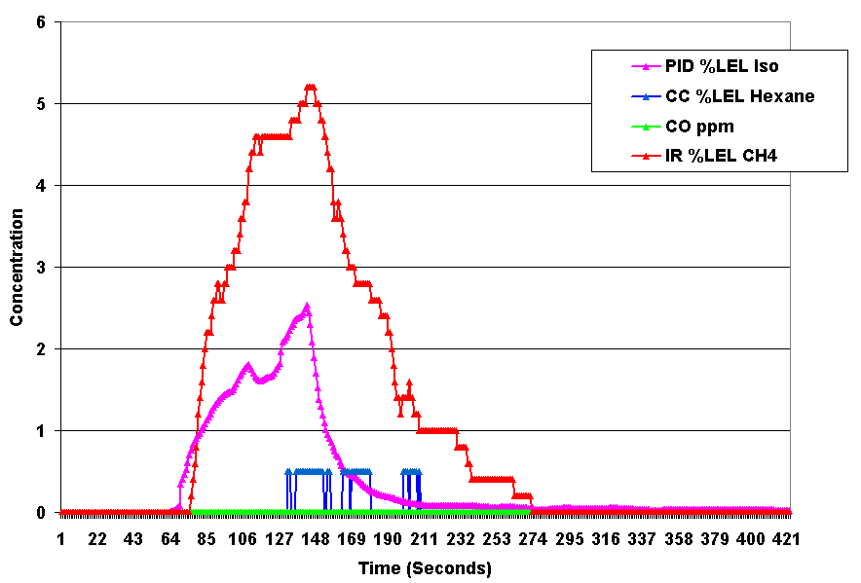
G460 has the flexibility to support the right sensor technology for the job!

Slide 33
GfG wins hands down when it comes to features AND three year cost of ownership!

Slide 34
Sales Support: www.Goodforgas.com
Data sheets
Price lists
Manuals
Application Notes
Product images
Print ads
...and more!

Slide 35
G450 / G460 Basic Operation

Slide 36
Basic operation
Basic operation is extremely simple
Single on-off button all that is needed for most day to day use
Read and understand the operations manual before use!

Slide 37
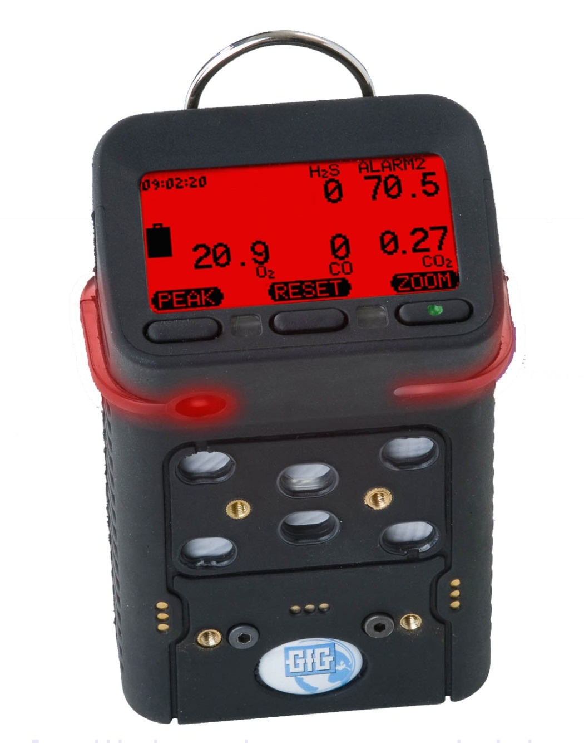
External features and controls
Control buttons
D-ring for carrying strap
LCD
On / Off button
Wrap-around 360° alarm light bar
Alarm LEDs
Audible alarm port
Diffusion inlets
Cal adapter screws
Battery pack screws
Charging contacts

Slide 38
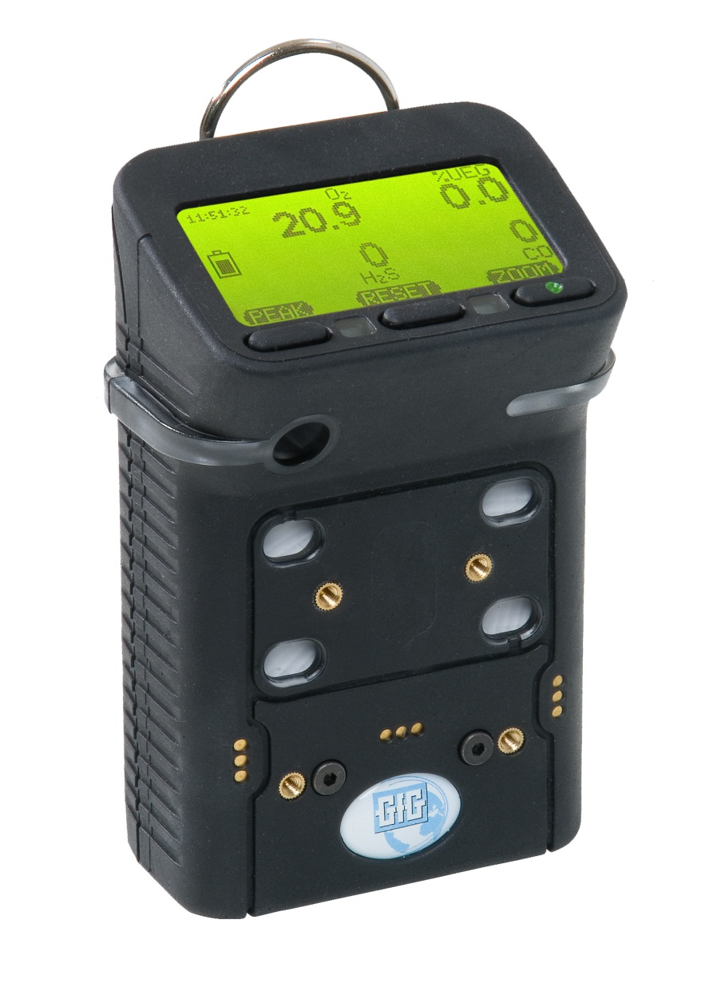
Battery Pack Location
Battery pack
Battery pack screws

Slide 39
Turning the instrument on
Verify proper performance by performing bump test before each day’s use
Make sure instrument located in fresh air before turning on
Press the right hand button to turn on
On / Off button (one with green indented dot)

Slide 40
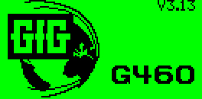
Verifying firmware version
The first screen in the start-up sequence shows the software version (firmware) currently installed

Slide 41
Startup sequence
After turning on instrument will display sequence of screens
Status of sensors
Alarm settings
Calibration and bump test due dates
Audible and visual alarms will briefly activate
Count-down indicates when G460 ready to use
Instrument will display alarm notification if bump test or calibration is overdue

Slide 42
Instrument start up
If the instrument displays a “Bump test” or “Calibration” warning during startup, press “NEXT” to acknowledge and continue
Do not use the instrument to monitor for gas until the required procedure is completed!
Check battery status when startup is complete
Verify that the readings stabilize at fresh air values (20.9% O₂, 0% LEL, 0 ppm toxic gas) and perform a fresh air Autocal adjustment if needed
Use the Docking Station or manually perform the required Bump Test or Calibration procedure
BUMP TEST overdue

Slide 43
“Bump test” and “Calibration” overdue alarms
The audible and LED alarms are activated and a warning message indicates the “Bump test” or “Calibration” due date has been exceeded
The warnings can be acknowledged by pressing the “NEXT” button, in which case the instrument continues the startup sequence
The alarms will continue to be displayed every time the instrument is turned on until they are cleared
The “Bump test” overdue alarm can only be cleared by using a Docking Station
The “Calibration” alarm can be cleared either by using a Docking Station, or performing a full manual calibration on the instrument
overdue

Slide 44
Turning the instrument off
Press and hold down the right hand “Zoom” button for 5 seconds to turn off
LCD will count down (3…2…1)
Release button when steady tone indicates shut-down is complete
On / Off (“Zoom”) button

Slide 45
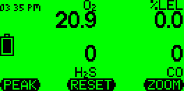
Function of buttons
The “name” and function of the control buttons change depending on what you are doing or seeing on the display

Slide 46
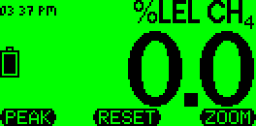
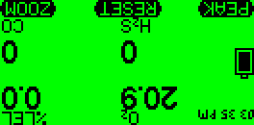
LCD features
Pressing any button will causes display backlight to be activated
Press the “Zoom” button once to magnify readings, press “Zoom” again to see next gas
Pressing “Peak” and “Zoom” at same time will “flip” display

Slide 47
LCD features
Pressing “Reset” and “Zoom” at same time puts instrument directly into “AutoCal” mode

Slide 48
Rechargeable battery pack
Available with optional built-in flashlight LEDs
LED location

Slide 49
To turn on LED flashlight
From normal operation:
Press and hold "Peak" until the soft key changes name to "Lamp" and lamp icon shows in display
LEDs will remain lit for 60 seconds, then turn off
Press "Lamp" to turn off sooner

Slide 50
Instrument readings and alarms
LEL:
Readings in 0.5% LEL increments
H₂S:
Standard H₂S sensor:
Readings in 0.1 ppm increments
COSH sensor:
H₂S readings in 0.2 ppm increments
CO:
Readings in 1.0 ppm increments
O₂:
Readings in 0.1% volume increments

Slide 51
G450 / G460 alarms

Slide 52
Effects of O₂ concentration on combustible gas readings
LEL readings may be affected if levels of O₂ are higher or lower than fresh air
The standard catalytic LEL sensor requires a minimum level of 10% oxygen to read LEL
If the O₂ concentration is too low the LEL reading will be replaced with question marks
Readings in fresh air
Readings in O₂ deficient air
Readings when O₂ too low for LEL sensor

Slide 53
Effects of high concentrations of gas on LEL sensor
Additional concerns when using standard catalytic LEL sensors:
Work is not permitted in areas where the concentration of gas exceeds safety limits!
If the explosive gas concentration is too high there may not be enough oxygen for the LEL sensor to detect properly
Concentrations above 100% LEL can damage the LEL sensor
Readings in fresh air
Initial alarm at 10% LEL
High (“Alarm 2”) at 20% LEL
High (“Alarm 3”) at 50% LEL
Over-limit alarm (arrows) at 100% LEL

Slide 54
Peak Reading Mode
Main screen shows the current gas concentrations
Press “Peak” once put instrument into “Peak” reading mode
Icon in display indicates when in peak reading mode
Press “Reset” to clear the peak readings
Press “Peak” to return to normal operation
Note: after 15 minutes G450 returns to normal gas reading screen

Slide 55
Clearing "Peak Mode" readings
"Peak Hold" function shows most significant values ONLY between the time "Peak" button is first pushed and the next time it is pushed to clear the "Peak" readings
Pushing "Peak" again clears the displayed "Peak Mode" readings and returns instrument to normal operation
Clearing "Peak Hold" readings DOES NOT clear or reset the Max, STEL or TWA readings in the instrument memory

Slide 56
Viewing Peak, STEL and TWA readings for entire monitoring interval
The instrument can also display Peak, STEL and TWA readings for the entire monitoring interval (the period of time that the instrument has been turned on)
Press "Zoom" to make numbers larger, then press and hold "Zoom" for approximately 2 seconds (till instrument beeps)
Display will now show Max, STEL, TWA for toxic sensors; Max combustible gas, and Min O2
Press "Zoom" to advance from one sensor to the next

Slide 57
G450 / G460 battery packs
Interchangeable rechargeable (NiMH) and alkaline battery packs last up to 25 hours
NiMH batteries provide excellent cycle life and low temperature performance
NiMH battery packs warranted for 2-years
Typical run-time after two years for properly maintained NiMH battery packs is usually around 16 hours

Slide 58
G450 / G460 Drop-in Charger
Smart charger includes trickle charge mode to prevent damage to battery pack due to overcharging
Available in single and double versions
Available for use with 12 VDC vehicle charging system

Slide 59
Optional G450 / G460 Drop-in Charger for Pump Equipped Instruments
Charger simultaneously charges both pump AND instrument
Available for use with 12 VDC vehicle charging system

Slide 60
G450 / G460 Charging Cycle
GfG smart chargers begin the charging cycle in the “fast charging mode”, then switch to “trickle charge mode” when the battery is charged to 90% of its full capacity
Completely discharged batteries may require up to 6 hours to reach the trickle charge stage
Note: If possible, leave the instrument in the charger for an additional one or two hours after reaching the trickle charge stage to reach 100% of the charge capacity of the battery

Slide 61
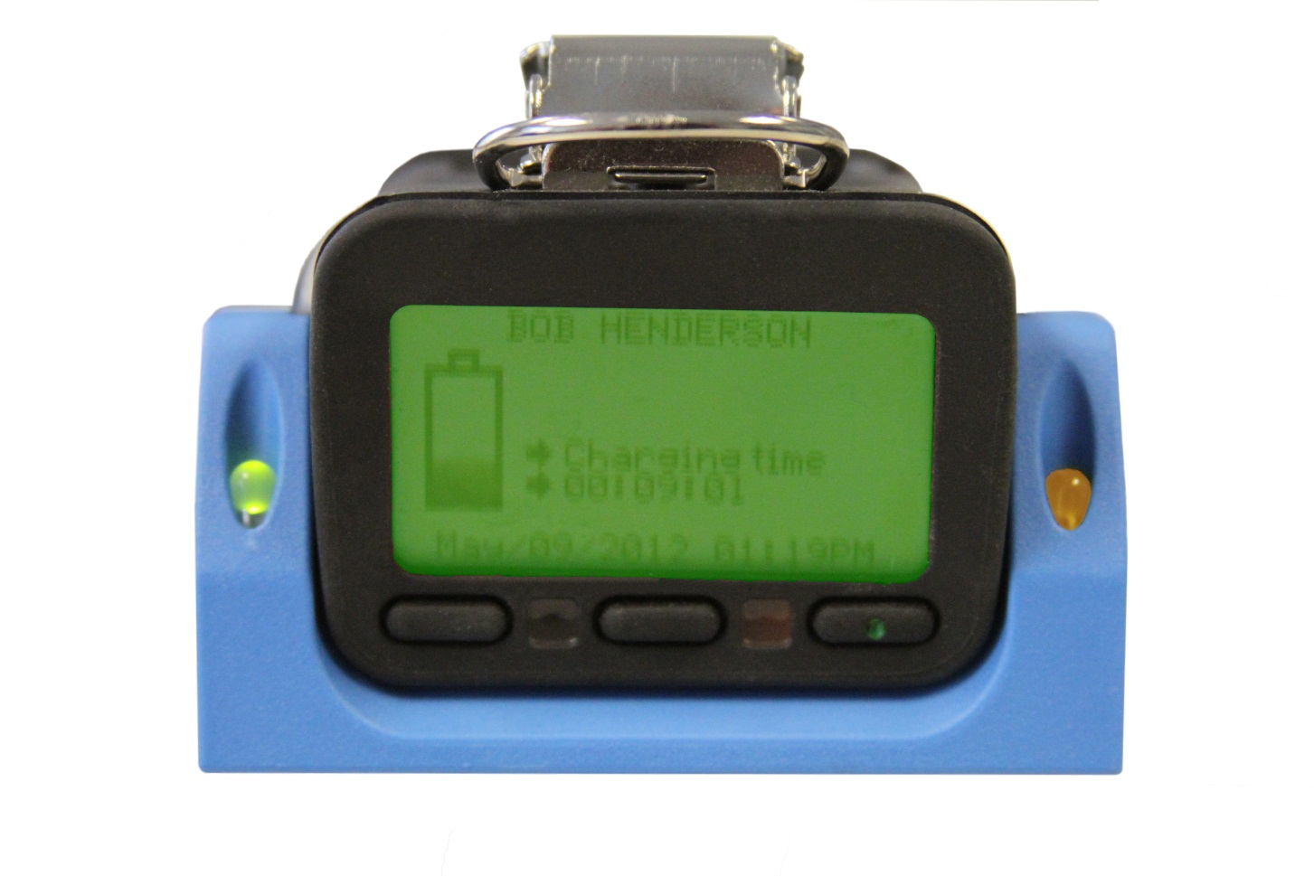
G450 / G460 Charging Cycle
The green LED in the “single” charger cradle indicates power
A solid amber LED indicates fast charging
A flashing amber LED indicates trickle charging
The instrument display indicates how long the instrument has been in each stage of the cycle
Solid amber indicates fast charging, flashing amber indicates trickle

Slide 62
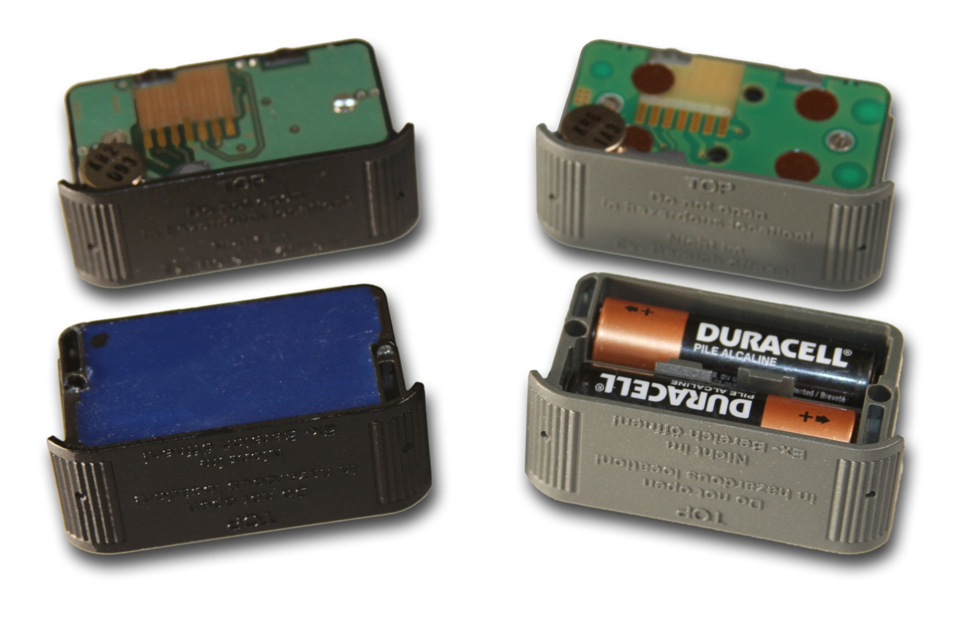
Changing battery packs
NiMH: Black
Alkaline: Gray

Slide 63
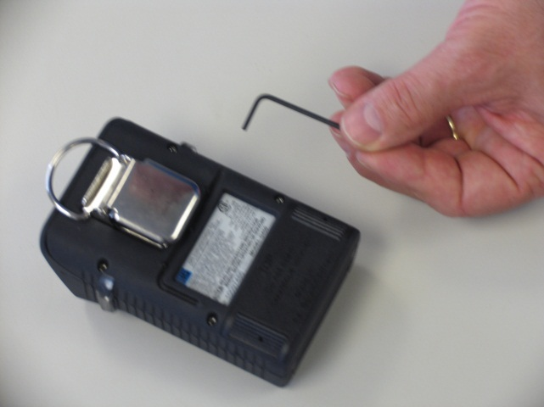
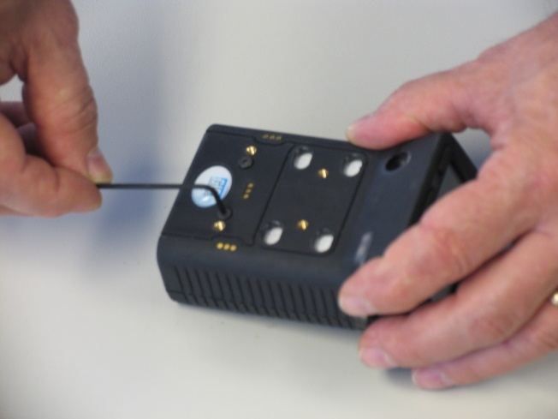
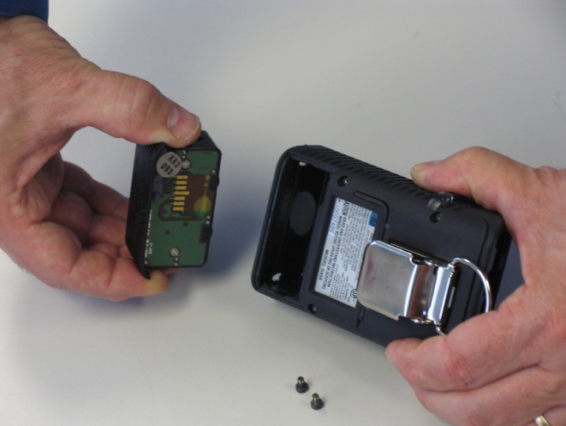
Changing battery packs
Use the hex wrench tool to loosen and remove the two screws securing the battery pack to front of the instrument housing
GENTLY remove the battery pack from the instrument
NOTE: USE YOUR FINGERS TO REMOVE THE BATTERY PACK FROM THE INSTRUMENT
NEVER USE A SCREWDRIVER OR OTHER HARD TOOL TO REMOVE THE BATTERY PACK

Slide 64
Changing battery packs
Make sure that the vibrator (the flat disc on the top of the battery pack is) is at the top when the battery pack is reinserted into the instrument
DO NOT FORCE WHEN INSERTING THE PACK INTO THE HOUSING!
Reinstall and tighten the screws
MAKE SURE SCREWS ARE SECURE BUT DO NOT OVERTIGHTEN!
Vibrator

Slide 65
Voltage depression due to over-charging
NIMH batteries do not develop “memories”, however, if they are not exercised they may become “lazy”
Even though the normal amount of power is stored the battery, the peak voltage in “lazy” batteries drops more quickly than usual
Voltage depression is caused by the formation of small crystals of electrolyte on the plates, increasing resistance and lowering the voltage of some individual cells in the battery
To the user it appears the battery is not holding its full charge; to the instrument the rapid drop in voltage indicates that the batteries are about to run out of energy
Exercising the battery by putting it through a deep-discharge cycle can break down the crystals, and improve or restore the run time of the instrument

Slide 66
“Anti-lazy battery” deep-discharge cycle
Fully charged instruments that fail to operate for the expected time should be exercised by means of the “anti lazy battery” deep discharge cycle
Note: Instruments that are left on the charger for prolonged periods between use may benefit from being exercised by being deep discharged on a quarterly basis

Slide 67
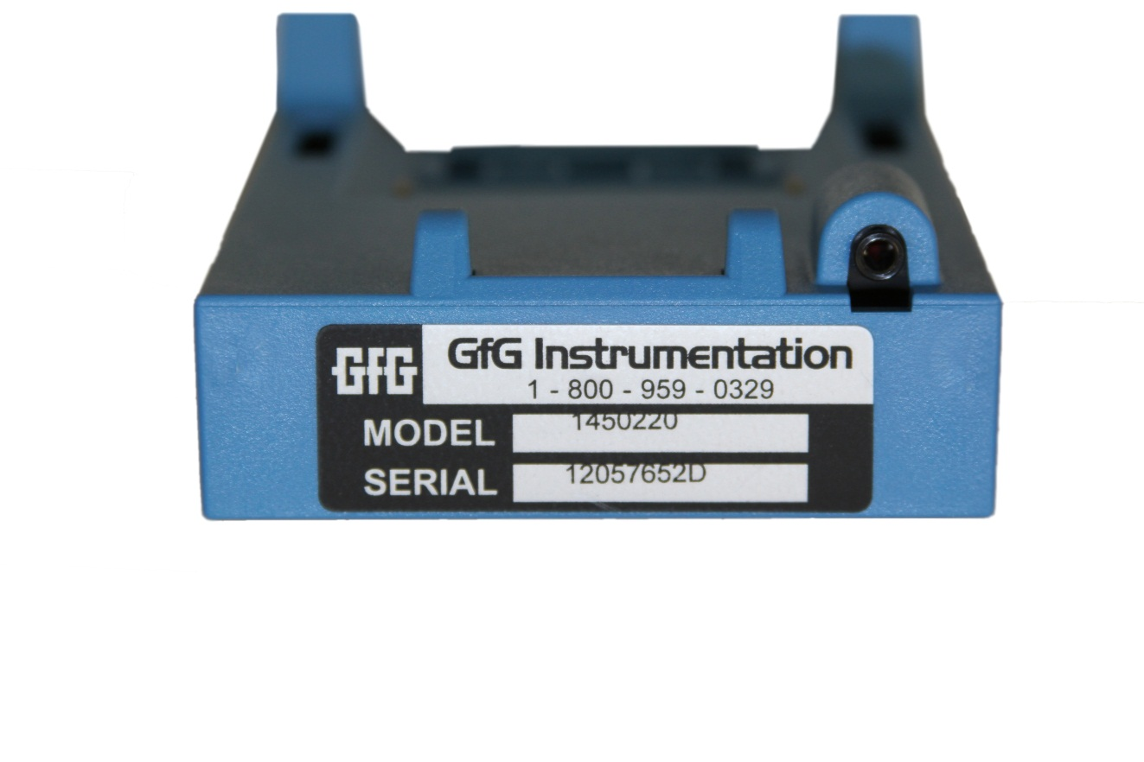
Charger cradle hardware compatibility
G450 and G460 instruments with version 3.41 and higher firmware have enhanced “anti-lazy battery” as well as other features
GfG recommends updating your instrument firmware to take advantage of these enhanced features
To take full advantage of the latest anti-lazy battery options it is also necessary to have the latest version charger cradle and power adapter
Note: Charger cradle and power adapters sold prior to October, 2011 can be updated at the GfG factory in Ann Arbor to the latest configuration
Cradle serial numbers ending in “D” indicate the latest version
Power adapter must be equipped with “stereo” type jack with two black stripes

Slide 68
Main menu screen
Press and hold down “Reset” button until “Main menu” choices appear:
Location (use to enter a location name)
User (use to enter a user ID number)
Datalogger (use to adjust datalog interval)
Alarm clock (use to activate a periodic alarm based on the clock time)
Service (use to access the “Service Menu”)
AutoCal® (use to make either fresh air or span calibration adjustment)
Options (use to adjust display contrast, alarm loudness, confidence beep, or activate “Anti Lazy Battery” option)
Pump (use to review pump status of motorized pump)

Slide 69
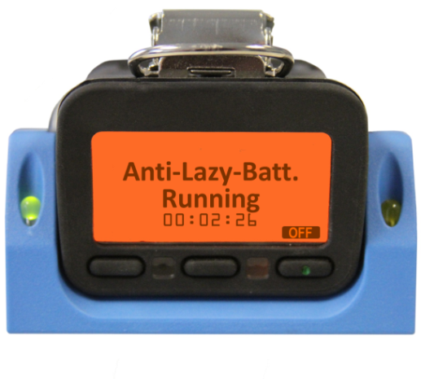
One-time deep discharge cycle for NiMH battery pack
From “Option Menu” choose “Anti-Lazy-Battery”
Press “Change” to turn on the one-time deep discharge feature
Display will show “1X” instead of “Off”
Press “Exit” to return G450 to normal operation
DO NOT TURN THE INSTRUMENT OFF!
Allow to run until battery completely drained, then recharge normally, OR
When down to last 10% of battery place instrument in charger
Do not place in charger until battery icon shows it is down to the last 10% remaining voltage
Instrument will complete anti-lazy battery deep discharge, then charge normally

Slide 70
Automatic deep discharge cycle
It is possible to program the instrument so the deep discharge cycle is always automatically activated whenever the instrument is placed in the charger when the battery is below 10% remaining voltage
From “Options” choose “Anti-Lazy-Battery” then press “Change” to activate the one-time deep discharge cycle (display will show “1X” )
Press “Change” again to choose “Days”
Anytime the instrument is placed in the charger when there is less than 10% remaining voltage the deep discharge cycle will be activated automatically

Slide 71
Limiting automatic deep discharge cycle to certain days
Since deep-discharge can take up to 20 hours to complete, it may be advisable to limit automatic deep-discharge to certain days of the week (i.e. enabling the feature for Fridays to give the instrument a full weekend to complete discharging and recharging)
Press the “down arrow” key to highlight the “Anti-Lazy days” choice, then press “Change”
The instrument will display the days of the week
Select the desired days for the automatic activation of this feature, then “Exit” to return to normal operation

Slide 72
Automatic deep discharge cycle
Pressing “Off” while the instrument is in the charger immediately ends the deep-discharge cycle, and returns the instrument to normal charging
Press “Off” to immediately end deep discharge

Slide 73
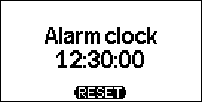
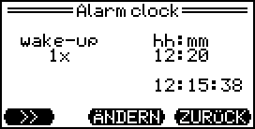
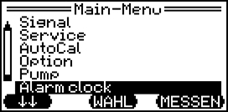
G450/G460 New Firmware V3.44
Addition of a “Clock function”
Example in Measuring mode Setting in the main menu under “Alarm clock” - Selection: OFF, 1x, daily - Setting the alarm time hrs:mins

Slide 74
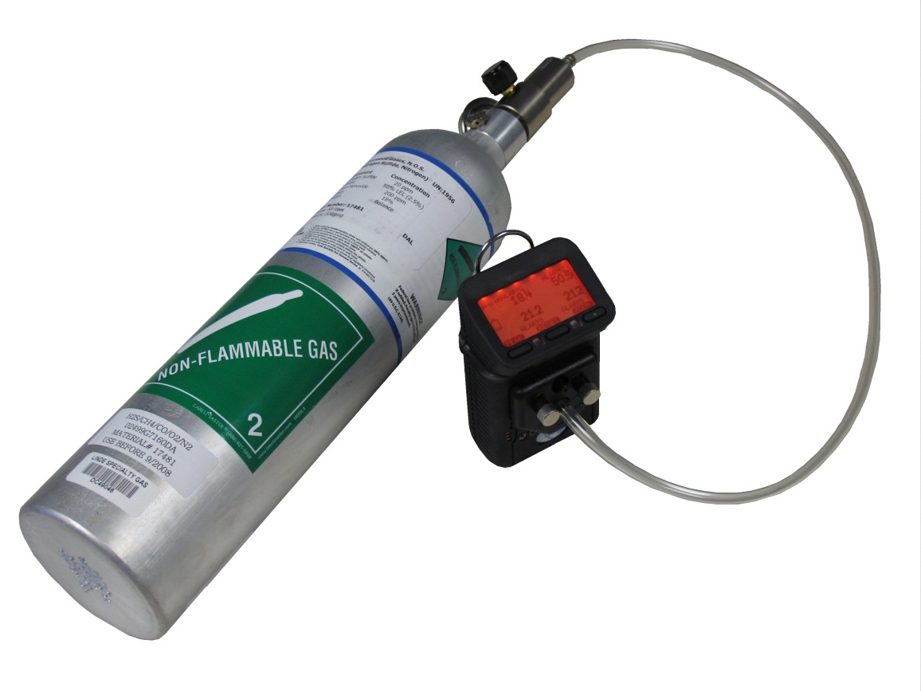
Bump Test (Manual Procedure)
Make sure the instrument is located in fresh air, turn on, and allow to warm up
Note readings, and perform fresh air zero if necessary
Attach calibration adapter; instrument will display "AutoCal menu"
Press "Exit" to show normal gas reading screen
Flow gas to sensors; alarms should activate, and readings should stabilize at expected values (if sensors fail to respond properly, instrument should be calibrated before further use)
Turn off gas, remove cal adapter and allow readings to stabilize at fresh air values

Slide 75
Bump Test
Response of sensors to Quad Mix (graphs)
Readings recorded while instrument operated in normal gas reading mode
Simultaneous response to all four gases, as well as match between cal gas concentrations and readings

Slide 76
Bump Test
Response of sensors to Quad Mix (table)
Readings recorded while instrument operated in normal gas reading mode
When a sensor is in alarm readings are recorded in red

Slide 77
Manual AutoCal
AutoCal allows instrument to be “Fresh air” or “Calibration” (span) adjusted if needed

Slide 78
Attach Cal Cap to Enter Fresh Air and Span “AutoCal”
Choose ZERO or CAL and apply gas (if calibrating), e.g. an H₂S/CO mix.
Adjustment is automatic
Display shows when cal adjust has been successfully completed
Attach cal cap to unit;
instrument automatically
enters “AutoCal” menu

Slide 79
Can also enter “AutoCal” mode by pushing “Reset” and “Zoom” buttons at same time
Choose ZERO or CAL and apply gas (if calibrating), e.g. an H₂S/CO mix.
Adjustment is automatic
Push “Reset” and “Zoom” at same time; instrument automatically enters “AutoCal” menu
Display shows when AutoCal adjust has been successfully completed

Slide 80
Calibration gas concentrations
Best to use the default cal gas concentrations
Default GfG concentrations used to calibrate instrument:
200 ppm CO
20 ppm H₂S
50% LEL methane (CH₄)
If you use different concentrations you must change instrument settings!

Slide 81
What should you do if you fail AutoCal adjustment?
AutoCal adjusts all of the sensors that can be adjusted based on the calibration gas being used
The display will show an “Error” for any sensors that were not successfully adjusted
The most common reasons for failing AutoCal adjustment are:
Forgetting to attach the cal adapter
Forgetting to turn on the flow of gas
Empty calibration gas cylinder
Wrong cylinder / wrong concentration(s) in calibration gas
Gas has expired dating and is no longer usable
Before giving up, check the gas and fittings and try again

Slide 82
What if you check the gas and fittings but still fail AutoCal adjustment?
To avoid accidentally using the wrong cal gas, or zeroing the instrument in the presence of contaminants;
AutoCal has a maximum permitted change in adjustment between one fresh air zero, or one span calibration and the next
If the change between the zero or span setting exceeds this maximum, the instrument will not properly adjust
In this case you will need to perform a single-sensor calibration on the sensor or sensors that have failed to calibrate properly

Slide 83
Single sensor calibration procedure (part 1)
Use single sensor calibration procedure whenever you need to calibrate one sensor at a time
Press and hold “Reset” button to show the “Main Menu” then chose “Service”
For “Security Code” use “1100” as the password
Choose “Sensors” then select the sensor that you intend to calibrate
Make sure to use “1100” as password.
“1100” is a special password that allows a wider maximum calibration adjustment window.

Slide 84
Single sensor calibration procedure (part 2)
A screen will show the menu choices for the selected sensor
If the sensor needs to be fresh air adjusted choose “Zero”
If the sensor does not need to be fresh air adjusted choose “Calibrate”

Slide 85
Single sensor calibration procedure (part 3)
To perform a fresh air zero:
Make sure the sensor is exposed to fresh, contaminant free air
Make sure to remove the cal adapter if you are using the surrounding air to adjust the sensor
The “Zero” screen will show the current reading
Press “Start” to begin the fresh air adjustment
An “OK” indicates when the procedure is complete, after which the screen returns to the “Zero” screen
You MUST save the results of the fresh air or calibration adjustment or they will not be saved to the instrument’s memory!

Slide 86
Saving single-sensor “Zero” and “Calibration” results (part 4)
If you do not deliberately save the results, after a few minutes the instrument will return to normal operation and the results will not be saved!
Press “Exit” to save the results and return to normal operation
Each time you press “Exit” you move up one level in the instrument program
The final screen will ask whether you want to “Save new adjustment?”
Press “Yes” to update the instrument memory

Slide 87
Single sensor calibration procedure (part 5)
To perform a span Calibration:
Choose the sensor to be calibrated
Choose “Calibrate” from the menu
Make sure the calibration adapter, calibration gas and regulator are attached to the instrument
The “Span” calibration screen shows the “CalGas” concentration that the instrument will use to adjust the sensor
Verify the concentration of gas in the cylinder matches the “CalGas” value
If needed, you can adjust the “CalGas” value by selecting “Gas” then using the arrow (↑↑ or ↓↓) buttons to change the concentration
Press “Exit” after you finish adjusting the “CalGas” concentration

Slide 88
Single sensor calibration procedure (part 6)
To perform a span Calibration:
The “Readout” shows the current sensor reading
Open the regulator valve to begin flowing gas to the sensor
The “Readout” number will begin to rise as the sensor is responds to the gas
Press “Start” to begin the calibration adjustment
The “Span” calibration screen will show an hour-glass icon while the sensor is being adjusted, then an “OK” message when the adjustment is complete
Press “Exit” to return the instrument to normal operation.
Remember to “Save” the new adjustment or the results of the calibration will not be updated to the instrument memory

Slide 89
DS-400 Docking Station for daily bump check and / or periodic calibration
Standalone operation:
No computer required!
Docking station controlled by instrument’s control buttons:
Push "Test" for Bump Test
Push "Cal" for Auto Cal
Push "Cancel" to charge only

Slide 90
DS-404 Multi-inlet Docking Station for bump check and periodic calibration
Inlets for 4 cylinders of gas
Automatic Bump and Cal for 5, 6 and 7 channel instruments
Supports:
Quad mix (O₂, LEL, CO, H₂S)
5-mix with SO₂
5-mix with CO₂
Isobutylene
HCN
NO₂
And other individual gases

Slide 91
Using DS400 Docking Station for daily bump check and / or periodic calibration
Standalone operation: DS-400 does not require connection to an external computer
Test results and other messages displayed on instrument LCD

Slide 92
Using DS-400 Docking Station for daily bump check and / or periodic calibration
Using DS-400 allows instrument to record "Bump Test" as specific event in instrument's memory
It is possible to set a "Bump Test Due" date in the instrument's memory
Only way to reset next "Bump Test Due" date is by means of DS-400 Docking Station

Slide 93
Using DS-400 Docking Station for daily bump check and / or periodic calibration
Make sure DS-400 attached to test gas and power
Make sure the instrument is located in fresh air, turn on, and allow to warm up
Note instrument readings, and perform fresh air zero if necessary
Place instrument in DS-400
Docking station controlled by instrument’s control buttons:
Push "Test" for Bump Test
Push "Cal" for Auto Cal
Push "Cancel" to charge only

Slide 94
How to do bump test
Make sure instrument turned on
Best if instrument allowed to warm-up at least 5 minutes before bump test
Make sure Docking Station plugged in and connected to gas
Higher inlet is for fresh air
Lower inlet is for span gas
Place instrument in Docking Station
Instrument display will indicate status and results of test

Slide 95
How to do bump test
After 10 second count-down; Docking Station automatically performs bump test
Instrument screen shows a check mark besides each sensor as bump check completed
If instrument is not removed from Docking Station; 5 minutes after test completed instrument automatically turns off and goes into charging mode

Slide 96
DS400 Docking Station
Bump-Test includes:
Visual alarm function
Audible alarm function
Time for activation to alarm 1
Time for activationto alarm 2
Time to t50
Calibration Test Includes:
Fresh air zero adjustment
Span calibration adjustment
All test results:
Stored to instrument memory
Stored to flash memory card in Docking Station

Slide 97
What to do if instrument fails bump test
Red color warning screen and message indicates bump test failed
This means instrument needs to be “Autocal” adjusted before further use
Remove instrument from Dock, and press “Reset” (center) control button to clear alarm message
Place instrument back in Dock
Before end of count down press Autocal button

Slide 98
DS-400 charging tray options
DS-400 Docking Stations can be equipped with a "single" or "double" charging tray for recharging the instrument and pump battery pack at the same time
The trays are designed to be easily interchanged
The charging tray is secured in the Docking Station housing by a single Phillips screw

Slide 99
Removing or changing the DS-400 charging tray
Charging tray screw
Remove the charging tray screw;
Lift the tray from the front and pull up and forward

Slide 100
DS400 Docking Station options
"USB anywhere" external hub allows customer to transmit test results via Ethernet connection to internal or external network

Slide 101
Pump Start-up
Make sure the pump is properly attached to the instrument
Attach the tubing and sample probe assembly
Turn the instrument on
After the instrument has completed the self test and warm-up sequence, use the on / off slide switch turn the pump on
The instrument will display pump battery status
Block the inlet to verify that the low flow alarm activates properly

Slide 102
Using the motorized sample pump
Sampling Rules
Maximum recommended sampling distance 300 feet (100 meters) with
1 second per foot of tubing (3 seconds per meter)
2 minutes sample time (sensor response)
Confined Space sampling:
Top, Middle, Bottom (at a minimum, sample at every 4 ft. interval )

Slide 103
Performing a gas test
Perform proper instrument start up
Make sure instrument has been properly bump-tested before use
Perform proper pump start up (if applicable)
Make sure sample probe assembly is used whenever using the motorized sampling pump
Make sure sample probe assembly is equipped with hydrophobic barrier and particulate filters – replace if discolored or dirty, or if the flow is being blocked
Test all areas as required
Fill in Gas Test Sheet

Slide 104
Time required for proper testing
Wait until the sensor readings have completely stabilized!
Remember that you may need up to 2-minutes – or even longer – for the sensors to finish stabilizing
If tubing or a wand is used as well you have to add an additional 1-sec per foot of tubing for the gas to reach the sensors
So, if you were testing a vessel that was 10 feet deep and using 10 feet of tubing, how long would it take to sample and test the atmosphere in the bottom of the vessel?
2 minutes + (1 sec. x 10 feet) = 2.17 minutes
The time it takes for the pump to pull the sample through a 3.5 meter length of tubing
Time required for each test
The time it takes for the sensors to finish stabilizing after the gas begins to reach the sensors

Slide 105
G450 / G460 Advanced Operation
WARNING: Advanced user options and setup choices should only be accessed or changed by authorized personnel

Slide 106
Advanced user options: Service Mode
From “Main menu” screen choose “Service”
The LCD will ask you for a security code
Enter “0 0 1 1”
The “Service menu” screen should appear with the following choices: “System” and “Sensors”

Slide 107
Making a change and leaving "Service Mode"
Use arrow keys to select (highlight) option or setting you intend to change
Press "Edit", then use arrow keys to change setting
Press "Exit" to return to normal operation (you may need to press "Exit" several times)
You MUST press "Yes" to save the changes

Slide 108
Advanced user options: Service Mode “System” menu
Use “System” choice to:
Set “Bump test” due date
Set “Calibration” due date
Set interval for “Inspection” due date
Set “Time”
Set system “Options” (language, vibrating alarm, alarm latch, SD card check, display zoom, auto-save setup changes)
“Sensor-Enable” to turn sensors off or on
“AutoCal – Air” specify which sensors adjusted during the “AutoCal – Air” procedure
“Autocal – Gas” specify which sensors adjusted during the “AutoCal – Gas” procedure
“Information” verify firmware version currently installed

Slide 109
Advanced user options: Service Mode “Sensor” menu
Use the “Sensors” choice to change settings for individual sensors
Each sensor has unique list of options and setting choices

Slide 110
Advanced user options: Oxygen “Sensor” menu
“Adjust Zero Point”
WARNING: In the “Adjust Zero Point” procedure readings of the O₂ sensor are adjusted while the sensor is exposed to pure nitrogen (0.0% oxygen). Never attempt to “Adjust Zero Point” while the sensor is located in fresh air

Slide 111
Advanced user options: Oxygen “Sensor” menu
“Calibration”
In this step oxygen sensor readings are span adjusted to match the concentration of oxygen in fresh air (20.9%)
This is the same procedure as the “AutoCal – air” adjustment normally used to adjust sensor readings to match the expected concentrations in fresh air

Slide 112
Advanced user options: Oxygen “Sensor” menu
Oxygen sensors have three user adjustable alarm settings
Alarms 1 and 2 are normally “descending” alarms that are activated by the concentration falling below the alarm value
Alarm 3 is an “ascending” alarm that is activated by the concentration rising above the alarm value
Highlight the desired alarm, then press “Edit” to change the value
Press “Exit” to accept the new value and return to the O2 sensor menu
WARNING: Setting an alarm value to ( – – ) turns the alarm off. When the alarm is turned off the user will not be notified in the event of an alarm. This could result in injury or death.

Slide 113
Advanced user options: LEL “Sensor” menu
LEL sensor menu choices:
Zero: Perform fresh air zero adjustment
Calibrate: Perform span calibration adjustment
Alarms: Change current alarm settings for LEL sensor
Calibration dates: Most recent three dates
Information: Display sensor ID information
Gas and unit: Choose correction factor for new gas from library
Calibrate
Alarms
Calibration dates
Information
Unit and gas
Unit and Gas
%LEL H2
%LEL C3H8
%LEL C4H10
%LEL C5H12
%LEL nHexane
%LEL nHexane
%LEL CH4O

Slide 114
Selecting a new gas from the "Gas and Unit" library
LEL readings are displayed in measurement units for gas selected
Name of gas selected will appear in the sensor menu LEL position
In normal operation screen will show name of new gas selected in place of "% LEL"
%LEL nHexane
nHx

Slide 115
CC LEL sensor “Gas and Unit” library choices
The following CC LEL sensor “gas and unit” choices are available as setup choices in the on-board library:
CC LEL Gas List | Common Name
CH4 | Methane
H2 | Hydrogen
CH4O | Methanol
C3H8 | Propane
C2H6O | Dimethylether
Acetone | Acetone
C3H8O | Isopropyl Alcohol
C3H6O2 | Methyl Acetate
C4H10 | Butane
EtActat | Ethyl Acetate
n-Butanol | n-Butyl alcohol
C5H12 | Pentane
MEK | Methyl Ethyl Ketone
MIBK | Methyl Isobutyl Ketone
n-Hexane | n-Hexane

Slide 116
Additional catalytic LEL sensor response factors
Gas | Relative response (compared to CH4) | Correction factor
Acetone | 0.70 | 1.43
Acetylene | 0.900 | 1.11
Ammonia | 1.40 | 0.71
1, 3-Butadiene | 0.60 | 1.67
n-Butane | 0.65 | 1.54
Carbon monoxide | 1.20 | 0.83
Cyclohexane | 0.50 | 2.00
Ethyl acetate | 0.55 | 1.82
Ethyl alcohol | 0.85 | 1.18
Ethylene | 0.90 | 1.11
Gasoline (unleaded) | 0.60 | 1.67
Gasoline (leaded) | 0.60 | 1.67
n-Heptane | 0.45 | 2.22
n-Hexane | 0.55 | 1.82
Hydrogen | 1.10 | 0.91
Isobutylene | 0.80 | 1.25
Isopropyl alcohol | 0.65 | 1.54
Methane | 1.00 | 1.00
Methyl alcohol | 0.85 | 1.18
Methylethylketone | 0.55 | 1.82
n-Octane | 0.35 | 2.86
n-Pentane | 0.55 | 1.82
Propane | 0.65 | 1.54
Propylene | 0.87 | 1.15
Toluene | 0.40 | 2.50
Listed responses are for guidance only
Relative response ratios may differ from sensor to sensor, and may shift over the life of the sensor
Cumulative exposure to sensor poisons and / or inhibitors may also affect the relative response ratios
The relative response values have been rounded to the nearest 5%

Slide 117
Advanced user options: Toxic “Sensor” menus
Toxic sensor menu choices include:
Zero: Perform fresh air zero adjustment
Calibrate: Perform span calibration adjustment
Alarms: Change current alarm settings for LEL sensor
Calibration dates: Most recent three dates
Information: Display sensor ID information

Slide 118
PID sensor menu
PID sensor choices include "Range and Gas"
Use to choose correction factor for new gas from PID library
PID readings displayed in measurement units of gas selected
Name of gas selected will appear in the sensor menu PID position
In normal operation screen will show name of new gas
CH4
iButyln
CO
Range and Gas
0-2000ppm iButyln
0-2000ppm Gasolin
0-2000ppm MIBK
0-2000ppm Acetone
0-2000ppm Deether
0-2000ppm Propyln
0-2000ppm iButyln

Slide 119
PID sensor “Gas and Unit” library choices
PID Gas List Abbreviations | Common Name | Range with 0 – 2000 ppm full range PID (ISO) | Range with 0 – 500 ppm full range PID (ISO)
iButyln | Isobutylene | 0 – 2000 | 0 – 500
VOC | Generic VOC with user assigned CF | 0 – 2000 | 0 – 500
Gasolin | Gasoline | 0 – 2000 | 0 – 500
MIBK | Methyl-iso-butyl-ketone | 0 – 2000 | 0 – 500
Acetone | Acetone | 0 – 2000 | 0 – 500
Deether | Diethylether | 0 – 2000 | 0 – 500
Propyln | Propylene | 0 – 2000 | 0 – 500
MEK | Methyl-ethyl-ketone | 0 – 1500 | 0 – 375
Diesel | Diesel | 0 – 1500 | 0 – 375
TrClEyn | Trichloroethylene | 0 – 1000 | 0 – 250
Benzene | Benzene | 0 – 1000 | 0 – 250
Toluene | Toluene | 0 – 1000 | 0 – 250
Xylene | Xylene | 0 – 1000 | 0 – 250
Styrene | Styrene | 0 – 800 | 0 – 200
Jetfuel | Jet fuel (JP-8) | 0 – 800 | 0 – 200
nButnol | n-Butyl-alcohol | 0 – 6000 | 0 – 1500
EtActat | Ethyl acetate | 0 – 6000 | 0 – 1500
nHexane | n-Hexane | 0 – 6000 | 0 – 1500
NH3 | Ammonia | 0 – 6000 | 0 – 1500
cHexane | Cyclo hexane | 0 – 3000 | 0 – 750
VyChlrd | Vinyl chloride (VCM) | 0 – 3000 | 0 – 750
MeBromd | Methyl bromide | 0 – 3000 | 0 – 750
nNonane | n-Nonane | 0 – 3000 | 0 – 750
Octane | Octane | 0 – 3000 | 0 – 750
Heptane | Heptane | 0 - 3000 | 0 – 750

Slide 120
PID range and resolution
Two versions of the PID sensor available for G460:
“Standard” PID provides 0.5 ppm resolution over 0 – 2000 ppm (isobutylene scale)
“High Resolution” PID provides 0.1 ppm resolution over 0 – 500 ppm (isobutylene scale)
“VOC” choice allows the user to specify custom correction factor for a gas not included in the standard on-board library
The full range for the gas selected depends on the relative response of the sensor to the target gas compared to isobutylene
For instance, when “NH3” (ammonia) is selected, because of the lower relative response to ammonia compared to isobutylene, the full range is expanded from 0 – 2000 (iso scale) to 0 – 6000 ppm (NH3 scale)

Slide 121
Advanced user options: Viewing or changing span gas values
G450 / G460 instruments automatically adjust sensor readings during the AutoCal® process
Fresh "Air" AutoCal® adjusts sensor readings to match those expected in uncontaminated air that contains 20.9% O₂
"Gas" AutoCal® adjusts sensor readings to match the concentrations in the calibration gas used for this procedure
The factory default "span" gas values used by the instrument to adjust sensor readings are:
LEL Sensor: 50% LEL
CO Sensor: 200 ppm
H₂S Sensor: 20 ppm

Slide 122
Advanced user options: Viewing or changing span gas values
In order to use gas with a different concentration to calibrate the instrument, you will need to change the span "Gas" value for that sensor
From the "Sensor Menu" choose the sensor with the span gas values you want to view or change, then choose "Calibrate", then "Gas"
Use the arrow keys to adjust the gas value, then "Exit"
Old value
New value

Slide 123
Advanced user options: Viewing or changing alarms
From the "Sensor Menu" choose the sensor with the alarm values you want to view or change, then choose "Alarms",
Use the arrow keys to select the alarm to adjust, then "Edit"
Use the arrow keys to adjust the alarm, the "Exit" when finished
NOTE: Setting the value to zero turns the alarm off. The display will show a dashed line.
STEL alarm off
STEL alarm on

Slide 124
G450 / G460 Advanced Service Procedures
WARNING: Advanced service procedures should only be undertaken by authorized personnel

Slide 125
Date Code Method of Calibration
To avoid accidentally using the wrong calibration gas, or zeroing the instrument in the presence of contaminants, the G450 and G460 include a maximum permitted adjustment between one fresh air zero, or one span calibration and the next
If the change between the zero or span setting exceeds this maximum, the instrument will not properly adjust
Entering the service menu via the “Date Code” method turns the protective window off, permitting the affected sensor(s) to be properly adjusted
WARNING: Date code method of calibration should ONLY be used when other methods fail to permit proper adjustment of sensors

Slide 126
Date Code Method of Calibration
Select the Service Menu in the normal way
When prompted, use the date of the day and the month as the Password
For instance, if the current date is January 24, 2011 the four digit Date Code Password would be: 2401
If the affected sensor is still incapable of proper zero or span adjustment when properly exposed to gas, it will probably need to be replaced
Do not make any unecessary changes to the instrument’s programming while in this restricted Factory Service Mode!
All installed sensors MUST be zero and span calibrated before further use
WARNING: Once you have entered the Service Menu via the Date Code Method you MUST zero and span calibrate ALL sensors before further use

Slide 127
Updating G450 / G460 Firmware
You will need:
Latest firmware version to be installed
Latest version can be downloaded from www.goodforgas.com
Charger cradle and data download interface cable
Make sure the GfG drivers for the interface cable have been installed on your computer

Slide 128
Update firmware: Step 1
Load the new “Update firmware” application onto your computer
The latest version can be downloaded at www.goodforgas.com
Read the description of changes from the previous version
Decide whether to proceed with update

Slide 129
Update firmware: Step 2
Connect download interface cable to cradle and connect cable to USB port in computer
Turn instrument on then place in cradle
Make sure neither the instrument or computer run out of power during update procedure
Make sure battery gauge in LCD shows at least two segments
Do not disconnect or disturb interface cable and instrument during update process
Battery power gauge

Slide 130
Update firmware: Step 3
Open G450 / G460 Update program
Select com port from pull down menu then click on “connect” button
Note: Correct com port is usually the one with the highest number
Choose desired set of languages from pull-down menu
G450 supports sets of three languages at a time as choices in on-board memory
G460 supports all available languages at same time in on-board memory
Com Port Connect Button
Pull-down G450 language menu

Slide 131
Update firmware: Step 4
Click on “Start Update” button
A green status bar will indicate progress
The instrument will turn itself back on in normal operation when the update is complete
The instrument must be calibrated before it is put back into service!
“Start Update” Button

Slide 132
Update firmware: If a problem is encountered
A red status bar indicates a problem has been encountered
Remove the instrument from the cradle, then replace in cradle and click on the start button to repeat the update process
If the update application fails to restart the procedure, try momentarily disconnecting the interface cable from the computer, and / or closing and restarting the update application

Slide 133
Configuration Update Software
Warning:
GfG “Config update” software is primarily designed for use during factory production procedures
Use of GfG “Config update” software is restricted to factory trained and authorized service technicians
Use ONLY those “Config update” choices which are absolutely necessary to complete the required service procedure

Slide 134
Using Configuration Update Software
You will need:
Charger cradle and data download interface cable
Make sure the GfG drivers for the interface cable have been installed on your computer
GfG “Config update” software
Latest version can only be obtained from GfG factory headquarters in Ann Arbor, Michigan
Contact factory to obtain latest version

Slide 135
Configuration update: Getting started
Load the “Config update” software onto your computer
Read the ECN (“Engineering Change Notice”) that explains the changes from the previous version
Decide whether to proceed with update

Slide 136
Configuration update: Connecting with computer
Connect download interface cable to cradle and connect cable to USB port in computer
Turn instrument on then place in cradle
Make sure neither the instrument or computer run out of power during update procedure
Make sure battery gauge in LCD shows at least two segments
Do not disconnect or disturb interface cable and instrument during update process
Battery power gauge

Slide 137
Configuration update: Open Com Port
Open G450 / G460 “Config update” program
Select com port from pull down menu then click on “connect” button
Correct com port is usually the one with the highest number
Com Port Connect Button

Slide 138
Configuration update: “Step 1” screen
After successfully opening com port “Config update” software opens on the “Step 1” screen
The choices in the “Step 1” screen are only used during in-factory production procedures
Do not make any changes in the “Step 1” screen
DO NOT INITIALIZE THE INSTRUMENT!
DO NOT INITIALIZE INSTRUMENT!

Slide 139
Configuration update: What if you accidentally click the “Initialize” button in the“Step 1” screen?
Clicking “Initialize” resets the instrument to the original defaults for a brand new board.
You MUST verify that all settings (including alarms, language, datalogger, vibrator and serial number) are correct BEFORE the instrument is returned to service.
The “Reconfiguration” tab is used to assign a new serial number, and to activate the datalogger and vibrator alarm.
MAKE CERTAIN the “Datalogger” and “Vibrator” boxes are checked (selected) in the “Reconfiguration” screen before the instrument is returned to service.
Verify that the bump test, calibration, inspection and sensor alarms are all properly set before the instrument is returned to service. You can verify these settings either by turning the instrument on in normal operation, and watching the sequence of screens during the self-test and warm-up sequence; or you can use the “0011” passcode to enter the “Service” menu in the normal way to verify settings and make changes.
DO NOT INITIALIZE INSTRUMENT!

Slide 140
Configuration update: “Step 2” screen
“Step 2” screen used to reset sensor warranty expiration dates or pick different type of sensor for installation in the identified sensor location
Click “Read config from G450” button to verify the current sensor settings and warranty expiration dates
Click “single sensor config” to reset the warranty clock with today’s date (the new warranty exp date will be three years from today)
Do not “write config to all sensors” unless you have replaced all of the sensors with brand new sensors!
Click to read warranty exp dates
Use “single sensor config” to change warranty date when installing a new sensor
DO NOT CLICK “WRITE CONFIG TO ALL SENSORS”

Slide 141
Resetting the warranty expiration date for a new G450 sensor
In the G450 replacing an old sensor with a new one does not automatically update the warranty exp date
When a sensor is replaced with a newly purchased sensor the warranty exp date should be updated
“Config update” software is used to update the warranty expiration to 3-years from today’s date
Use the “Step 2” screen and “single sensor config” choice to update ONLY the warranty expiration dates of the newly installed sensor(s)
Normally, when a sensor is replaced under warranty the original warranty date should NOT be updated
Click to read warranty exp dates
Use “single sensor config” to change warranty date when installing a new sensor
DO NOT CLICK “WRITE CONFIG TO ALL SENSORS”

Slide 142
Configuration update: “Step 2” screen
“Step 2”
Click “Restart” to update the instrument and return to normal operation
Click “Restart” to update the sensor changes

Slide 143
Configuration update: PL gas / extras screen
The choices in the “PL gas / extras” screen are exclusively used during in-factory production procedures
Do not make any changes in the “PL gas / extras” screen

Slide 144
Configuration update: Reconfiguration screen
The “Reconfiguration” screen is used to assign a new serial number to the instrument
Make sure the assigned serial number matches the serial number on the external label
NEVER turn-off (deselect) “Data logger”
NEVER turn-off (deselect) “Vibrator”

Slide 145
Sensor replacement
Make sure instrument is turned off
Remove battery pack
Using the star-hex tool, loosen the four screws holding the front and back of the instrument housing together
GENTLY remove the back cover
DO NOT USE SCREWDRIVERS OR OTHER HARD TOOLS TO PRY APART THE CASE SECTIONS!

Slide 146
Sensor replacement
GENTLY straighten yoke wires connecting the sounder with the main PCB (wires extend through circular hole in board to sounder)
BE VERY GENTLE! If you pull too hard you can separate the wires from the board or sounder
Main PCB
Yoke wires
Sounder

Slide 147
Sensor replacement
Once the yoke wires have been positioned vertically to board,
GENTLY loosen the main board and display assembly, then
Lift the main board and display assembly upwards from the housing and turn it so the sensors are exposed
BE CAREFUL NOT PULL THE YOKE WIRES HARD ENOUGH TO CAUSE DAMAGE

Slide 148
G450 Sensor replacement
In the G450 the sensor positions are defined
Identify the sensor you intend to replace
Remove and replace the required sensors
IN THE G450 THE SENSOR YOU REMOVE MUST BE REPLACED WITH THE EXACT SAME TYPE OF SENSOR IN THE EXACT SAME POSITION,
SWITCHING SENSOR POSITIONS WILL RESULT IN CALIBRATION OR SENSOR TEST FAILURE WHEN THE INSTRUMENT IS RESTARTED
H2S (blue ring top)
LEL (stainless steel housing)
Oxygen (purple housing)
CO (solid red or red ring top)

Slide 149
G460 sensor replacement
G460 sensors are equipped with “smart” PCBs that identify the type of sensor and other settings to the instrument
As long as the type of sensor is supported when installed in a particular position on the PCB, the instrument will automatically update the sensor configuration when it is restarted

Slide 150
G460 Interchangeable Smart Sensors
Five Smart Sensor positions on PCB:
All you need to do is plug the sensor into a position designed for that type of sensor
EC 1: COSH
EC 1, 2, 3: CO, H2S, O2, NH3, SO2, H2, PH3, HCN
EC 2, 3: NO, NO2, CL2, HCL, ETO, O3, ClO2, HF
EC 2: PID
PL: 1 – 100% LEL “pellistor” sensor
IR: 0.1 - 5.0 Vol % CO2; 0 – 100% LEL combustible; 0 – 100% vol combustible

Slide 151
G460 Main PCB: Five Smart Sensor Positions
EC3 (Upper Left)
PL (Upper Right)
EC2 / PID (Lower Right)
IR (Center)
EC1 (Lower Left)

Slide 152
G460 Smart Sensor PID
PID Smart-Sensor
Broad range VOC measurement
Extremely sensitive
Available in two ranges:
0.5 – 2,000 ppm (Standard PID sensor)
0.1 – 500 ppm (Optional high resolution PID sensor)

Slide 153
G460 PID maintenance
The G460 PID is protected by both external and internal filters
Because gas diffuses into and out of the sensor (rather than using a pump to pull the atmosphere across the lamp and electrodes) the system is less prone to particulate contamination
Note: The PID lamp and electrodes
should only be cleaned when needed!
The primary symptoms that indicate the need to clean the lamp are:
Unstable readings
Oversensitivity to humidity
Failure to calibrate

Slide 154
G460 PID Maintenance
The following slides show the step-by-step procedure for cleaning the G460 PID
The manufacturer of the PID lamp (Baseline-MOCON, Inc.) has also posted a training video at the following link:
http://vimeopro.com/gasanalysis/pid-tech-plus
The password is: baseline11
G460 PID cleaning kit (PN 7740-026): includes replacement filters, lamp polishing pads, tweezers and compressor stick
Note: The appearance of the Baseline-MOCON
“PID Plus” sensor in the video is slightly different
from the GfG PID version. The procedure for
disassembly and cleaning the lamp is exactly the
same, however.

Slide 155
G460 PID Maintenance Kit
PID maintenance kit components
Inner filter
Outer filter (moisture barrier)
Padded stick
Lamp polishing pad

Slide 156
G460 PID Maintenance Cautions
Wear gloves when handling or disassembling PID
Note: Direct contact between fingers and PID lamp, electrodes and other components can leave oils and contaminants behind that can degrade performance

Slide 157
G460 PID Maintenance
Make sure instrument is turned off!
Remove battery, open housing, and CAREFULLY remove main board and display assembly exposing sensors
Remove PID sensor
PID sensor

Slide 158
G460 PID Maintenance
Use tweezers to pry the top off of the sensor
Position the tweezers next to the cap opening
Remove the sensor cap

Slide 159
G460 PID Maintenance
Remove filters (inner and outer)
Remove spacer

Slide 160
G460 PID Maintenance
Gently remove sensor PCB
Grip at back of board (near pins)

Slide 161
G460 PID Maintenance
Use tweezers to GENTLY pry the lamp out of the sensor
Do not touch window or body of lamp with naked fingers

Slide 162
G460 PID Maintenance
Use circular motion to polish face of lamp window with polishing pad

Slide 163
G460 PID Maintenance
Clean any lamp, pin, or electrode PCB surfaces that have come into contact with naked skin with alcohol before reassembling
Make sure that all components are COMPLETELY air-dried before reassembly
Do not use blowers or heated air sources to speed up drying!

Slide 164
G460 PID Maintenance
Insert lamp back into PID sensor assembly
NOTE: Metal pads in PID lamp MUST line up with contacts in socket of sensor assembly
Metal pads
Metal contacts

Slide 165
G460 PID Maintenance
Use padded stick to press lamp into place

Slide 166
G460 PID Maintenance
Reassemble:
Sensor PCB
Spacer
Filters (2)
Sensor cap
Plug PID sensor back into instrument
Calibrate the PID sensor before returning the G460 to service!

Slide 167
Infrared CO₂ and combustible gas Smart Sensor
Proprietary GfG infrared sensor technology
Three-wavelength smart-sensor design
Expected operational life: 5+ Years!
Available as a one channel or two channel detector for simultaneous measurement of CO₂ and combustible gas
Full range:
0.1 – 5.0 % volume carbon dioxide (CO₂)
0 – 100% LEL combustible gas
0 – 100% volume combustible gas
Infrared sensor installed in center (dedicated) IR sensor position

Slide 168
Changing sensor gasket and filters
Gently remove the old gasket
A new gasket should be installed anytime a sensor is replaced
Filters that have become discolored or dirty should be replaced as needed
Make sure the new filter is positioned properly
IF THE NEW FILTER IS NOT INSTALLED PROPERLY THE INSTRUMENT HOUSING MAY LEAK WHEN EXPOSED TO RAIN OR MOISTURED

Slide 169
Reassembling the instrument housing
Reinstall the main PCB and display assembly
Make sure the assembly is inserted properly within the grooves of the housing
DO NOT FORCE!
BE CAREFUL NOT TO PINCH OR PULL UNNECESSARILY ON THE YOKE WIRES
Fold the yoke wires flush with the main PCB
MAKE SURE THE YOKE WIRES ARE POSITIONED BENEATH THE EDGE OF THE DISPLAY
Make sure the yoke wires are bent flush with the main PCB and below the lip (edge) of the display
Edge of display

Slide 170
Reassembling the instrument housing
Reattach the back of the instrument housing
SQUEEZE THE CASE SECTIONS FIRMLY TOGETHER BEFORE TIGHTENING THE FOUR SCREWS
Tighten the 4 screws in diagonal sequence (just like tightening the lug nuts on a tire)
TIGHTEN THE FOUR SCREWS SECURELY BUT DO NOT OVERTIGHTEN!

Slide 171
Returning the instrument to service
Calibrate ALL sensors in the instrument (whether or not they have been changed) before returning the instrument to service
It is best to let new sensors stabilize in the instrument for 30 minutes prior to calibration

Slide 172
Questions?

